Slide 1

Epidemiology for Public Health Social Work
Esther Velásquez, ScD, MSW, MPH
Social Epidemiologist & Public Health Social Worker

Slide 2

Identify Learning Objectives
The goal of this slide deck is to help you “befriend” the science of epidemiology and to appreciate its usefulness. At the end of this presentation, you will be able to:
Articulate why public health social workers need knowledge of epidemiology
Define epidemiology and identify areas of study within the field.
Use existing theory to explain disease distribution within a population.
Use epidemiologic tools to measure disease or health outcome frequency and to compare frequencies across populations.
Gain familiarity with epidemiologic study designs as well as commonly referenced research and statistical concepts.
Identify the overlap of PHSW and epidemiology.
Understand ways that PHSW can be applied to epidemiology as well as ways that epidemiology can be applied to PHSW.

Slide 3

Public Health Social Work &
Epidemiology
Public health social work (PHSW) is a sub-discipline within social work, as well as a unifying framework, for addressing major health issues, promoting health equity, & improving conditions of well-being
(Cederbaum, Ross, Ruth & Keefe, 2018)
PHSW relies upon multifaceted, wide-lens public health approaches, particularly epidemiology (Ruth, Sisco, & Marshall, 2016)
Notes:
.

Slide 4
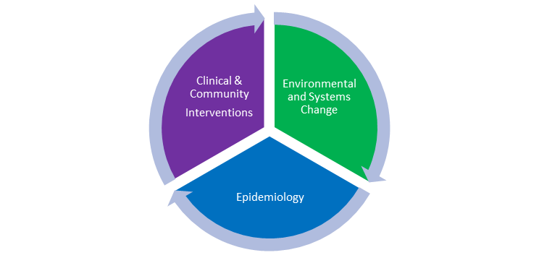
The Public Health Social Work Model
Reliance on science of epidemiology
Use of clinical, mezzo, macro skills
Focus on systems, environmental, structural change
Wide-lens view of “person and population”
Emphasis on prevention
Person and Population
(Ruth & Wilkinson, 2017)
Notes:
Epidemiology is central to the PHSW model and has been part of social work since its beginning. As this slide deck will explain in detail, epidemiology is the scientific study of the health and well-being of populations. Epidemiology is useful for understanding patterns of disease and social problems across population groups. Learning why some groups have greater risk, as well as why some have greater “protection,” is an important part of learning how to prevent illness and problems, and to promote human well-being.
The figure above reflects the tripartite nature of public health social work and illustrates the importance of epidemiology to social work. Learning about epidemiology is critical to PHSW!

Slide 5
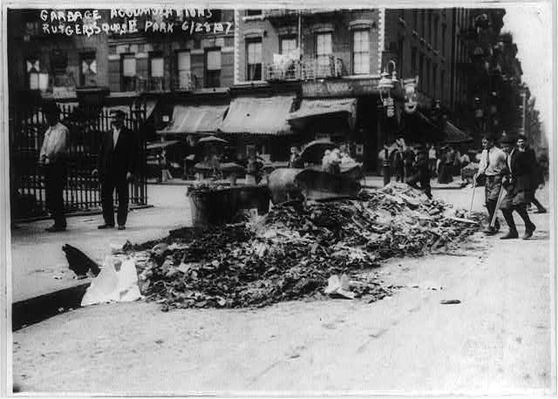
Historical Example: Jane Addams and “People’s Epidemiology”
Jane Addams’ Epidemiological Question:
Were high death rates in Chicago’s 19th ward
associated with lack of sanitation
and build-up of garbage
in this poor neighborhood?
Notes:
At this time, uncollected garbage and refuse was a major public health problem, particularly in poor neighborhoods. However, public health officers and social workers needed to work together to “prove” this to the public and to government.

Slide 6
Addams’ Use of PHSW Model
To answer she engaged in:
Systematic observation: “counted” illness/deaths & recorded uncollected garbage i.e. “people’s epidemiology”
Clinical/community interventions: worked with local women’s clubs to provide aid to sick and interest women in hygiene
Systems advocacy: Political pressure by women’s groups to clean up neighborhoods led to Addams's appointment as garbage inspector
Notes:
https://www.thoughtco.com/jane-addams-1779818
First, epidemiology. Addams had long suspected that the abundance of garbage was connected to higher death rates in the area. She then systematically investigated—using basic skills of early epidemiology- to ascertain whether there was a connection between the two. When the investigation confirmed that there was a connection between lack of refuse collection and elevated death rates in wards, Addams was determined to improve waste collection and reduce deaths. While simultaneously working with women’s clubs to provide care for sick individuals in the neighborhood, clinical & community interventions), Addams undertook an advocacy campaign which ultimately led to her appointment as the garbage inspector for the ward. Through this position she set new expectations for garbage collection in the ward and created accountability among the civil servants performing the work. After her one-year term, Addams was demonstrated reduced death rates in the 19th Ward. This environmental and systems change effort represented social work’s use of basic epidemiology to drive changes in the conditions under which people lived.

Slide 7
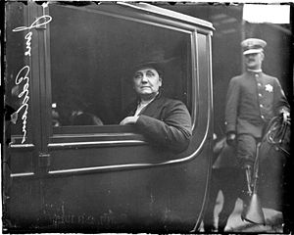
Use of Epidemiology Increased Early SW Impact
Result: Conditions changed; one year of effective training and monitoring of increased refuse removal, death rates decreased
Jane Addams in her role as
Garbage Inspector
Notes:
Use of epidemiology by early social workers increased the profession’s impact. Here, Jane drives around inspecting the garbage. Jane Addams is our inspiration as we move forward learning more about the now very sophisticated science of epidemiology. As you go through the following slides, keep in mind that this is a powerful tool for social work and you can adapt it to help you have greater impact.

Slide 8
Epidemiology: Basic Concepts

Slide 9
The Field of Epidemiology
Introduction and overview
Definition
  “Epidemiology is the study of the distribution and determinants of health-related states or events in specified populations, and the application of this study to the control of health problems.” (1)
Key areas of study
  Environmental; social; infectious disease; genetic and molecular; nutritional; reproductive; pharmaco-epidemiology; clinical
Current trends and hot topics
  Big data, genetics, infectious disease outbreaks, gun violence, suicide, substance use disorders
Notes:
DEFINITION
The word epidemiology is derived from three Greek words
epi = “on or upon”
demos = “the common people”
logy = “the study of”
Ask the audience: What is meant by “distribution” of health states or events?
ANSWER: Distribution refers to the spread of a health outcome in a population. How common is the outcome among the population? Are there particular individuals that experience the outcome more or less frequently? [Epidemiology also considers distribution over space and time. Was the frequency of the outcome changed in the last 100 years? 10 years? Is the outcome more common in one physical or social space as compared to another?]
KEY AREAS OF STUDY (Rothman, Greenland, and Lash; 2008)
All areas of epidemiologic study are related to health and well-being, and therefore all have relevance for PHSW. Depending upon a PHSWers area of work or expertise, one particular area may be of most relevance. However, generally speaking, social epidemiology and clinical epidemiology are likely to be most relevant for PHSW.
Environmental epidemiology: “[The environment] includes physical, chemical, and biologic agents, as well as social, political, cultural, and engineering or architectural factors affecting human contract with such agents” (Rothman, Greenland, Lash; 2008; p. 598). Environmental epidemiology assess the impact of exposures such as cigarette smoke or noise pollution on health; exposure to these factors depends upon where individuals live, work, and play. Additionally, social, political, cultural, and engineering factors (such as social norms, laws and regulations, and building ventilation) shape exposure.
Infectious disease epidemiology: studies the transmission, exposure, susceptibility, infection, and progression of infectious diseases within a population
Social epidemiology: studies the impact of social factors (such as gender, race/ethnicity, and socioeconomic status) on health outcomes
Genetic and molecular epidemiology: studies the role of biomarkers and genetic factors (i.e. presence of a gene or expression of a gene); a biomarker is an indicator of a physiology state such as the level of a protein in the blood
Nutritional epidemiology: examines the impact of dietary factors on health; dietary factors include type of nutrients consumed, frequency of nutrients consumed, quantity of nutrients consumed; nutritional epidemiologists may also use biomarkers, such as tissue samples, and anthropometric measurements, like body-mass index, in their work
Reproductive epidemiology: examines the health outcomes and events related to reproduction from reproductive development in childhood to senescence in adulthood and all the events (e.g. sexual activity, conception, pregnancy, etc.) in between; differs in many ways from other areas of epidemiology (e.g. endpoints/outcomes are often not disease-based; often necessary to consider the behavior and traits of a couple rather than an individual; challenges gathering accurate data as is the case in counting the number of failed pregnancies when very early conception loses are often undetected)
Pharmacoepidemiology: studies the use and effect of drugs/medicines among groups of people; when a new drug is developed or when an existing drug is used for a new purpose, pharmacoepidemiologic studies inform epidemiologists and health care providers of the efficacy and safety of the drug
Clinical epidemiology: “Clinical epidemiology is the study of the variation in the outcome of illness and of the reasons for that variation” (Rothman, Greenland, Lash; 2008; p. 641). Here are some examples of research questions that clinical epidemiology may seek to answer: How does drug X impact the likelihood of a heart attack among patients with high blood pressure? Do patients receiving only physical therapy for some condition report less or more pain after 6 months as compared to patients who received both surgery and physical therapy?
Any of these areas of epidemiology may be relevant for social work depending upon where the social worker is employed and what s/he is doing in her/his role. That said, because of the social justice focus of social epidemiology along with the attention paid to social determinants of health, social epidemiology likely has the most overlap with social work. Social workers interested in learning more about epidemiology might focus on literature and journals in the domain of social epidemiology such as Social Science and Medicine or the Journal of Epidemiology and Community Health.
CURRENT TRENDS AND HOT TOPICS
Ask the audience: Are there other hot topics that you have noticed? Which topics do you think are most relevant for public health social work? Why?
Big data: Big data differs from “traditional” data in that it is greater in quantity and complexity. Due to developments in computer technology and statistical computation it has become possible to analyze enormous amounts of complex data. Sources of big data for health include social media, electronic medical records, patient registries (e.g. cancer or rare disease registry), government/public records (e.g. birth certificates), claims data from payer)
Genetics: Epidemiology draws conclusions based on population data, not on individual data. As more genetic data becomes available for analysis, this enables epidemiologists to identify trends and relationships between genetics factors and health that may not otherwise be detectable in a single individual.
Infectious disease outbreaks: Infectious disease outbreaks are ongoing; however, the Ebola outbreak from 2013-2016 and the 2016 Zika outbreak gained international attention and response. The events increased discussion about the need to prevent and prepare for emerging infectious diseases.
Gun violence: Gun violence in the United States is a key area of study in epidemiology due to the numbers of gun-related deaths and injuries as well as mass shootings, particularly in schools.
Suicide: In 2018, a study from the CDC indicated that suicide has increased more than 30% in half of U.S. states since 1999 (Stone et al., 2018). Around the same time, two individuals with prominence in the public eye, fashion designer Kate Spade and chef and television star Anthony Bourdain, committed suicide. The events led to in increase in awareness and discussion of suicide as a public health problem.

Slide 10

Epidemiology assists us in theorizing about what helps people stay or get well and what causes illness or social problems…
“Theory is essential for formulating, testing, and assessing competing explanations—in other words, for good science.
And good science in turn is a precondition for science that can make a difference for the good.”
-Krieger, 2011, p. viii
Theories of Health
Notes:
Why should social workers care about theory? Theory helps explain things!
INTERACTIVE ACTIVITY:
National data indicates that high school students with lower socioeconomic status have lower educational attainment than students with higher socioeconomic status. This remains the case when you compare just those students with the highest SAT math scores. Here is a 5-minute video from the National Center for Education Statistics that explains the findings in greater detail: https://youtu.be/y5SujjW3nVk
ASK THE AUDIENCE: Why do you think that high school students with lower socioeconomic status have lower educational attainment than students with higher socioeconomic status? How would you test your hypothesis?
In her book, Epidemiology and the people's health: theory and context, Dr. Krieger argues
theory is influenced by the person(s), place, and time in which the theory was developed
often the work of health professionals is guided by an underlining theory even if they do not explicitly identify the theory
being explicit about the theory that is guiding the work, even if it is not a formalized theory, is encouraged to improve the ability of those directly involved as well as peers to understand, inform, and evaluate the work
all theories have strengths and limitations
rarely is one theory or even theories from one field sufficient to explain all aspects of health
how a theory explains a problem influences the subsequent solutions generated

Slide 11
Many Theories of Health and Disease
Biomedical model
Disease is explained solely by biological, chemical, and physical phenomena; focus on the individual; societal health dependent upon medical knowledge
Lifestyle or Individual behavior science
Individual risk factors drive disease; emphasizes individual responsibility and implies that individuals have choice; a “lifestyle” is a set of behaviors shared by a social group over time
Political economy of health
Societal health is produced by the structure, values, and priorities of the political and economic systems
Social determinants of health
Health is influenced by social factors such as socioeconomic status, race, gender, social and physical qualities of the lived environment
Psychosocial theories
The distribution of adverse psychological stressors is socially patterned and adverse psychological stress can harm somatic and mental health
Notes:
Theories about what causes distribution of disease in a society changes over space and time. The theories/models listed on this slide are not an exhaustive list; however; these are more commonly known theories/models and illustrate the large variation in explanations offered for disease distribution.
INTERACTIVE ACTIVITY: Ask the audience to select a health outcome or ask them to choose from one of the following: generalized anxiety disorder, HIV/AIDs, heart disease.
Ask the audience to use one of the theories listed to explain the distribution of the health outcome among Americans or divide the audience into small groups and assign them different theories from the list.
Example: The following is an example of how an audience may use the theories listed above to explain the distribution of obesity in the U.S. population.
health outcome = obesity
Biomedical model: obesity is caused when the caloric consumption exceeds the caloric need or calories burned
Lifestyle: obesity is caused when individuals eat more food (especially foods high in calories, sugar, and fat) than their bodies need and/or when individuals do not engage in enough physical activity to use all the calories that they consumes
Political economy of health: one example could be government corn subsidies which enable the food industry to produce beverages sweetened with high fructose corn syrup for low cost; these products are then sold to consumers for low prices; consumption of these products with low nutritional value and high calories increases risk of obesity
Social determinants of health: obesity is caused by qualities of the environment where individuals live, work, and play (e.g. few safe places like parks for physical activity; few affordable and conveniently located places to purchase nutritious food and an abundance of inexpensive, unhealthy food); some individuals are at greater risk of experiencing environment that fail to promote healthy living (e.g. individuals with lower income may not be able to afford to live in neighborhoods with safe outdoor space for physical activity)
Psychosocial theories: eating may be used as a coping mechanism by individuals experiencing stress; individuals with limited access to healthier coping mechanisms are particularly vulnerable; a vicious cycle can be created in which overweight/obese individuals may feel discrimination against them because of their weight and may suffer emotionally which leads to greater reliance on eating as a coping mechanism

Slide 12
What Predicts What? X’s and Y’s
To better understand root causes, epidemiologists have created:
Predictor/Explanatory/Exposure Variables
“X” variables that predict or explain the outcome
Risk factors are predictor variables that increase risk of a negative health outcome
Protective factors are predictor variables that decrease risk of a negative health outcome
Outcome Variables
“Y” variables that are the health or social outcome of interest
Example
Smoking increases the risk of heart disease (risk factor—an X).
Exercise decreases the risk of heart disease (protective factor—also an X).
Heart disease is the outcome of interest (the Y”
Notes:
X’s and Y’s
X’s and Y’s are used as mathematical notation in epidemiology and biostatistics to denote explanatory variables and outcome variables. Individuals who have never been exposed to statistics or epidemiology have been introduced to the concept of X and Y when learning how to calculate the slope of a line and plot points on a graph with an x-axis and a y-axis.
INTERACTIVE ACTIVITY: Youth.gov (https://youth.gov/youth-topics/substance-abuse/risk-and-protective-factors-substance-use-abuse-and-dependence) reviews risk factors and protective factors for substance abuse for youth from birth to young adulthood. The table describes risk and protective factors at the individual, family, and community level. Use this as a reference, and ask the audience to brainstorm factors at different levels and life stages in small groups.

Slide 13
Relationships between X’s and Y’s
Correlations
Statistical strength of the relationship between two variables (As garbage proliferated, morbidity/mortality increased…)
Values range from -1 to 1 where 0 indicates no relationship
Confounding
A common cause of two variables that appear to be associated (Perhaps hot weather created both increased garbage and increased illness?)
Causal Direction
Does X cause Y or does Y cause X? (Did increased garbage on streets CAUSE illness/death or did those deaths somehow increase garbage proliferation?)
Ecological Fallacy
making an inference about an individual based on aggregate data for a group (Not every person living in the 19th ward got sick or died…)
Contextual versus Compositional
Is the relationship a result of the context or the composition of the group? (Maybe sick people are drawn to living together? Or perhaps the “context of garbage” would sicken everyone?
Notes:
CORRELATION
Negative values indicate that as one variable value increases, the other decreases (e.g. as the number of people using seatbelts increases, the number of automobile deaths decreases). Positive values indicate that as one variable value increases, the other increases as well (e.g. the number of social supports and a self-reported mental health score)
If you only remember one thing about correlation, remember that correlation ≠ causation. Not all variables that are statistically correlated are causally related. Additionally, we may find that two variables are highly correlated, and then discover that the relationship is much weaker when we account for the influence of other variables. For example, we may find a strong relationship between teeth brushing and cavities, but then when we consider whether individuals have fluoride in their drinking water we find that the relationship between teeth brushing and cavities is reduced. That is, some of the variation in cavities that we previously attributed to teeth brushing is actually explained by water fluoridation.
CONFOUNDING
Sometimes we observe a relationship/association between two variables. Before we assume that one of the relationships must cause the other, it is essential to consider confounding. Is there another variable that causes the two variables and could thus explain the statistical association that we observe? Here are some commonly used examples of confounding:
There is a positive correlation between ice cream sales and homicides such that when one increase the other increases? Does buying ice cream lead people to commit homicide or does committing homicide lead people to buying ice cream? Ice cream and homicides while associated are not causally related. High temperatures lead to increases in ice cream sales as well as increases in homicides. Therefore, temperature is a common cause or a confounding variable in this case.
Suppose that you measure the shoe size of all of the students in an elementary school and then give them a test to assess their reading skills. You find that students with larger shoe sizes have better reading skills. Can you conclude that bigger feet mean better reading ability? No. This is a case of confounding by age. Students who are older have larger feet, and students who are older have developed better reading skills.
CAUSAL DIRECTION
Before concluding that X causes Y, consider the possibility that Y causes X. For example, assume you find a strong statistical relationship between disruptive student behavior in a classroom and teacher teaching style. Is the teaching style influenced by the student behavior or does the student behavior lead to a particular teaching style?
There may be cases when both statements are true. Perhaps engaging in physical activity increases self-esteem and perhaps higher levels of self-esteem lead to increased physical activity.
ECOLOGICAL FALLACY
Remember that epidemiology focuses on population distributions and uses many observations from the population to make inferences about health and disease outcomes in the population. Consider this: there is substantial evidence that smoking cigarettes increases risk of lung cancer. However, we cannot conclude from this evidence that a given individual who smokes cigarettes will develop lung cancer or that an individual with lung cancer must smoke cigarettes.
CONTEXTUAL VERSUS COMPOSITIONAL
Here “context” could refer to social/political/environment context.
For example, perhaps you observe youth participating in an afterschool program at a community center have better school attendance than their peers that do not attend. Do the students attending the program attend school more because of the afterschool program (contextual) effect or do the students that attend the program inherently more likely to attend school (compositional)?
Another example: imagine that a city councilor notices that city residents in neighborhoods with more green space engage in more physical activity each week than residents in neighborhoods with less green space. Is this a result of the neighborhood characteristics (contextual effect) or the resident characteristics (compositional effect)? Perhaps individuals who regularly engage in physical activity are more likely to live in places where green space is more accessible.

Slide 14
Epidemiology and the Lifecourse
  Life course epidemiology considers the impact & variation of exposure to risk factors & protective factors across the life course. Social workers work with people of all ages and appreciate concepts of life course
Key Concepts (Kuh et al., 2003; Glymour, Ertel, & Berkman; 2009)
age effect: the effect of an exposure at a particular biological age
period effect: the effect of an exposure at a particular historical time
cohort effect: a cohort is a group of people that share a common attribute or experience; a cohort effect is the effect of this common attribute or experience at a particular historical time critical period:
sensitive period: a period during life in which an exposure has a stronger impact on health than it would during another point in life
critical period: a specific period of time during which an exposure can have a negative or positive impact on health
accumulation: the idea that multiple or chronic exposures throughout life to harmful factors has a greater impact on health; that is the impact is greater than the sum of its parts; could be true for protective factors too
Notes:
The general idea of lifecourse epidemiology is that as an individual’s biology and physiology is changing throughout their life so is the social, physical, and political world around them. Thus, exposures at one point in life may not have the same impact as they would at another point in life.
EXAMPLES:
A lifecourse epidemiology/PHSW example: There were economic recessions in the U.S. in 1980-1982 resulting in high unemployment rates. Researchers wanted to know if adolescents who were exposed to high unemployment rates (9.25%) as infants during the economic recessions would have an increased risk of substance abuse and delinquent behaviors. In 1997, they assessed the behaviors of adolescents across the U.S. and compared the impact of the regional unemployment rate on adolescent behavior. They found that a 1% deviation from mean re-gional unemployment rates at the age of 1 year was associated with an increase in the odds ratios of using marijuana, smoking, using alcohol, arrest, gang affiliation, and theft
(Ramanathan, Balasubramanian, & Krishnadas; 2013).
ASK THE AUDIENCE: In the above example, the researchers did not measure the association between unemployment in an adolescent’s home when they were an infant and their adolescent behavior. Instead, they observed the impact of regional unemployment rates on the adolescent’s behavior. Some of these adolescents may have had unemployment in their families while others did not. How do you think high unemployment rates could impact a child whose family didn’t directly experience unemployment?
Age effect: Malnutrition. Malnutrition during the 3 years of life can lead to stunted growth, cognitive impairment, and reduced educational and work performance (UNICEF, 2018)
Period effect: Exposure to the HIV virus in the late 1980s. At the beginning of the HIV/AIDS epidemic, it was not known what caused the symptoms or how the illness could be treated. Individuals who became infected in these early years had a much worse prognosis as compared to individuals diagnosed in recent years.
Cohort effect: A study of individuals who experienced the Dutch famine of 1944-1945 while in utero found that women in this group had an increased risk of obesity at age 50 years. (Ravelli, Der Meulen, Osmond, Barker, & Bleker, 1999)
SENSITIVE VERSUS CRITICAL PERIODS
The distinguishing feature between sensitive and critical periods is that critical periods are thought to be more absolute in that the health outcome will not occur if exposure does not occur during a period time. A clear example of this is pregnancy. If a woman is not exposed to sperm during a particular time, she will not become pregnant (assuming no medical intervention). The sensitive period, in contrast, might suggest that a woman is more likely to conceive during her most fertile years; however, it’s possible that she might conceive during less fertile years.
ASK THE AUDIENCE:
Can you think of sensitive periods? Critical periods?
Do you think the following are examples of sensitive periods or critical periods? Why or why not?
social-emotional development
language development
public-speaking skills
Kuh, D., Ben-Shlomo, Y., Lynch, J., Hallqvist, J., & Power, C. (2003). Life course epidemiology. Journal of Epidemiology & Community Health, 57(10), 778-783.
Glymour, M. M., Ertel, K. A., & Berkman, L. F. (2009). What can life course epidemiology tell us about health inequalities in old age?. Ann Rev Gerontol Geriatr, 29, 27-56.
Ramanathan, S., Balasubramanian, N., & Krishnadas, R. (2013). Macroeconomic environment during infancy as a possible risk factor for adolescent behavioral problems. JAMA psychiatry, 70(2), 218-225.
Ravelli, A. C., van der Meulen, J. H., Osmond, C., Barker, D. J., & Bleker, O. P. (1999). Obesity at the age of 50 y in men and women exposed to famine prenatally–. The American journal of clinical nutrition, 70(5), 811-816.
UNICEF. 2018. Malnutrition rates remain alarming: stunting is declining too slowly while wasting still impacts the lives of far too many young children. https://data.unicef.org/topic/nutrition/malnutrition/
Last updated May 2018

Slide 15


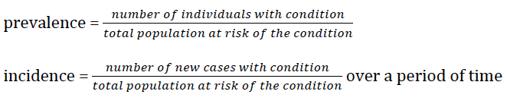
Prevalence and Incidence
[INSERT PICTURE OF FAUCET WITH RUNNING WATER]
Prevalence and incidence are two fundamental epidemiologic concepts to understanding the burden of a health outcome in a population
Prevalence refers to the proportion of a population that has a health condition
Incidence refers to the new cases of a disease or health condition that occur in a population over a defined period of time
Notes:
EXAMPLE: The concept of a running faucet into a sink is a metaphor commonly used to explain incidence and prevalence. Let’s consider the health outcome major depressive disorder.
Think of incidence as the water running into the sink from the faucet; these are the new cases of MDD. When describing incidence, it is necessary to specify a time period such as the “annual incidence” or the number of new cases in a year.
The water in the basin of the sink represents the prevalence or all of the existing cases in a population at a given point in time. The onset of some of these cases will vary, some may be 3 months ago and others 3 weeks ago.
The water exiting the sink through the drain is relevant too. This represents the cases leaving the affected population either because they became deceased or were cured of the condition. The number of individuals leaving the affected population impacts the prevalence but not the incidence.
Therefore, by creating an effective treatment program for MDD, you will reduce the overall number of individuals who have MDD; however, the treatment program will not have an impact on the new cases occurring. In contrast, a prevention program that aims to promote mental health will impact BOTH the incidence and the prevalence. You can think of a treatment program as opening the drain in the sink and a prevention program as shutting off or reducing the flow of the water.
ASK THE AUDIENCE: What do you think was the prevalence of a major depressive episode among U.S. adults in 2016? Or rather, what percentage of U.S. adults experienced a major depressive episode during 2016? (Answer: 6.7% or 16.2 million individuals) SOURCE: National Institute of Mental Health. (2017, November). Major Depression [Website]. Retrieved from https://www.nimh.nih.gov/health/statistics/major-depression.shtml
TEST YOUR KNOWLEDGE: Indicate whether the statement refers to incidence or prevalence.
1. “[In 2016] An estimated 3.1 million adolescents aged 12 to 17 in the United States had at least one major depressive episode.” SOURCE: National Institute of Mental Health. (2017, November). Major Depression [Website]. Retrieved from https://www.nimh.nih.gov/health/statistics/major-depression.shtml (ANSWER: prevalence)
2. There were 4 cases of depression diagnosed at the student health center last month. (ANSWER: incidence)
3. Almost 30% of the boys enrolled in the afterschool program last year had depression. (ANSWER: prevalence)

Slide 16
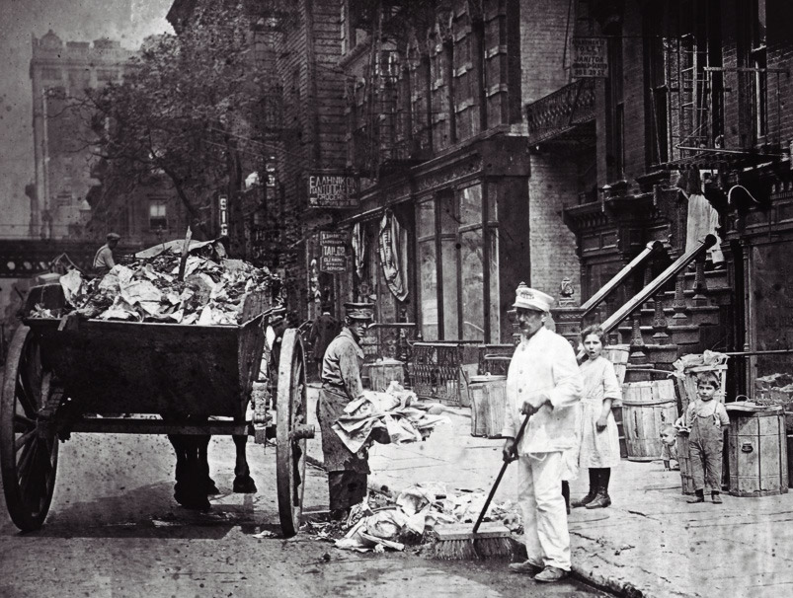
Prevalence and Incidence Applied to Jane Addams and the 19th Ward
Addams used both prevalence and incidence, before and after, in her PHSW efforts to remove the “risk factor” of garbage.
Prevalence: what proportion of the population of the 19th ward is sick on any given day, week, month or year, prior to our intervention to remove garbage? Does the prevalence of illness/death go down after a period of time following the intervention?
Incidence: How many new people are getting sick or dying each day, week, month or year prior to our PHSW intervention? How many new cases of illness are there once we have begun the intervention of collecting garbage, training garbage collectors, and regular inspections?
Notes:
EXAMPLE: The concept of a running faucet into a sink is a metaphor commonly used to explain incidence and prevalence. Let’s consider the health outcome major depressive disorder.
Think of incidence as the water running into the sink from the faucet; these are the new cases of MDD. When describing incidence, it is necessary to specify a time period such as the “annual incidence” or the number of new cases in a year.
The water in the basin of the sink represents the prevalence or all of the existing cases in a population at a given point in time. The onset of some of these cases will vary, some may be 3 months ago and others 3 weeks ago.
The water exiting the sink through the drain is relevant too. This represents the cases leaving the affected population either because they became deceased or were cured of the condition. The number of individuals leaving the affected population impacts the prevalence but not the incidence.
Therefore, by creating an effective treatment program for MDD, you will reduce the overall number of individuals who have MDD; however, the treatment program will not have an impact on the new cases occurring. In contrast, a prevention program that aims to promote mental health will impact BOTH the incidence and the prevalence. You can think of a treatment program as opening the drain in the sink and a prevention program as shutting off or reducing the flow of the water.
ASK THE AUDIENCE: What do you think was the prevalence of a major depressive episode among U.S. adults in 2016? Or rather, what percentage of U.S. adults experienced a major depressive episode during 2016? (Answer: 6.7% or 16.2 million individuals) SOURCE: National Institute of Mental Health. (2017, November). Major Depression [Website]. Retrieved from https://www.nimh.nih.gov/health/statistics/major-depression.shtml
TEST YOUR KNOWLEDGE: Indicate whether the statement refers to incidence or prevalence.
1. “[In 2016] An estimated 3.1 million adolescents aged 12 to 17 in the United States had at least one major depressive episode.” SOURCE: National Institute of Mental Health. (2017, November). Major Depression [Website]. Retrieved from https://www.nimh.nih.gov/health/statistics/major-depression.shtml (ANSWER: prevalence)
2. There were 4 cases of depression diagnosed at the student health center last month. (ANSWER: incidence)
3. Almost 30% of the boys enrolled in the afterschool program last year had depression. (ANSWER: prevalence)

Slide 17
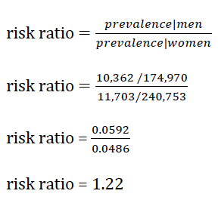
Risk Ratio
Heavy Drinking Behavior among U.S. Women and Men, BRFSS 2015
 | Heavy Drinker | Not a Heavy Drinker | Total
Men | 10,362 | 164,608 | 174,970
Women | 11,703 | 229,050 | 240,753
Heavy drinker is defined as >14 drinks per week for men and >7 drinks per week for women.
Result: Men have 1.22 times the risk of heavy drinking as compared to women. A risk ratio > 1 indicates an increased risk of the outcome. Being male increases your risk of heavy drinking!
Source: Centers for Disease Control and Prevention. (2015). Behavioral Risk Factor Surveillance System. Available from https://www.cdc.gov/brfss/annual_data/annual_2015.html
Notes:
GENERAL NOTES:
Ratios are commonly used in epidemiology to compare the occurrence of a health outcome among one group to the occurrence in another group. Risk ratios help us appreciate the factors involved in an increase or decrease of a factor.
Interpreting the equation: To calculate the risk ratio using prevalence, we first calculate the prevalence of heavy drinking among men, and then we calculate the prevalence among women. Then we divide the two ratios.
Rather than calculating the risk of heavy drinking among men as compared to women, we could also calculate the risk of of heavy drinking among women as compared to men. RR=(11,703/240,753)/(10,362 /174,970) = 0.82. Thus, women have 0.82 times the risk of heavy drinking as compared to men. Or stated alternatively, women have reduced risk of heavy drinking as compared to men. A risk ratio <1 indicates a decreased risk of the outcome.
Note: The symbol “|” in mathematics is read “given”.
MAKE THIS AN INTERACTIVE ACTIVITY: The Center for Disease Control has an online data analysis tool that allows you to compare health outcomes for interest across different geographical regions in the United States. Visit the website https://nccd.cdc.gov/weat/#/ and click on “Cross Tabulations” to make a table similar to the one in this slide. Try calculating the risk ratio and odds ratio for heavy drinking by educational attainment among males using 2015 data. Note that there are at least four educational attainment categories, select two for comparison.

Slide 18
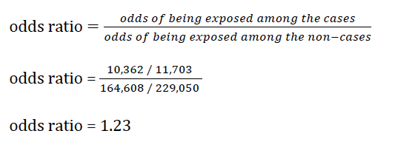
Odds Ratio
Heavy Drinking Behavior among U.S. Women and Men, BRFSS 2015
 | Heavy Drinker | Not a Heavy Drinker
Men | 10,362 | 164,608
Women | 11,703 | 229,050
Heavy drinker is defined as >14 drinks per week for men & >7 drinks per week for women.
Result: Men have 1.23 times the odds of heavy drinking as compared to women. Men have an increased odds of heavy drinking as compared to women.
Source: Centers for Disease Control and Prevention. (2015). Behavioral Risk Factor Surveillance System. Available from https://www.cdc.gov/brfss/annual_data/annual_2015.html
Notes:
GENERAL NOTES: Another way to think about risk and protection is to think about Odds Ratios, which, in this example, help us think about the odds of a man being a heavy drinker.
Interpreting the equation: To calculate the odds ratio (the odds of being a man among the heavy drinkers/the odds of being a man among the non-heavy drinkers), we generate the ratio of heavy drinking men to heavy drinking women. Then we generate the ratio of non-heavy drinking men to non-heavy drinking women. Finally, we divide the two ratios.
An odds ratio >1 indicates that the outcome is more likely to occur among the exposed as compared to the unexposed.
An odds ratio <1 indicates that the outcome is less likely to occur among the exposed as compared to the unexposed.
The odds ratio can provide a reasonably good estimate of the risk ratio when the health outcome is uncommon, less than 10% for example. In some instances, the researcher may not know the total population and therefore cannot calculate the risk ratio. In such situations, the odds ratio can be a useful alternative.
MAKE THIS AN INTERACTIVE ACTIVITY: The Center for Disease Control has an online data analysis tool that allows you to compare health outcomes for interest across different geographical regions in the United States. Visit the website https://nccd.cdc.gov/weat/#/ and click on “Cross Tabulations” to make a table similar to the one in this slide. Try calculating the risk ratio and odds ratio for heavy drinking by educational attainment among males using 2015 data. Note that there are at least four educational attainment categories, select two for comparison.

Slide 19
Effect Measure Modification
Heavy Drinking Behavior among U.S. Women and Men Modified by Self-reported Mental Health, BRFSS 2015
 | Bad Mental Health |  |  | Good Mental Health
 | Heavy Drinker | Not a Heavy Drinker | Prevalence | Heavy Drinker | Not a Heavy Drinker | Prevalence
Men | 1,345 | 13,110 | 9.3% | 8,872 | 149,200 | 5.6%
Women | 1,659 | 25,850 | 6.0% | 9,931 | 199,273 | 4.7%
Risk Ratio | 1.54 |  |  | 1.18
Perhaps we think that mental health might influence the effect of gender on heavy drinking behavior. Therefore, we calculate the risk ratio of heavy drinking among men as compared to women by self-reported mental health status.
Source: Centers for Disease Control and Prevention. (2015). Behavioral Risk Factor Surveillance System. Available from https://www.cdc.gov/brfss/annual_data/annual_2015.htm
Notes:
Heavy drinker is defined as >14 drinks per week for men and >7 drinks per week for women.
The mental health categories are determined by the question, “Now thinking about your mental health, which includes stress, depression, and problems with emotions, for how many days during the past 30 days was your mental health not good?” Individuals who report 14 or more days in which their mental health was “not good” are classified as having “bad mental health.” Individuals who report less than 14 days in which their mental health was “not good” are classified as having “good mental health.”
REMIND THE AUDIENCE:
In the previous risk ratio slide, we calculated the risk ratio of heavy drinking among men as compared to women. We found that Men have 1.22 times the risk of heavy drinking.
INTERPRETING THE RESULTS:
We find that the prevalence of heavy drinking is higher for both men and women with bad mental health as compare to men and women with good mental health. We also find that mental health does modify the effect of gender on heavy drinking behavior. Among individuals with bad mental health, men have 1.54 times the risk of heavy drinking as compared to women. Among individuals with good mental health, men have 1.18 times the risk of heavy drinking as compared to women. Thus, in both groups, men have an increased risk as compared to women, but the effect is greater among the bad mental health group as compared to the good mental health group.
ASK THE AUDIENCE:
How do you explain these results? Why do you think the risk is greater for men among the bad mental health group?
Are you surprised that the prevalence of heavy drinking is higher among both men and women in the bad mental health group? Why or why not?
How can these results be used in clinical practice?
How can these results be used for program planning at social service and/or health care agencies?
How can these results be used to design programs/campaigns to prevent heavy drinking?

Slide 20
Incidence Rate
The term “rate” is used often liberally. A true rate incorporates time into the denominator.
“Person-time” = amount of time an individual in an at-risk population remains in the population
  When an individual leaves the population, s/he no longer contributes time.
  Additionally, some individuals who are at-risk may eventually have the outcome of interest. When this occurs, they cease to contribute person-time.
Example: In 2010, there were 10.0 cases of child maltreatment per 1,000 U.S. children. In other words, there were 10.0 cases per 1,000 person-years observed (Child Trends, 2016).
Notes:
What is meant by an “at-risk population?”
The at-risk population only includes those individuals who could potentially develop the outcome of interest. Thus, if you’re estimating the incidence rate of gestational diabetes in the past year, the denominator will only include women who were pregnant in the past year and at-risk of developing gestational diabetes.
When do individuals “leave” the population?
Individuals who were once at-risk of developing the health outcome and then are no longer at-risk of developing the outcome, leave the population and stop contributing to person-time. There are many reasons why an individual may stop contributing person time. For example, if you are interested in delinquent behaviors among adolescents, once an individual ages out of adolescence, s/he stops contributing person-time. Similarly, youth do not start contributing person-years until they reach adolescence. Additionally, if a person develops the outcome of interest or dies, s/he is no longer “at-risk.”
INTERACTIVE ACTIVITY:
Observe and discuss trends in U.S. child maltreatment using data from Child Trends:
https://www.childtrends.org/wp-content/uploads/2015/03/40_fig1.jpg
Notice that there is a y-axis on the left side of the graph and another on the right side. What does the y-axis on the left side indicate? What does the y-axis on the right side indicate? (ANSWER: The y-axis on the left refers to the absolute number of child maltreatment cases in the U.S. over time. The y-axis on the right refers to relative number of child maltreatment cases per 1000 children per year.)
If you’re interested in knowing how child maltreatment in 2010 compares to child maltreatment in 1990 relatively speaking, is it better to use the absolute number of cases or the incidence rates? (ANSWER: It’s helpful to know both the absolute and relative numbers. However, keep in mind that the total population of U.S. children has changed over time. Therefore, it is useful to compare the incidence rates for direct comparisons rather than the absolute numbers.)
If you were going to launch a national effort to reduce child maltreatment, what additional information might you want to know to plan your intervention? How would you use this information? (Possible Answers: Are there particular areas of the U.S. with higher rates of child maltreatment? What are the characteristics of children that are most likely to experience child maltreatment? What are the characteristics of communities with higher rates of child maltreatment? With lower rates of child maltreatment? What U.S. cities have the highest absolute numbers of child maltreatment cases?)
OTHER COMMONLY USED RATES
Mortality rate: mortality rates are often presented as the number of deaths per x number of individuals per year. Pay close attention to the age-group specified and the type of death being counted.
Fertility rate: fertility rates are often presented as the number of live births per x number of women of child-bearing age per year. Note that the age of the women included in the denominator will sometimes vary.

Slide 21


Incidence Rate Ratio
To calculate the incidence rate ratio (IRR), calculate the incidence rate for the exposed group and then for the unexposed group. Lastly, calculate the ratio of these two rates.
Example:
Using child maltreatment data from Child Trends (2016), calculate the IRR of child maltreatment (with duplicate victims) in 1990 as compared to 2010.
In 1990, there was 1.34 times the rate of child maltreatment in the United States as compared to 2010.

Slide 22


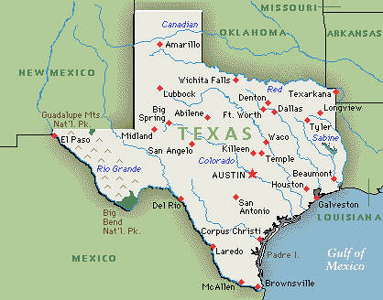
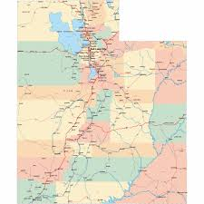

Crude and Adjusted Estimates: Comparing Apples to Oranges
[DC graphic]
Percentage of people living below the federal poverty line, 2012-2016
J[US graphic]
[TX graphic]
[UT graphic]
United States
15.1%
Texas
16.7%
Utah
11.7%
D.C.
17.9%
Children <5 years old are more likely to be living in poverty than
any other age group in the United States.
Percentage of the population < 5 years of age, 2012-2016
United States
6.2%
Texas
7.3%
Utah
8.6%
D.C.
6.4%
DATA SOURCE: U.S. Census Bureau, 2012-2016 American Community Survey 5-Year Estimates
Percentage of the population < 5 years of age living below the FPL, 2012-2016
United States
23.6%
Texas
26.1%
Utah
14.8%
D.C.
21.7%
Notes:
EXPLAINING CRUDE AND ADJUSTED ESTIMATES THROUGH AN EXAMPLE
First, ask the audience to compare the percentages of people living below the federal poverty line in the United States, Texas, Utah, and the District of Colombia. Which states have more poverty as compared to the US?
Second, tell the audience that certain age groups are more likely to experience poverty including the under 5 population. Does this change how they would interpret the percentages of poverty? Which states may have more children <5 than the U.S. at large? Why do they think this? (ANSWER: Because < 5 population is more likely to be living in poverty, you might guess that Texas and D.C. have more young children than the U.S. at large while Utah has fewer young children.)
Third, display the percentage of children < 5 years of age that are living below the federal poverty line. Review the audiences predictions with them and identify which states they correctly predicted the < 5 population and which states they incorrectly predicted. (Likely the audience guessed that Utah had a small <5 population than the US and that D.C. had a larger <5 population than the U.S.).
Fourth, reveal the percentage of the <5 population living below the federal poverty line for the 4 geographic areas. How does the percentage of children <5 living below the federal poverty line compare to that of the entire population for the four areas? (ANSWER: All areas have greater poverty for children <5 than for the entire population. This is expected since we know that children <5 are more likely to be living in poverty than any other age group). For Texas, Utah, and D.C., describe how the percentage of all people living below the FPL and the percentage of the <5 people living below the FPL compares with the percentages for the U.S. overall. Are there any surprises?
The District of Colombia has a higher percentage of all people living below the FPL than the United States, a similar percentage of the population <5, and a lower percentage of <5 poverty. How would you explain this? (ANSWER: Other age groups must have higher percentages of poverty in D.C. than in the U.S. at large which causes the overall percentage of poverty to be higher in D.C.)
BONUS ACTIVITY: Use the U.S. Census Fact Finder tool to compare the distribution of poverty by age in the District of Colombia and the United States.
Visit https://factfinder.census.gov/faces/nav/jsf/pages/searchresults.xhtml?refresh=t
Under the “Topics” tab in the left column, expand “People,” in the pop-up window. Then expand “Poverty,” and click on “Poverty.” This selection will be added to the window entitled “Your Selections” on the left side of the screen. Close the pop-up window.
Under the “Geographies” tab in the left column, select “United States - 010,” in the drop down menu in pop-up window. “United States” will appear in a box below the drop down menu in the pop-up window. Select “United States” and then click below on “Add to your selections.” This selection will be added to the window entitled “Your Selections” on the left side of the screen. Next, select “State – 040” from the drop down. Select “District Colombia” and then click below on “Add to your selections.” This selection will be added to the window entitled “Your Selections” on the left side of the screen. Close the pop-up window.
In the main search window, several search results will appear. Check the box next to “S1701 POVERTY STATUS IN THE PAST 12 MONTHS” and then click “View” in the search results window.
BONUS QUESTION: What is the federal poverty guideline for a family/household of 4 in 2018? (ANSWER: $25,100. This means that to fall below the federal poverty line, the family/household income cannot exceed $25,100/year. This applies to the 48 contiguous states and the District of Colombia. Source: Annual Update of the HHS Poverty Guidelines; HHS Notice. Fed. Reg. Vol. 83, No. 12 (January 18, 2018).

Slide 23
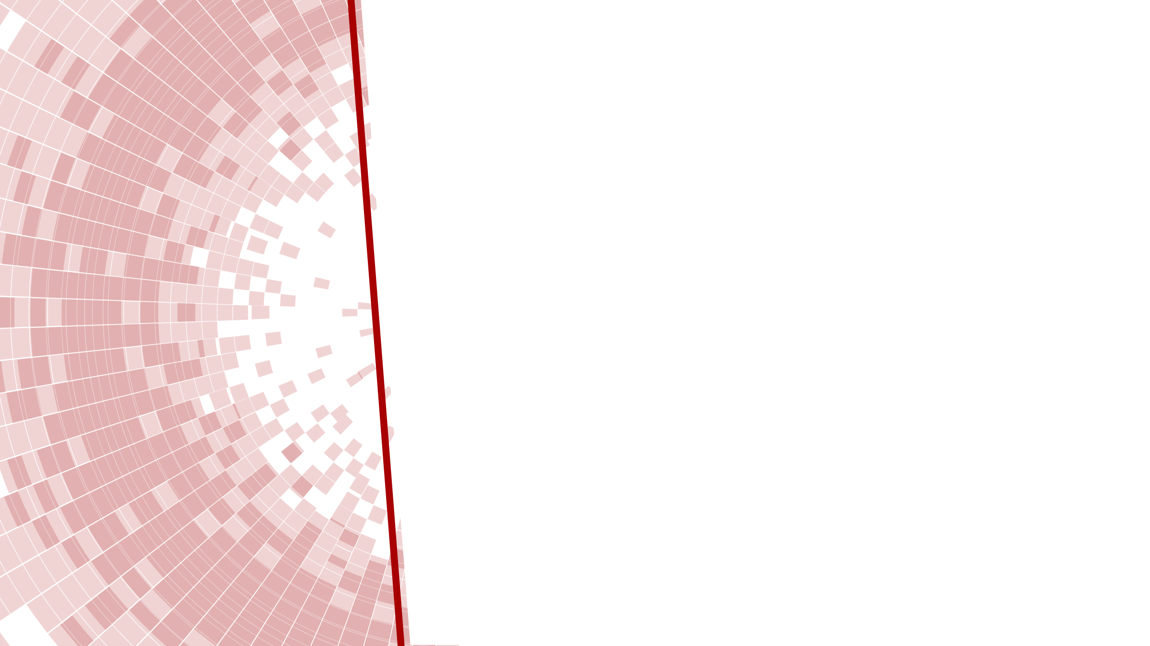
Graphs and Figures
Graphs and figures are frequently used in epidemiology
Examples: population pyramids, maps, scatterplots, distribution curves, line graphs, bar graphs, histograms, pie charts
Characteristics of misleading graphs
Scale does not begin at 0 or there is a break in the scale
Y-axis uses an exponential scale that distorts change between x-axis units
High-quality graphs “speak for themselves,” that is, all the information needed to understand and interpret the graph is included in the graph
Graphs can be used to visually convey data from multiple tables and the graphical format can help to highlight trends and relationships
Watch Professor Hans Rosling’s on Gapminder.org explain his line graph describing trends in income inequality and life expectancy.
Notes:
An exhaustive review of the use and interpretation of graphs and figures is outside the scope of this presentation. See the “Additional Resources” slide at the end of this presentation for further discussion of this topic.
INTERACTIVE ACTIVITES
Professor Hans Rosling on Gapminder
Ask the Audience: Name the various variables that Professor Rosling conveys in his line graph. (ANSWER: region of the world, country, country population, GDP per capita (income), life expectancy in years).
Ask the Audience: Professor Rosling points out that among middle-income countries there is great variability in average life expectancy; these countries with similar gross-domestic product per capita have life expectancies ranging from 50-75 years. What explanation does Professor Rosling offer for this variability? (ANSWER: variations in distribution and use of income) Can you expand on his answer; what does he mean by variations in distribution and use of income? (ANSWER: Distribution refers to whether the money within the country is distributed across many people or whether there are a few people with lots of money and many people with little money. Use of money refers to the amount and proportion of money within a country that is spent on products or services that benefit health versus those that negatively impact health or do not impact health at all.) Do you agree with Professor Rosling’s explanation? Why or why not?
Worldmapper
The website https://worldmapper.org/ resizes world maps to visually display the distribution of resources and population characteristics throughout the world.
Ask the audience: If the data in the map displayed were instead displayed in a table, what would it look like? What is the appeal or benefit of using a figure like one from World Mapper?

Slide 24
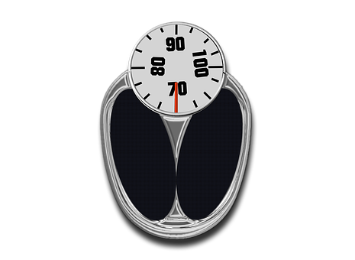
Validity
Insert graphi of a scale
In epidemiology, validity refers to the accuracy and precision of the measure.
Imagine that we measure anxiety among a random sample of college freshman at a large university.
Internal validity refers to how well our measure accurately identified anxiety among participants.
External validity refers to the ability of the results to describe anxiety levels among all freshman at the university.
Bias is systematic error and detracts from the validity of a measure
Is the scale valid? Does it tell me the true weight of the person?
Notes:
GENERAL NOTES
External validity is also referred to as generalizability. Epidemiologists are interested in knowing whether their results are generalizable across settings, persons, time.
Example of bias: Suppose anxiety manifests in somatic symptoms for a sub-groups within our population. If we fail to measure somatic symptoms when assessing anxiety, we will systematically be underestimating the level of anxiety among these individuals. This is systematic error.
Various factors can threaten validity. Here are some examples:
selection: selection refers to the individuals that you include in your assessment; if you only sample freshman enrolled in a particular class or only those that volunteer, your assessment may be inaccurate if those individuals systematically differ from the source population; random samples strengthen validity
attrition: attrition refers to drop-out of participants in a study; if you administer an intervention to reduce anxiety and some participants stop participating, it’s possible that your end result will be different than it would have been if those individuals had remained in the study
missing data: missing data is a problem when it is not missing at random; for example, if you administer a measure to assess anxiety and individuals with anxiety systematically leave some items blank due to discomfort sharing their answer or another reason, you will get biased results
Testing: data collection itself can impact the association between the exposure and the outcome
history: events outside of the study may impact the findings; for example, measuring anxiety levels the week of finals may result in higher averages than measuring anxiety at another week during the semester
Maturation: the outcome of interest naturally changes over time; anxiety among college freshmen may naturally be higher at the beginning of the year when they are adjusting to a new environment, and therefore, lower scores at the end of the year in comparison to the beginning of the year may be due to this natural adjustment

Slide 25
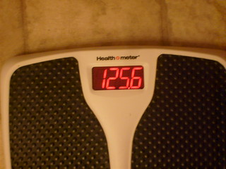
Reliability
Insert graphic of a scale
In epidemiology, reliability refers to the ability of an instrument to give the same result on repeated measures.
Different tools for assessing reliability
Examples: test-retest, inter-rater, parallel forms, spilt-half
Challenges to assessing reliability
Is the scale reliable? Does it tell me the same weight each time assuming my weight doesn’t change?
Notes:
Test-retest Reliability
Administer the same measure on two separate occasions to the same people and evaluate consistency of scores.
Challenge: This method assumes that the construct being measured will not change over time. The experience of completing the measure the first time may influence results on the second occasion, particularly if the two assessments are completed relatively close in time.
Inter-rater Reliability
Using two or more raters to categorize study participants or data and evaluating the consistency of the rating.
Parallel Forms Reliability
Consistency between two measures of the same construct (e.g. anxiety) taken at the same time.
Challenge: It can be difficult to identify equivalent measures.
Split-half Reliability
Compare two halves or subsets of a scale using correlation.
Challenge: This method can be used for a scale but not for an index.

Slide 26
Many Types of Epidemiological Studies
Experimental
The researcher assigns study participants to a treatment group.
Observational
The researcher passively observes the population.
Cohort
A group of people with a common attribute or experience are observed over time.
Cross-sectional
The researcher measures the exposure and outcome at a single point in time.
Ecological
The researcher evaluates the relationship between the exposure and outcome using population-level data.
For additional information see: (Aschengrau and Seage, 2013)
Notes:
Experimental Studies
Clinical trials and randomized controlled trials are examples of experimental studies. Experimental studies can be used to assess how well an agent prevents an outcome or treats an outcome. Randomized controlled trials are often considered the “gold standard” of study designs. However, there are limitations to these studies such as differential attrition (people in the control group may be more likely to drop out), limited generalizability, randomization may be imperfect particularly with smaller sample sizes, and the treatment may not e implemented as intended.
Randomization means that all subjects have an equal probability of being assigned to either or all of the treatment groups. The purpose of this is to balance the observed and unobserved participant characteristics across the treatment groups. For example, perhaps age or particular attitudes influence the efficacy of the treatment. Through randomization, the researcher aims to have equivalent average ages and attitudes across all treatment groups so that these variables do not influence the findings.
Observational Study
Prospective observational studies enroll participants in the study before an outcome has occurred and then observe them going forward. Retrospective observational studies enrolls participants and collect data on their history of exposures and outcomes.
Some exposures cannot ethically be assigned, such as poverty. Other exposures, such as sociodemographic characteristics like gender or race, cannot be manipulated by a researcher. In such instances, observational studies can be used.
Cohort Studies
Examples of well-known cohort studies include the Framingham Heart Study, the Nurses' Health Study, and the Physicians' Health Study. An advantage of cohort studies is that the researcher can establish temporal order between the exposure and the outcome. Disadvantage of cohort studies include high cost, attrition (participants dropping out of the study), long induction of outcome may make this design not feasible, and for some outcomes (e.g. dementia) the onset is not always clear.
Cross-sectional Studies
This type of design is well suited for assessing prevalence in a population. However, because temporality between the exposure and outcome cannot be assessed (that is, it’s unknown which happened first), it is not possible to identify a causal direction between the outcome and the exposure.
Ecological Studies
Unlike the other study designs described here, the ecological study uses population-level or aggregate data rather than individual-level data. For example, a researcher may observe the number of cancer deaths in cities and measures of air pollution for the city during a particular time period to assess the relationship between these two variables. This differs from a study using individual-level data which would measure the individual air pollution exposure of each study participant and the cancer status of each participant. For exposures such as air pollution, traffic congestion, or income inequality ecological studies work well since it can be costly and/or difficult to measure individual-level exposures in these instances.

Slide 27
Scales and Indexes
Measurement Scales
Used to measure an underlying variable or latent construct that is difficult to observe directly (e.g. depression)
Consist of a group of items that are combed to calculate a summary score indicative of a level of the latent construct
Careful development includes expert input to generate a pool of items that exhaust all aspects of a construct as well as statistical analysis to select the appropriate items and the appropriate number of items
Example: Center for Epidemiologic Studies Depression Scale (CES-D), NIMH
Index
An index is an instrument in which the various items contribute to a common outcome
Example: Addiction Severity Index
Notes:
GENERAL NOTES
Measurement Scales
Use validated measurement scales that have been carefully developed and validity and reliability have been evaluated. Keep in mind that the scale is not valid unless used in its entirety and in the language in which it was developed. Many scales have shortened versions, versions for specific populations, and versions in alternative languages. If an alternative version has been developed and validated, it is appropriate to use this version instead.
INTERVACTIVE ACTIVITY:
Review the CES-D with the audience and discuss the scoring and interpretation of scores.
Review the Addiction Severity Index with the audience to give them a sense of what an index and its items look like in comparison to a scale. The ASI is scored in part by the interviewer and in part by a computer program. The interviewer provides a severity rating of the individual’s need for treatment. The computer program generates a composite score that summarizes problem severity during the 30 days prior to the interview.

Slide 28
P-values, Confidence Intervals, and Statistical Significance
P-values and statistical significance
P-value is the probability of observing the study results or a more extreme finding/value
Researchers commonly deem findings as “statistically significant” if the p-value is less than a pre-specified level (e.g. p<0.05)
The p-value is NOT the probability that the null hypothesis (i.e. no relationship between X and Y) is true
Confidence intervals
If the study is repeated 100 times, the true measure of the association will fall within the confidence interval 95 out of 100 times
Notes:
P-VALUES AND STATISTICAL SIGNFICIANCE
There is a great deal of misuse and misunderstanding around p-values in the literature. Goodman (2016) provides an explanation of the problem and encourages researchers to base their conclusions on multiple aspects of the research (e.g. study design, quality of the instruments used, sampling procedure, etc.) as well as replicability of the findings in other studies.
CONFIDENCE INTERVAL
Another way to think about a confidence interval is that if a study is repeated 100 times, the true measure of the association will fall outside of the confidence interval 5 out of 100 times. That is, based on this measure, the researcher will draw the wrong conclusion 5% of the time.

Slide 29

Epidemiology Informs PHSW
    Epidemiology:
    Helps measure “person in environment” context of situations social workers encounter (e.g. How many youth have attempted suicide in a community? Are rates elevated, & compared to who? If so, what are our theories on causation?)
    Enables evaluation of risk and protective factors (Which groups of youth seem most at risk? What factors—such as family functioning or school context—seem protective against suicide attempts?)
    Frames the science of “what works”? (Involvement in sports may seem protective against suicide attempts, but after measuring, perhaps we find only for boys)
    Helps social workers understand complex, multiple levels of intervention interaction between individual, familial, community, societal health and illness (Suicide prevention only works when multiple levels of intervention are engaged: family AND school)

Slide 30




Suggestions: How to Integrate Epidemiology into PHSW
    Use formal and informal epidemiology to estimate health and social issues in your agencies and communities; compare your frequencies with other populations, and set health goals in your agency or community
    Use epidemiologic tools to assess the efficacy of social service programming on health and social outcomes
    Identify and utilize only those measurement scales and indexes that have been validated
    Draw upon epidemiologic research to identify target populations, population need, and efficacious interventions

Slide 31

More Suggestions
    Use qualitative data and clinical or field experience to guide epidemiologic data collection and interpretation.
    Identify limitations in existing research, evidence-based interventions, and tools in practice. Use this feedback to guide future investigations and program development.
    Use clinical and field knowledge to identify priorities for the local and national research agendas.
    Foster relations between communities and epidemiologic researchers encouraging community participation and leadership in local research.

Slide 32

References
Last JM, editor. Dictionary of epidemiology. 4th ed. New York: Oxford University Press; 2001. p. 61.
Rothman, K. J., Greenland, S., & Lash, T. L. (2008). Modern epidemiology.
Stone, D. M., Simon, T. R., Fowler, K. A., Kegler, S. R., Yuan, K., Holland, K. M., ... & Crosby, A. E. (2018). Vital Signs: Trends in State Suicide Rates—United States, 1999–2016 and Circumstances Contributing to Suicide—27 States, 2015. Morbidity and Mortality Weekly Report, 67(22), 617.
Krieger, N. (2011). Epidemiology and the people's health: theory and context. Oxford University Press.
Child Trends. (2016). Child maltreatment: Indicators of child and youth well-being. Retrieved from https://www.childtrends.org/wp-content/uploads/2016/09/40_Child_Maltreatment.pdf
Annual Update of the HHS Poverty Guidelines; HHS Notice. Fed. Reg. Vol. 83, No. 12 (January 18, 2018).
United States. (1978). The Belmont report: Ethical principles and guidelines for the protection of human subjects of research. Bethesda, Md.: The Commission.
Aschengrau, A., & Seage, G. R. (2013). Essentials of epidemiology in public health. Jones & Bartlett Publishers.
Addams, J. (1990). Twenty Years at Hull-house, with Autobiographical Notes. New York, The Macmillan Company.

Slide 33

About the Author
Esther E. Velásquez, MSW, MPH, ScD is a research specialist in the Science and Technology Platform at Ariadne Labs, a joint health system innovation center of the Harvard T.H. Chan School of Public Health and Brigham and Women’s Hospital.
Dr. Velásquez received MSW and MPH degrees from the Boston University Schools of Social Work and Public Health, and a ScD in Social Epidemiology from the Harvard T.H. Chan School of Public Health.
She is a mixed methods researcher with experience as a clinical social worker. Dr. Velásquez's primary research interest is to apply social epidemiologic research methods to address the social determinants of health inequities.

Slide 34
Acknowledgements
The Advancing Leadership in Public Health Social Work Education project at Boston University School of Social Work (BUSSW-ALPS), was made possible by a cooperative agreement from the Health Resources and Services Administration (HRSA) of the U.S. Department of Health and Human Services (HHS) under grant number G05HP31425. We wish to acknowledge our project officer, Miryam Gerdine, MPH. Thanks also to Sara S. Bachman, BUSSW Center for Innovation in Social Work and Health, and the Group for Public Health Social Work Initiatives
The ALPS Team:
Betty J. Ruth, Principal Investigator bjruth@bu.edu
Madi Wachman, Co-Principal Investigator madi@bu.edu
Alexis Marbach Co-Principal Investigator alexis_marbach@abtassoc.com
Nandini Choudhury, Research Assistant nschoud@bu.edu
Jamie Wyatt Marshall, Principal Consultant jamiewyatt1@gmail.com

