Slide 1
Public Health Social Work 101
Betty J. Ruth, Principal Investigator
Madi Wachman, Co-Principal Investigator
Advancing Leadership in Public Health Social Work Education

Slide 2
Presentation Outline
Defining health and current health landscape
Brief review of health social work
PHSW: History, definitions, and roles
PHSW: Reclaiming for greater health impact
  Deliberately link public health and social work
  Reclaim and conceptualize
  Illuminate the PHSW approach’s contribution to SW impact on health
PHSW in Action
  Applying PHSW to various Issues and settings
  Using PH, SW and PHSW competencies
  Profiles of PHSW
PHSW Resources
  Learning more about PHSW and the ALPS project

Slide 3
1. Defining Health and the Current Health Landscape
Notes:
So let’s talk a little bit more about what is happening now in the health landscape so we can try to understand what is needed.

Slide 4

The Current Landscape
“The delivery of (health and social work services) occurs in a fragmented system that emphasizes disease treatment over prevention, uses a maze of bureaucratic structures to contain spiraling costs, and fails to meet the health needs of a significant portion of the population.” (Marshall, Ruth et al., 2011)
Notes:
This is what it all feels like on the ground as you're trying to help people!
I like this quote because I think it captures something we all know about the non-system in which we work here in the US. We have a health care system riddled with inequalities and inefficiencies. It is now common knowledge that the US spends more on health care than any other country, close to 20% of the GDP, yet the results of the investment are unclear and by any measure—equity, efficiency, access, it appears that health care progress as we came to expect it in the 20th century, has stalled. We rank poorly in comparison with other nations on nearly every measure of health status: 50th and 47th on infant mortality and life expectancy respectively.

Slide 5
What is Health?
Many Definitions of Health :
Biomedical Model: Health is absence of bodily disease: focus on diagnosing individual body/organs; curing ill health by treatment (Farre & Rapley, 2017)
Holistic Model: Health is state of “… complete physical, mental and social well-being and not merely the absence of disease or infirmity” (WHO, 1946)
Wellness Model: Health as process or force such as “…extent to which an individual or group is able to realize aspirations & satisfy needs, and to change or cope with environment. Health is a resource for everyday life, not the objective of living; it is a positive concept, emphasizing social & personal resources, as well as physical capacities.” (World Health Organization, 1946).
Notes:
Many definitions of health:
Medical Model Issues: See Farr & Appley (2017) https://www.ncbi.nlm.nih.gov/pmc/articles/PMC5746722/
Holistic/Wellness: Although this definition has positive elements that have kept it in active use for decades, it has significant shortcomings that limit its usefulness. For example, emphasis on “complete” well-being fails to capture the longevity and high functioning of many individuals living with chronic conditions and disabilities. There are many critiques by gerontologists and disability experts on the limitations of both holistic and wellness models. Note all of these are what is known as absolutist. Everyone’s health is defined the same way. More recent critiques speak to relative health, reflecting differences in communities, populations, age groups etc. For instance, the WHO definition of health as complete wellbeing doesn’t fit those who are cancer survivors or people in recovery.

Slide 6
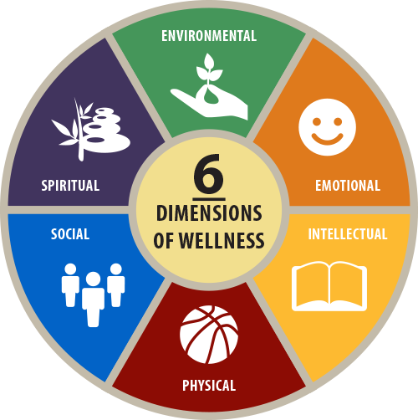
WHO Today: Six Dimensions of Health and Wellness
Notes:
Over the decades, the World Health Organization has expanded the definition of health to one of wellness. This takes into account that health occurs on a continuum and we don’t all enjoy exactly the same kinds of health throughout the life cycle. It moves away from a medical model preoccupation with exclusive focus on physical wellness.

Slide 7
Health and Health Care Occur in Systems
Health System: all activities dedicated to promotion, restoration or maintenance of health, including:
All hospitals, health centers, places where health care is delivered
Public health and prevention activities
Payors, such as insurance companies & other health financing actors (Medicare, Medicaid, etc.)
Health professionals and general workforce
Notes:
It is essential to note that most of health care occurs within systems and that societies organize in part to provide systemic support for health and well-being. The US health system is noteworthy for two major aspects: it is wildly complex and it is profoundly challenged by issues and poor health outcomes, considering the amount spent.

Slide 8
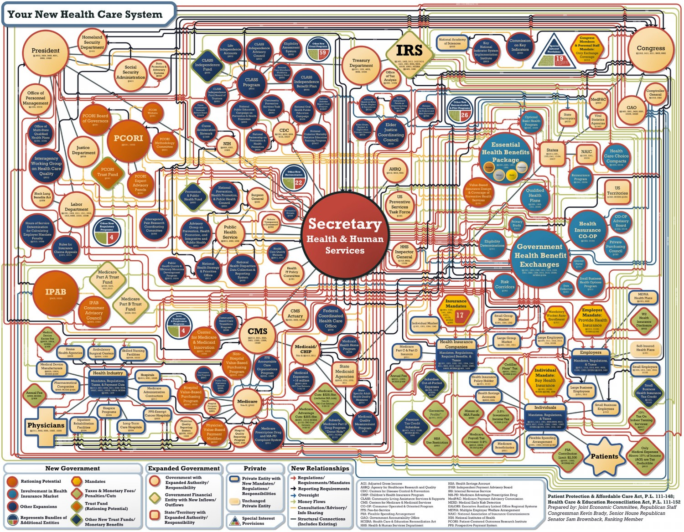
US ealth System: Complex & Beset by Challenges
Notes:
Although labeled a “New Health Care System,” this graphic, which emerged shortly after the ACA was enacted, is largely consistent with what is occurring several years later

Slide 9
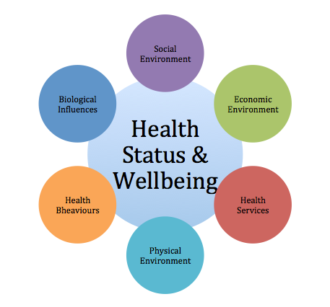
Challenges: Across Domains
Worsening national health statistics
  US ranks 43rd in average life expectancy; 55th in infant mortality (CIA, 2018)
Population changes
  Globalization, urbanization, aging, immigration
Environment
  Natural disasters, climate change, terror, and war
Diseases/disorders
  Pervasive chronic disease; emerging & persistent infectious diseases, trauma, suicide, addictions, gun violence
Rampant health inequities
  Socially determined inequities driven by racism, sexism, economic inequality, lack of access, unraveling of health reform, systematic disadvantaging (SDOH)
Systemic changes due to health reform and cost containment
  Integration, care coordination, behavioral health, financing changes, SW role shifts
Unmet social needs that contribute to poor health
Health
Behaviors
Notes:
There are numerous issues plaguing the US health system. Most of these are population level challenges that cannot be solved by piecemeal efforts or by clinical intervention with individuals. If social work is to have an impact on these arenas, it must both grasp them and be prepared to act on them. The following slides document the issues by using comparative health data.

Slide 10
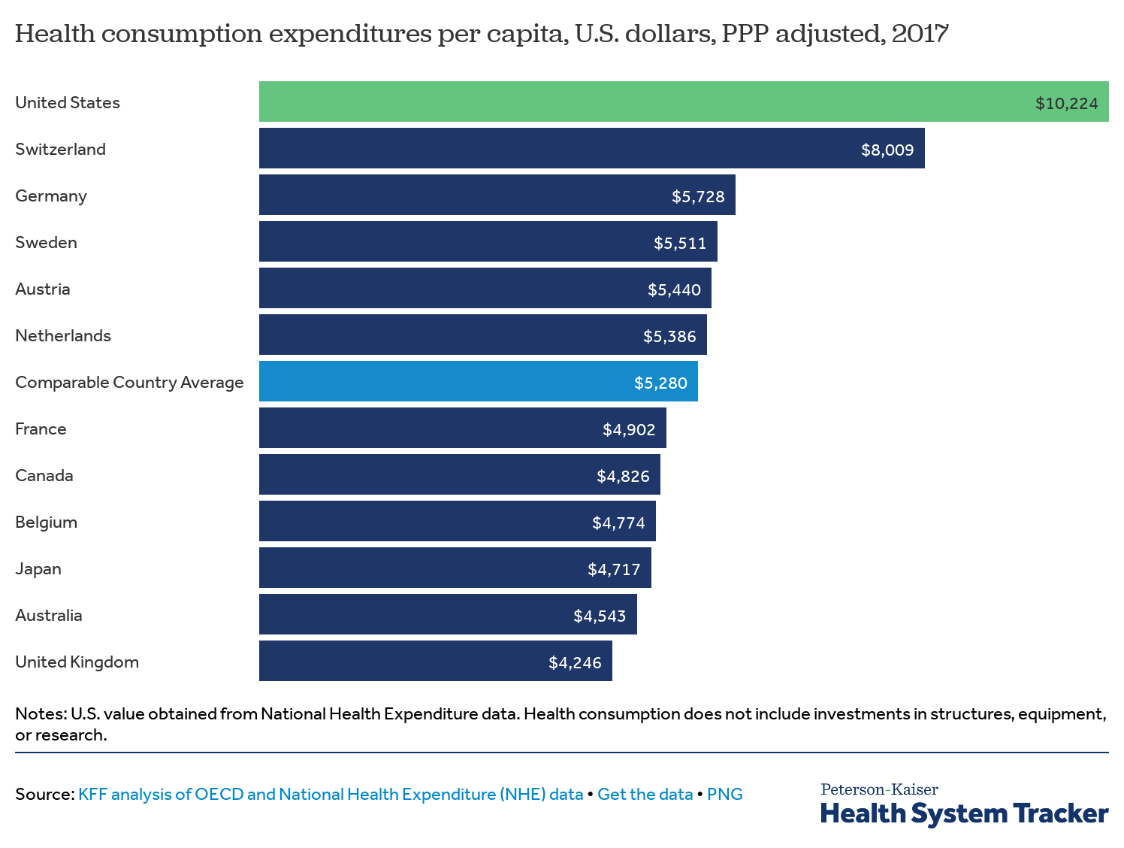
The American Health Care Paradox: World’s Most Expensive System…
Notes:
Various efforts to incrementally reform the US Health System have succeeded only in part. In fact, there’s a term for what’s going on in the US—“American Health Care Paradox”—by which is meant that we spend far more than any other country on health care, and we have the worst health outcomes on a number of measures, compared to the world’s richest countries, and even compared to developing countries in some measures.
https://www.google.com/search?q=us+health+outcomes+vs+other+countries&espv=2&biw=1218&bih=581&source=lnms&tbm=isch&sa=X&ved=0ahUKEwj8kObI0b7MAhXFFj4KHQYUDBcQ_AUIBygC#imgdii=tT8yfUros9p_cM%3A%3BtT8yfUros9p_cM%3A%3BgbHghouj-c0SWM%3A&imgrc=tT8yfUros9p_cM%3A
https://www.apha.org/topics-and-issues/generation-public-health/health-rankings

Slide 11
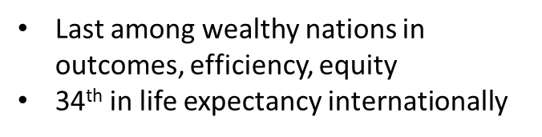
…with the Worst Comparative Outcomes
K. Davis, K. Stremikis, C. Schoen, and D. Squires, Mirror, Mirror on the Wall, 2014 Update: How the U.S. Health Care System Compares Internationally, The Commonwealth Fund, June 2014.
Notes:
K. Davis, K. Stremikis, C. Schoen, and D. Squires, Mirror, Mirror on the Wall, 2014 Update: How the U.S. Health Care System Compares Internationally, The Commonwealth Fund, June 2014.

Slide 12
Measures of Relative Poor Performance
Notes:
Here, the rankings of the US on a series of performance factors underscores the concerns. The one domain that the US ranks “middle” on is care process. The US tends to excel on measures that involve the doctor–patient relationship, performing relatively better on wellness counseling related to healthy behaviors, shared decision-making with primary care and specialist providers, chronic disease management, and end-of-life discussions. In the rest of the domains—access to care, efficiency, outcomes, and equity—we do worst.

Slide 13
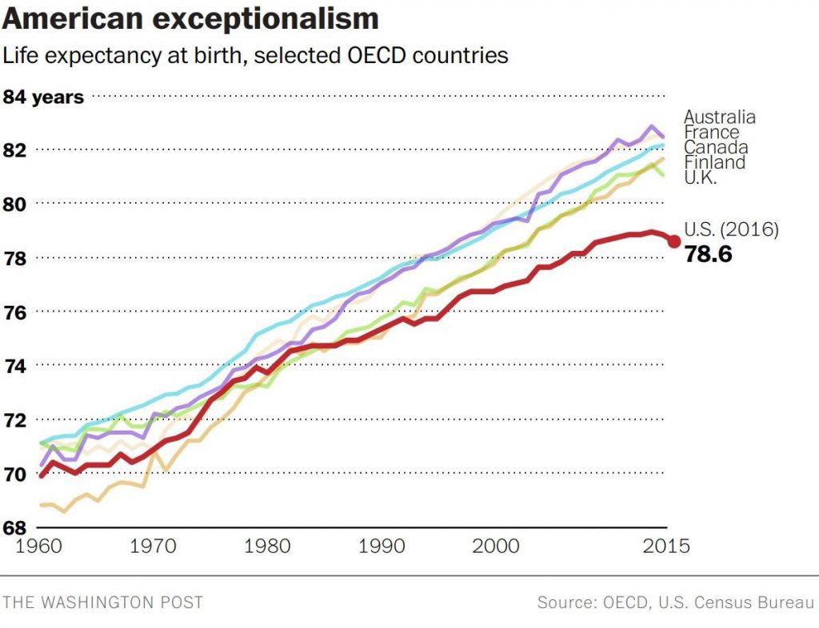
Example: Average Life Expectancy (ALE)
Notes:
Average Life Expectancy and Infant Mortality Rates are two of the most sensitive “flagship” indicators. An indicator is a measure used to express the behavior of a system or part of a system. Both ALE and IMRs are key measures of whether our health system is performing well. Moreover, these rates can be broken out according to subgroups or subpopulations, which can show is where inequities lie. And they can be used comparatively to tell us how we are doing in relation to other similar countries. Here, we can see that ALE is decreasing for the US—which is highly unusual in a high income country—and we can also see that other similar countries are far outstripping the US in ALE.

Slide 14
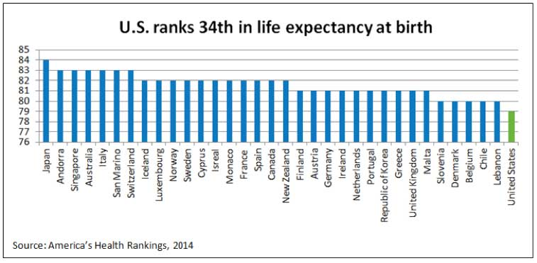
Another View of ALE
Notes:
This graphic just shows another version…

Slide 15
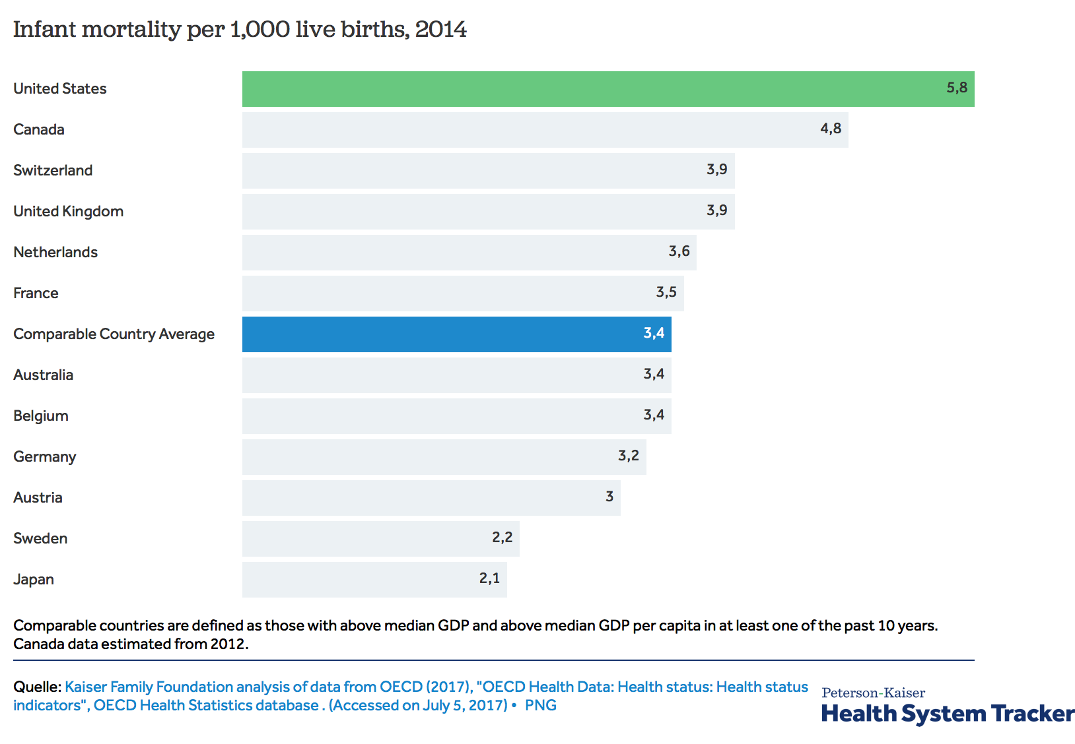
Example: Infant Mortality Rates
Notes:
Infant Mortality Rate is defined as the number of deaths of children under one year of age, expressed per 1,000 live births. The US ranks 34th and is increasingly ranked lower than many OECD countries. Again, these are sensitive indicators that reflect large scale social determinants of health.

Slide 16
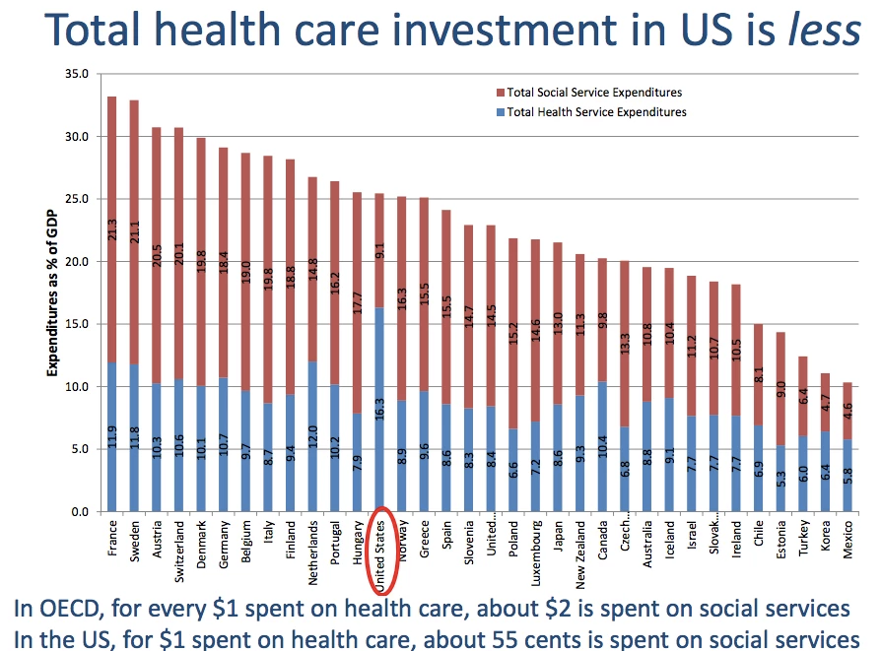
Example: Low Investment on Social Services
Notes:
One important factor associated with poor health outcomes is the relative disinvestment in social services. As can be seen in this graph, the US spends MUCH less than comparative counties on social services and this, in turn, contributes to our poor health outcomes.

Slide 17

But Why?
Current system is both costly and focused on sickness and profit
Over-reliance on medical model: diagnostics, treatment interventions, individual focus and not on population health
Approximately 95% of national health budget spent treating diseases
Half of annual deaths associated with preventable conditions; only 5% of national health $ dedicated to prevention (Galea, et.al, 2011)
Prevention and public health: logically and ethically compelling, but not priority in current system (Woolf, 2007)
Incremental health reforms in profit-oriented system have limited effect, leaving many still without access to care until very sick
Lack of investment in social welfare and unmet social needs
Notes:
So, even a short review of the current health care challenges suggests that significant environment, social, and economic factors—what we in public health refer to as the social determinants of health—are powerfully affecting health outcomes in the US across populations. Social workers are struggling to provide treatment, assistance, problem solving, remediation, and intervention to the most vulnerable people in society in a context that is in crisis, a context that is rapidly changing, a context that emphasizes intervention long after problems and diseases have occurred and advanced.
Despite the fact that there’s a growing financial, practice, and ethic urgency associated with the current health care arrangement, our efforts to reform it have been frustratingly piecemeal and slow. We know we have a long way to go still to clarify and strengthen our national health care systems and we know further that professions have a role to play in facilitating the shift to a more equitable and prevention oriented system.

Slide 18
2. Brief Review of Health Social Work
Notes:
Let’s turn our attention to the role of social workers in this system…

Slide 19

Social Work’s Role in Health
One of the fastest growing professions in US (Bureau of Labor Statistics, 2010)
Social work is a health profession
  Roughly half of nation’s 650k social workers practice directly in health (Stanhope et al., 2015)
  Remaining social workers focus on social determinants of health—housing, education, child welfare, criminal justice
  SW provides majority of social/mental/behavioral health services
Each day, half of 1% (roughly 1.6 million people) in “helping relationship” with social worker (Weissman, et. al, 2006)
Concern over adequacy of SW workforce as population ages (Whitaker, Weismiller, Clark, & Wilson, 2006)
Number of US social workers: 650,000
Notes:
Major themes:
Increased number of health social workers
New roles for social work
Need to demonstrate SW impact and value
Sense that SW must address SDOH to fulfill to social justice
Okay, so let’s focus on the present. At this time, some 35% work in traditional health care settings—hospitals, health centers, etc. That’s a significant minority; however, as you probably know now, as we move more to a public health orientation in the way we view overall population health, we don’t split mental health and substance abuse off on their own any more as if they weren’t part of health care. Thus, if you add in those employed in mental health and substance abuse hospitals and care—which I urge doing since these areas of practice are now largely integrated in our health care system—the majority of social workers are health social workers. Social work in health is not a niche; it’s the majority practice!

Slide 20

Many Types of Health Social Work (HSW)
Hospital>medical>health care SW
Disease-specific, e.g.: oncology, nephrology SW
Site-specific: e.g. NICU SW
Psychiatric>mental health SW
Mental health SW + Substance (ab)use SW =behavioral health SW
Public health social work
Notes:
Social work has many different names and types you may have encountered. These reflect our history which I'll briefly mention but I urge you to use the big umbrella and refer to all of it as “health social work”

Slide 21

Contemporary Roles of HSW
Allen & Spitzer (2015) Four C’s:
Provide counseling/therapy and other forms of direct client care
Collaborate and coordinate with health team members
Help patients manage the complexity of illness/disorders
Help patients negotiate the cultural and organizational context of health organizations
OR, if you prefer, Craig & Muskat (2013)
Bouncers, brokers, and glue (discharge planning, navigation, advocacy, assessment, case management, crisis intervention and integration)
Notes:
As is widely known, SW plays multiple complex roles in medical settings. And more importantly, there is considerable jockeying for position in health settings about who does which tasks. It is a very dynamic environment.

Slide 22

HSW (Largely) Downstream
Most health SW “downstream:” clinical services including diagnosis, counseling, treatment, psychosocial support, crisis intervention
Clinical services: crucial to individual and family well-being, but limited impact on promoting equity and improving population outcomes
Notes:
https://www.debeaumont.org/news/2019/meeting-individual-social-needs-falls-short-of-addressing-social-determinants-of-health/

Slide 23

Changing How We View and Do Health Social Work
Social workers are either working directly on health or they’re working on issues that socially determine health and well-being: housing, child welfare, education, access, community development, behavioral health, etc.
(MAYBE) ALL SOCIAL WORK IS…
HEALTH SOCIAL WORK NOW (Bywaters & Napier, 2009)
Notes:
There is a strong case to be made that SW is a health profession because of our breadth and depth in promoting human well being, working in health, and responding to unmet social needs. This wide lens framing, and the approaches it requires, is what’s known as the public health social work approach.

Slide 24

Adopting Public/Population Health Approaches
Implications:
Expanded professional focus on broader practice paradigm (individual/community/population)
Recalibrates education and workforce training to include “wide-lens” approaches
Strengthens profession’s reach, value, and impact by enhancing interprofessional/cross-sectoral collaborations & focus on population health outcomes (Beddoe, 2013)
Notes:
https://www.debeaumont.org/news/2019/meeting-individual-social-needs-falls-short-of-addressing-social-determinants-of-health/
The short-hand term for widening the lens and adopting a public health framework for social work can be captured by the terms “public health social work.” In the next section, we describe what this is, where it originated and what comprises it.

Slide 25
3. Public Health Social Work
History, Definitions, and Roles

Slide 26

Public Health Social Work (PHSW)
Sub-discipline and framework within social work that uses multifaceted, wide-lens public approaches to address major health issues, promote health equity and mitigate health problems (Ruth, Sisco, & Marshall, 2016)
Notes:
The working definition of the Group for PHSW Initiatives is above. Note that we refer to it both as a sub-discipline within the larger social work profession but also as a unifying framework relevant to all of social work. Note that we speak to wide lens public health approaches; in this, we include individual, community, and population health practices.

Slide 27
A Brief History of PHSW
Social work and public health closely linked across wide range of issues:
Maternal and child health (clean milk and water, home visiting, infant and maternal morbidity/mortality prevention)
Infectious disease control (TB, STDs)
Settlement houses (sanitation, school lunches, health advocacy, environment improvement)
Hospital-based social work “A curiously many sided job…addressing the sociologic side of patients’ distress, offering patients a chance to clear their mind and reshape their days.” (Cabot, 1905)
Notes:
The fact is, social work’s origins are in public health. We emerged side by side in the Progressive Era and many—if not most—of our early functions in health care related to public health and to what we now refer to as the “core or essential” skills of public health. The early social workers had a sense of themselves as public health actors. My own mentor, Ruth Cowin, spoke about being a first responder social worker at the Cocoanut Grove Fire in 1942, where 492 people died. She spoke so eloquently about what we now call disaster response—a core function of public health—and how she and her colleagues at Mass General knew they were working on the outlines of a new form of mental health work that centered on trauma.
Even in hospital social work, there was this sense, as you can see from the quote, of social work being part of addressing the sociologic side of illness, something that was considered both important and necessary enough to create a whole profession around.

Slide 28
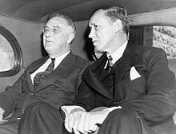
Social Work and Public Health: “Inseparable?”
“The fields of social work and public health are inseparable, and no artificial boundaries can separate them. Social work is interwoven in the whole fabric of the public health movement, and has directly influenced it at every point” (Hopkins, 1926)
President Roosevelt with Senior Advisor and Public Health Social Worker, Harry Hopkins
Notes:
Hopkins uttered this famous statement when he was director of the New York Tuberculosis Society.
Hopkins, who went on to become FDR’s senior advisor, was a social worker and an architect of the new deal. In fact, many social workers were integrated into the highest levels of federal leadership and helped to create what we now think of as our modern social welfare state. Chief among them were people who were public health social workers.

Slide 29
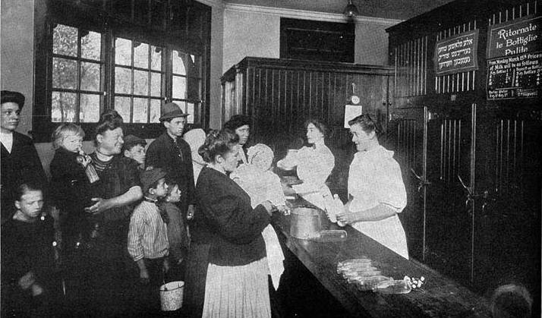
What Comprised Early Public Health Social Work?
Willingness to investigate social factors as causes of poor health (now called “social determinants of health)
Combined use of “wide-lens,” epidemiologically-informed clinical and community-level preventive interventions
Commitment to political activism aimed at structural and systemic changes in social conditions
Explicit focus on social justice
Social workers distributed milk at New York City milk depot, circa 1900
Notes:
Social work-led Children’s Bureau efforts led to a 50% decrease in infant mortality.

Slide 30
PHSW Timeline: Early 20th Century Successes
  Helped establish/lead maternal and child health programs 1900-1930’s
  Helped lead development of federal social welfare programs in 1930’s
  Developed early trauma and disaster response and interventions following WWII, WWII, and natural disasters
  Co-led early de-stigmatization and epidemic response in HIV/AIDS
  PHSW integrated into community and government health settings, health centers, specialty hospitals by 1950s
Notes:
While there were successes, political attacks against social workers—calling them communists, suffragists and socialists for wanting to craft a more just society—made many social workers, including PHSWs, more cautious. What started as a social determinants of health campaign—the infant and maternal morbidity reduction campaigns, led by social workers—achieved great success when the Children’s Bureau was established. But almost immediately after it was developed, it started coming under attack and the social justice work in the community grew more limited, careful, and conservative. As the 20th century went on, PHSW got integrated into many arenas and as long as there was federal leadership by social workers to protect these efforts, they flourished, even though it was a minority practice. After the 1960s, discussion of PHSW slows and then finally trickles away in the 80s/90s as clinical practice consolidates its majority in the field and establishes SW as a “mental health profession” dedicated to treatment. This isn’t to say that no community or public health work remains, it does. It’s just that after a certain point, it’s not championed, it has no leaders, people stop writing about it (e.g. not much written about PHSW in AJPH after the 1960s) and the idea of an integrated practice begins to draft away. However, the need for an integrated practice of social work/social welfare and public health doesn’t go away.

Slide 31
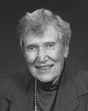
PHSW Timeline: Leadership
PHSW prevails – despite splintering of medical, psychiatric, and other types of health SW
Established PHSW leaders, particularly at federal level—Virginia Insley, Juanita Evans, Milt Wittman, Elizabeth Rice, Ruth Cowin—keep PHSW alive, even though a declining force within the profession
For one inspiring example: Ruth Knee NASW Foundation Social Work Pioneers: Ruth Knee
Notes:
PHSW prevails throughout the 20th century, not because it is the most numerically dominant form of practice, but because of the outstanding leadership shown by PHSWs who, beginning with the Maternal and Child Health Bureau, straight through to the 1980s, stayed in federal government and promoted the practice and protected funding streams. As the old guard left however, and as social work practice was drawn toward a predominantly clinical model of practice, the history, focus, and funding for PHSW decreased.

Slide 32

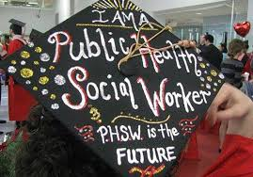
PHSW: Educational Efforts
Many historic efforts to integrate PHSW into SW education:
Lydia Rappaport’s work (1961): “integrating prevention into social work” inspired dozens of faculty throughout 60s/70s
Public Health Social Work Forward Plan (1980s-90s): introduced prevention curriculum for schools of social work (Siefert, 1992)
HRSA Advancing Leadership in PHSW funneled funding over 20 years to three primary schools of social work
Development of MSW/MPH programs: Late 1970s to current era; now 45 programs
Notes:
For a fascinating look at one area, check out the Maternal and Child Health Bureau timeline. https://mchb.hrsa.gov/about/timeline/index.asp Many long-term MCH training programs were established soon after the MCH departments in schools of public health, including Public Health Social Work (1948)

Slide 33

PHSW Timeline: Hindsight is 20/20
Lost leaders: Leadership aged out while field consolidated as “clinical” profession> gradual loss and “forgetting” of PHSW in both fields over time…
Health system evolution: Health SW became/remains largely clinical and is a major employer of SW; PHSW—like all of public health—is minimized
Continued need for PHSW: PH develops “community health work” to address social determinants of health, unmet social needs, and tasks previously done by PHSWs
Time to refresh: Profession begins to recognize that PHSW is “unifying framework” for approaching major challenges (Cederbaum, Ross, Ruth, & Keefe, 2018)

Slide 34
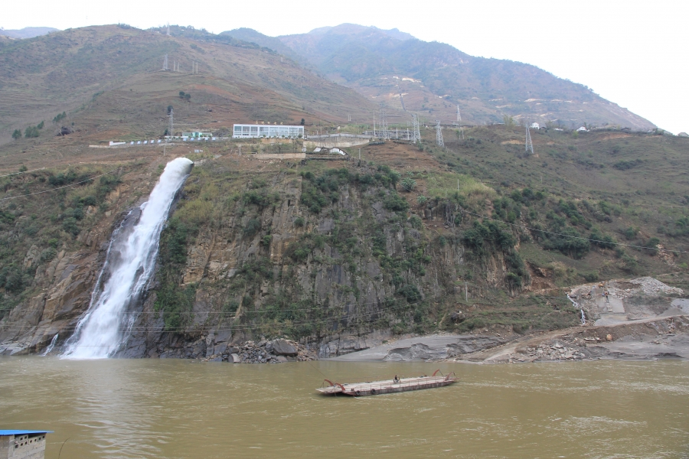
The Primary Rationale for Reclaiming PHSW…
PH (mostly) upstream
PHSW
SW (mostly) downstream
If you really want to stop people from drowning, you cannot ignore root causes…
Notes:
Public health helps you focus on ROOT CAUSES; see excellent article by Bravemen & Gottlieb (2011) on addressing cause of causes….https://www.ncbi.nlm.nih.gov/pmc/articles/PMC3863696/
Public health social work: important base for new high-impact health social work by:
Providing century’s worth of experience in how to broadly marry clinical, intermediate and population approaches for greater SW impact
Serving as inter-professional bridge between public health and social work/welfare
Addressing unmet social needs and social determinants of health by changing conditions of society, not just individual efforts

Slide 35
4. PHSW: Reclaiming for Greater Health Impact

Slide 36
PHSW: Pathways to Greater Impact
Reclaim PHSW
Link PH and SW
Increase SW’s Impact through PHSW

Slide 37
Deliberately Link Public Health and Social Work
Link PH and SW
Understanding PH and SW; clarifying the common ground and key distinctions between the fields
Recognize PHSW as interprofessional bridge

Slide 38
Understanding Both Fields
Public Health
Institute of Medicine: the field of practice concerned with “assuring the conditions in which people can be healthy.”
Social Work
IFSW: Profession dedicated to “restoration and enhancement of human function” and “promotion of change in social conditions to reduce human suffering.”
“An interdisciplinary field, based on biological and social sciences, with a mission to promote and protect the health of whole populations, and to prevent illness, injury and other disabling conditions.” -Turnock, 2007
NASW: “Based on values of…equality, worth, dignity of human beings, social work uses a human rights and social justice orientation to address complex needs of people in environments.”
Notes:
While PH and SW share “origins stories” and have worked collaboratively over the decades, they are not the same practice. The point of these charts is to give you a sense of how these are differentiated, and why both are necessary components of 21st century practice and why they should be linked. We begin with basic definitions.

Slide 39
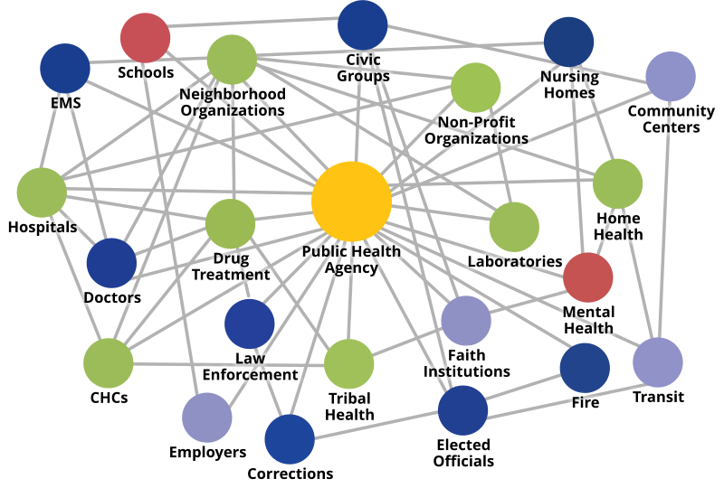
The Public Health System
Notes:
Note that the current public health system views almost all of the systems in which social workers practice as part of it. Here’s a graphic.

Slide 40
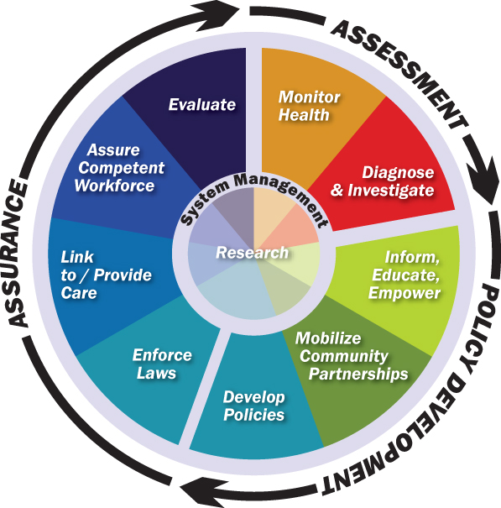
Public Health’s Ten Essential Services
The Center for Disease Control identifies ten services that encompass public health’s activities.

Slide 41
Common Ground: Complementary Approaches
Public Health
Social justice mission
Social Work
Social justice mission
Use of social sciences to drive theory/intervention
Emphasis on ecological models and the role of “environment”
Emphasis on resilience and protective factors
Goal to promote health and conditions of health
Use of social sciences to drive theory/method
Emphasis on “person in environment” approaches
Emphasis on strengths-based approach
Goal to improve human functioning and well-being

Slide 42
Complementary Theory Bases/Models/Approaches
Public Health
Social ecological theories
Social Work
Systems, ecological & “persons in environment” approaches
Stages of change theories (trans-theoretical)
Social cognitive theories
Health belief/behavior change theories
Capacity building theories
Stages of change theories (trans-theoretical)
Cognitive-behavioral practice models
Critical theories (e.g., structural & anti-oppressive SW)
Notes:
Note that this is not a comprehensive list of social work or public health theories.

Slide 43
Critical Practice Orientation Differences
Public Health
Primary focus on prevention
Social Work
Primary focus on intervention
Use of public health models/systems
Population emphasis with exclusive macro focus
Based on biological sciences, EBP, epidemiology
Public health often “up in the balcony”
Reliance on medical models/systems
Primary clinical emphasis with focus on individuals, groups, families
Lesser, but growing, emphasis on EBP and research
Social work often “down on the dance floor” of community
Notes:
We recognize aspects of macro practice may be more preventative but the bulk of social work is not macro practice.
We also recognize that public health works in the community to connect systems to people.

Slide 44

When Public Health and Social Work Bridge…
Good things happen:
SW and PH harvest a century’s worth of experience on how to maximize clinical, intermediate, and population approaches for greater health improvement
Public health and social work/welfare reconnect for greater effectiveness in addressing health inequities and unmet social needs
SW equipped with unifying framework to “tell a stronger story” about its value to health systems: e.g. when frail elders are discharged after SW involvement, they have fewer readmissions; social work prevents readmissions… (Altfield, et al, 2013).

Slide 45
Reclaim and Conceptualize Public Health Social Work
Reclaiming PHSW
Conceptualize the PHSW Model
Clarify PHSW’s relevance to clinical and macro practice

Slide 46
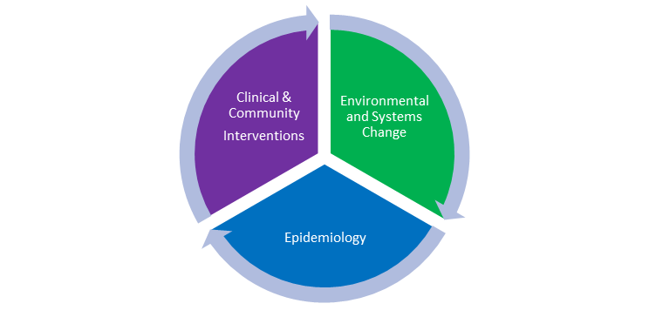
Components of PHSW Model
Use of clinical, mezzo, macro skills
Reliance on science of epidemiology
Focused on systems, aims for structural change in conditions
Wide-lens focus on “person and population”
Emphasizes prevention
Person and Population
(Ruth & Wilkinson, 2017)
Notes:
PHSW aims to improve social work’s impact on individual and population health through:
Use of epidemiologically-informed approaches
Focus on vulnerable sub-populations and health injustice
Addressing social and macro determinants that shape health
Emphasis on prevention
Use of multi-level intervention—from individual to systems—to impact and improve health
Cross-sectoral, inter-professional, and transdisciplinary collaborations
Advocacy for systems, environmental, and structural changes in conditions that affect health

Slide 47

PHSW: Clinical AND Macro
PHSW is an integrated approach that includes both clinical and macro social work
Macro= Purple (community aspect) and green (mostly)
Clinical = Purple (mostly)
Public Health without SW= Mostly green and blue, with some purple (community aspect)
Public Health Social Work: All three components come together to enable simultaneous focus on persons AND populations
Person and Population
Notes:
Component Model rough and simplistic, but gets the point across!
As public health has included more community health workers and other community based type clinical service extenders, it has begun to approach the integrated PHSW model, but alas, without the social workers as the primary labor force. (Although some social workers are deeply involved in helping develop the CHW workforce).

Slide 48
How PHSW Can
Increase Social Work’s Health Impact
Increase SW’s Health Impact through PHSW
Importance of health impact in post-ACA era
Visualizing health impact and “telling the story” of PHSW in a PHSW model

Slide 49

Can Social Work Have Greater Impact?
Social injustice, health inequities and health reform: require use of public health approaches
PHSW Challenge: build upon existing clinical/macro methods to enhance profession’s overall effectiveness and impact
Development of a Social Work Health Impact Model: adapted from Frieden’s Health Impact Model, SWHIM illustrates profession’s capacity for impacting health across systems and on multiple levels (Frieden, 2012; Ruth, Wachman, Marshall, Backman, Harrington, Schultz & Ouimet, 2017)
This Photo by Unknown Author is licensed under CC BY-SA-NC
Notes:
No profession can survive without describing its greater impact at this time. SW profession must be able to tell a coherent story about its impact in and across the health systems. The new Social Work Health Impact Model helps to frame this conversation, highlighting the contributions of all levels of social work and emphasizing the need for a more PHSW.

Slide 50
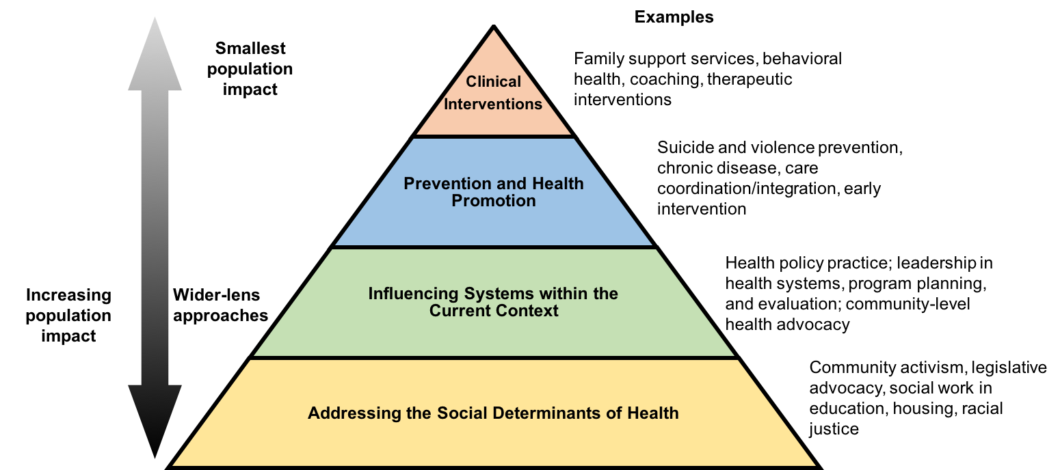
Visualizing SW Health Impact
Social Work Health Impact Model
(Ruth, Wachman, Marshall, Backman, Harrington, Schultz & Ouimet, 2017)
Notes:
Grasp implications of social determinants of health model; if health is broadly determined, and social workers are engaged across most of society’s social welfare systems, then all social work is health social work
Educate broadly using Social Work in Health Pyramid: most social workers primarily educated at “tip” of the, limiting abilities to work/collaborate/lead at other levels
Recalibrate SW curriculum to focus on broader model of practice that links clinical skills to wide-lens public health approaches; embrace PH approaches in all domains
Conceptualize, measure, fund public health social work education, evaluation, workforce development
Clinical interventions must be connected to three bottom levels of prevention, systems work, macro efforts to address SDOH.
When addressing climate change, happens at the systems level and SDOH.

Slide 51

SW Health Impact Model Implications
PHSW-enriched practice: Links clinical skills to public health approaches and focuses SW’s role on greater impact efforts to address SDOH
All social work is health: Health is broadly determined; social workers work across society’s social welfare, social development, and health systems; practitioners either work directly in health or on the social determinants of health
SW education recalibration: Integration of PH skills into SW education can strengthen practitioners’ readiness to participate in and lead prevention, transdisciplinary collaboration, epidemiologically-informed efforts to address SDOH, and advocacy to change social conditions
Intentional infusion of wide-lens approaches across all levels of practice: Social work visibility, value, collaborative potential, and impact increase through integration of PHSW.
Notes:
There are numerous “goods” that come from integrating wide-lens public health approaches into practice. Although the system appears to reward more limited forms of practice, the post ACA era is ripe for innovation.

Slide 52
5. PHSW in Action
Competencies
Profiles

Slide 53
PHSW in Action: Dual Professional Competence
Competence is central to professions; competent professionals practice with effectiveness and efficiency according to standards
Numerous components: knowledge, values, skills, and behaviors (Drisko, 2014)
Public health social workers use the theories, practices, concepts, and—most importantly—the competencies of social work and public health to improve health and well-being

Slide 54

Updated Competencies Needed!
Areas of practice thrive when practitioners can describe what it is, what it does, what it looks like in practice, who is doing it, and why employers need it!
Current PHSW standards dated (written in 1990s) but much can be learned from reviewing them: Existing PHSW Competencies
New ones needed…until then, utilize existing PH, SW and PHSW competencies
Notes:
Encourage students to consult ALPS documents: both MSW/MPH Handbook and PHSW Toolkit teach about competency integration.

Slide 55
PHSW and the Ten Essential Public Health Services
Public health social workers are broadly engaged in all areas of public health. One study (Ruth, Wyatt, Velasquez, Bachman, 2015), asked PHSW participants to describe their roles in the public health infrastructure. While respondents worked in all of the ten essential service areas the following four areas were primary:
Inform, educate, and empower people about health issues
Mobilize community partnerships and action to identify and solve health problems
Develop policies and plans that support individual and community health efforts
Evaluate effectiveness, accessibility, and quality of personal and population-based health services
Notes:
Encourage students to consult ALPS documents: both MSW/MPH Handbook and PHSW Toolkit teach about competency integration.

Slide 56
But What Do PHSWs Do?
Engage in and lead integrative efforts in behavioral health and primary care and other forms of health reform (health systems transformation)
Provide services in a public health framework for ongoing epidemic, disease or social issue (e.g. HIV, suicide, opiate epidemic)
Engage in community outreach and case-finding (Flint water crisis initiatives or disaster response)
Consult and collaborate on major issues (Parkinson’s falls prevention, eviction prevention, cardiovascular risk reduction)
Prevention and health promotion activities, program planning (bullying, violence, substance use disorders)
Research, formal and informal (e.g. community based participatory research)
Professional development/training/community and interprofessional education (collaboration across disciplines or sectors)
Community and legislative advocacy (addressing conditions that cause poor health: housing, lack of access to care, food instability)
Notes:
These are all examples of professional positions that our MSW/MPH alumni work in…Exercise: Look at the two sets of competencies to see what ones our practitioners are engaging in.

Slide 57

Social Work Competencies
CSWE Social Work Competencies:
1. Demonstrate Ethical and Professional Behavior
2. Engage Diversity and Difference in Practice
3. Advance Human Rights and Social, Economic, and Environmental Justice
4. Engage in Practice-informed Research and Research-informed Practice
5. Engage in Policy Practice
6. Engage with Individuals, Families, Groups, Organizations, and Communities
7. Assess Individuals, Families, Groups, Organizations, and Communities
8. Intervene with Individuals, Families, Groups, Organizations, and Communities
9. Evaluate Practice with Individuals, Families, Groups, Organizations, and Communities
Notes:
https://www.bu.edu/ssw/academics/msw/competencies/

Slide 58
Public Health Competencies
Evidence-based Approaches to Public Health
1) Apply epidemiological methods to the breadth of settings and situations in public health practice;
2) Select quantitative and qualitative data collection methods appropriate for a given public health context
3) Analyze quantitative and qualitative data using biostatistics, informatics, computer-based programming and software, as appropriate;
4) Interpret results of data analysis for public health research, policy or practice
Public Health and Health Care Systems
5) Compare the organization, structure and function of health care, public health and regulatory systems across national and international settings;
6) Discuss the means by which structural bias, social inequities and racism undermine health and create challenges to achieving health equity at organizational, community and societal levels
Planning and Management to Promote Health
7) Assess population needs, assets and capacities that affect communities’ health;
8) Apply awareness of cultural values and practices to the design or implementation of public health policies or programs;
9) Design a population-based policy, program, project or intervention;
10) Explain basic principles and tools of budget and resource management;
11) Select methods to evaluate public health programs
For more information: https://tdi.dartmouth.edu/education/degree-programs/masters-in-public-health/mph-competencies
Notes:
https://tdi.dartmouth.edu/education/degree-programs/masters-in-public-health/mph-competencies

Slide 59
Public Health Competencies
Policy in Public Health
12) Discuss multiple dimensions of the policy-making process, including the roles of ethics and evidence;
13) Propose strategies to identify stakeholders and build coalitions and partnerships for influencing public health outcomes;
14) Advocate for political, social or economic policies and programs that will improve health in diverse populations;
15) Evaluate policies for their impact on public health and health equity
Leadership
16) Apply principles of leadership, governance and management, which include creating a vision, empowering others, fostering collaboration and guiding decision making;
17) Apply negotiation and mediation skills to address organizational or community challenges
Communication
18) Select communication strategies for different audiences and sectors;
19) Communicate audience-appropriate public health content, both in writing and through oral presentation;
20) Describe the importance of cultural competence in communicating public health content
Inter-professional Practice
21) Perform effectively on inter-professional teams
Systems Thinking
22) Apply systems thinking tools to a public health issue
For more information: https://tdi.dartmouth.edu/education/degree-programs/masters-in-public-health/mph-competencies
Notes:
https://tdi.dartmouth.edu/education/degree-programs/masters-in-public-health/mph-competencies

Slide 60
Profiles of Public Health Social Workers

Slide 61
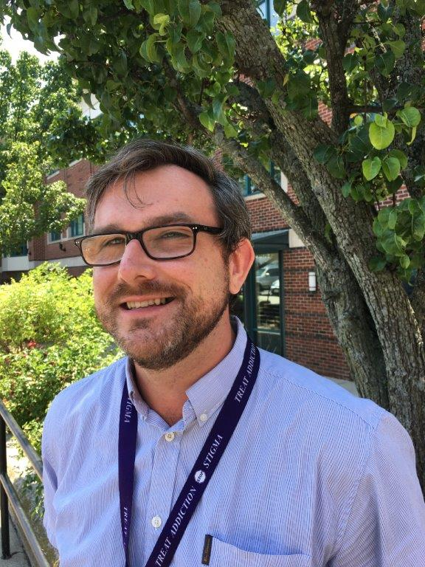
“I believe that all PHSW professionals are best equipped to deal with the suffering in our society when they’re able to view social ills through both individual and systems lenses. By treating the individual, we can help one person in a profound and meaningful way. But integrating that help into a broader, public health and public facing approach, we can support the revitalization of communities that have been devastated by addiction and other health inequities.”
Dan Hogan, MSW, MPH
Substance User Health Program Manager, Codman Square Health Center, Boston, MA
Dan’s current role as a “true blend” of clinical social work and public health. He endeavors to use the two disciplines to advocate for humane and sensible polices around substance user health, as well as to engage in harm reduction, community engagement, education, prevention and ultimately to help reform current substance use methodologies.

Slide 62

“Public health social work is the best combination. We’re people who can see the bigger picture and look at how to prevent the problem, while at the same time recognizing that the problem still exists and we can intervene.”
Jenn Valenzuela, MSW, MPH
Chief People Officer, Health Leads, Boston, MA
At Health Leads, Jenn leads all program implementation and integration in health systems and clinics across the country. Her team is responsible for coaching and training staff, establishing and promoting best practices across the country. Jenn makes a compelling case for PHSW. She sees public health social workers as capable of bringing and keeping social justice at the forefront of the work.

Slide 63
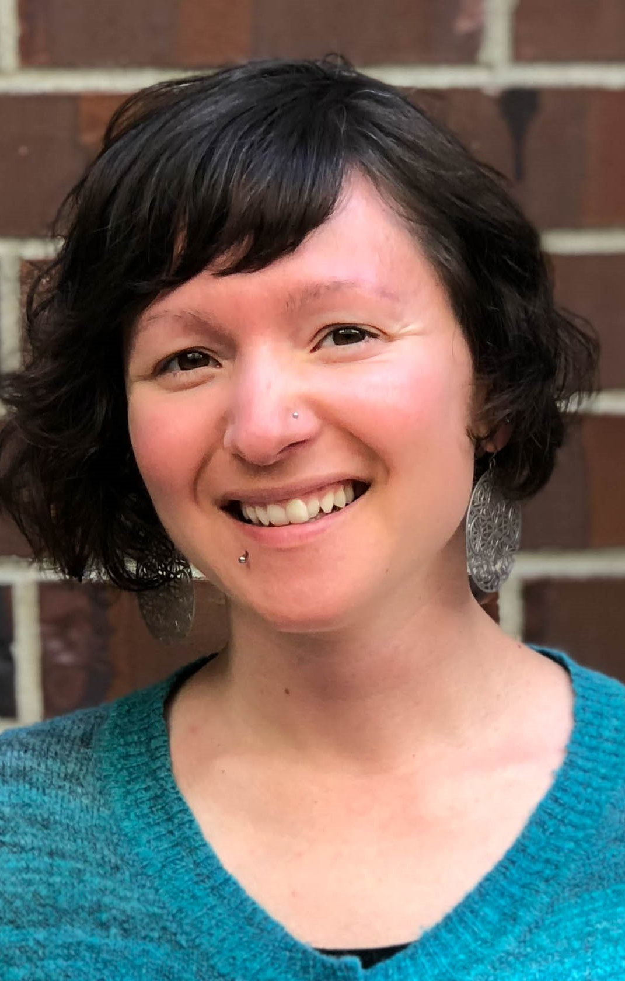
“I truly believe in the transformative power of public health social work. It is not just the marriage of two skillsets, but instead represents a whole that is greater than the sum of its parts.”
Bonnie Wennerstrom, MSW, MPH
Healthier Washington Connector, Seattle, WA
Bonnie’s “connector” position was created especially for her. She acts as an intermediary between all internal aspects of the agency’s work, bringing people and projects together to help move all systems, more efficiently and cohesively, to achieve the agency’s goals of a healthier Washington.
Notes:
Bonnie’s everyday work involves a complex array of activities: managing contracts between agencies, translating policy recommendations for operations and finance, providing thought partnership to multiple groups, writing reports for grant compliance, convening partners and stakeholders, and making recommendations to interagency leadership.

Slide 64

“I utilize my skills as a clinically trained social worker with a public health background in an inter-professional setting. Every day, I get to train a diverse team of providers to better understand mental illness, to apply a social work lens to engage people in treatment, to utilize public health programming and design to create new health promotion activities, and to evaluate them for their efficacy and efficiency.”
Daniel Do, MSW, MPH
Integration Care Manager Project Director, Community Health Center, Lynn, MA
Notes:
https://ciswh.org/public-health-social-work-in-action-dan-do

Slide 65
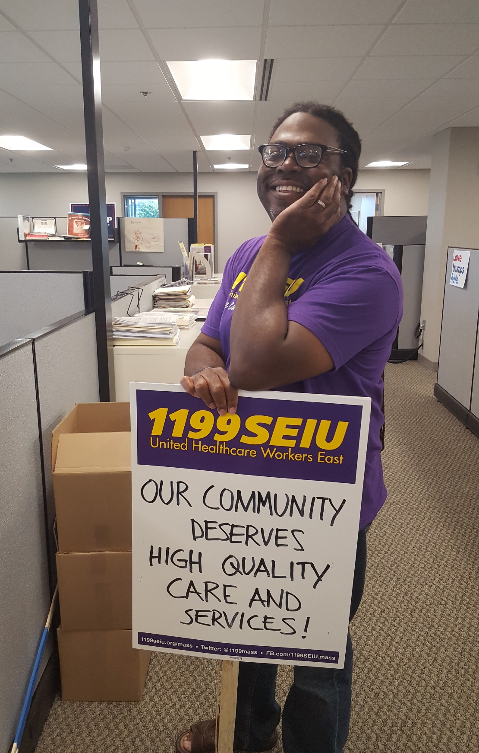
“My job involves the analysis and synthesis of healthcare-related financial and operations data related to the union’s organizing goals. I love that my job and my organization are involved in the community. We host annual health fairs, back-to-school drives, and candidate forums. We participate in various parades and cultural celebration and violence prevention initiatives. We’re We’re not just a union of healthcare workers, we’re a community advocacy organization too…it feels good to work somewhere that shares and acts on your shared social justice values.”
Allen Jackson, MSW, MPH
Senior Researcher, 1199SEIU United Healthcare Workers East, MA
As a labor union researcher, Allen relies on the “hard skills” such as statistics and data analysis, as well as on his macro social work skills. His agency is engaged in advocacy for improvement in the healthcare system, often advocating for the communities where the union members live, to promote health equity and work for social justice.
Notes:
https://ciswh.org/public-health-social-work-in-action-allen-jackson

Slide 66
6. Resources for Public Health Social Work

Slide 67

Obtaining Education in PHSW
Getting started:
Use materials from the Advancing Leadership in PHSW Education project (next slide)
Ask public health questions: What is the cause of the cause? How can we create a society in which no one wants to take their lives by suicide? Rather than pushing “resilience,” ask “how can we create a community in which children do not need to be resilient to survive?”
Familiarize yourself with public health sites: CDC, Prevention Institute, American Public Health Association’s Public Health Social Work Section: APHA PHSW Section or the Association of State and Territorial Public Health Social Workers http://astphsw.org/
Become familiar with public health, social work, and PHSW competencies
Seek out MSW/MPH students, programs, and alumni (Check out the MSW/MPH Handbook on the ALPS site)
Read the literature! (See our Resource Guide in the PHSW Toolkit)

Slide 68

PHSW 101 Authors
Betty J Ruth, MSW, MPH
Clinical Professor
Principal Investigator, Leadership in Public Health Social Work Education Initiative (BU-ALPS)
Director, MSW/MPH Program
Boston University School of Social Work
Email: bjruth@bu.edu
Madi Wachman, MSW, MPH
Assistant Director, Programs
Center for Innovation in Social Work & Health,
Boston University School of Social Work
Email: madi@bu.edu

Slide 69
More on the ALPS Project
Advancing Leadership in Public Health Social Work Education (ALPS) Resources https://ciswh.org/project/bu-alps
PHSW Toolkit
  Resource guide
  Profiles
  Foundational and topical slide decks
  Model PHSW Core Class Syllabus
MSW/MPH Program Handbook
  Integrative PHSW Seminar Syllabus
  PH and SW Competencies overview
Key Recommendations for Advancing PHSW

Slide 70
ALPS PHSW Slide Decks
Foundation Slide Decks
Public Health Social Work “101”
Epidemiology for Social Workers
Prevention for Social Workers
Social Determinants of Health for Social Workers
Topical Slide Decks
Substance Use Disorders and PHSW
PHSW in Higher Education
PHSW and Suicide
PHSW and Integrated Behavioral Health
PHSW and Racial Health Equity
PHSW and Children With Special Health Care Needs
PHSW and Liberation Health

Slide 71
Slide Deck Authors
Tamara J. Cadet, PhD., LICSW, MPH
Associate Professor, Simmons University School of Social Work (MA)
(PHSW: Addressing Racial & Ethnic Health Inequities)
Alexander Cohen, MSW, MPH
Manager, Behavioral Health Care Transformation
Cambridge Health Alliance (MA)
(PHSW: Advancing Integrated Health Care)
Elena Faugno, MSW, LCSW, MPH
Research Associate, Harvard Pilgrim Health Care Institute (MA)
(PHSW and Children with Special Health Care Needs)
Dawn Belkin Martinez, PhD, LICSW
Associate Clinical Professor
Boston University School of Social Work (MA)
(Liberation Health and PHSW)
Jamie Wyatt Marshall, MSW,MPH
Project Director, Group for Public Health Social Work Initiatives
Deborah Milbauer, MPH, MSW, LCSW
Public Health Consultant
Instructor, Dept. of Health Sciences, Northeastern University (MA)
(PHSW and Substance Use Disorders)
Betty J. Ruth, MSW, MPH
Clinical Professor & Principal Investigator, BU-ALPS
Boston University School of Social Work (MA)
(Introduction to PHSW)
Elana P. Sandler, MSW, MPH
Associate Professor of Practice
Simmons University School of Social Work (MA)
(Suicide Prevention and PHSW)
Valerie J. Tobia, LICSW, MPH
Director of Counseling and Health Services
Wheaton College (MA)
(PHSW in Higher Education)
Esther E. Velásquez, ScD, MSW, MPH
Social Epidemiologist (MA)
(Epidemiology for PHSW; Social Determinants of
Health for PHSW; Prevention for PHSW)
Madi Wachman, MSW, MPH
Assistant Director, Center for Innovation in Social Work and Health
Boston University School of Social Work (MA)
(Introduction to PHSW)

Slide 72
Related References
Beddoe, L. (2013). Social work education and health: Knowledge for practice. In B. Crisp & L. Beddoe (Eds.), Promoting Health and Well-being in Social Work Education (pp. 6–23). New York: Routledge.
Cederbaum, JA, Ross, AM, Ruth, BJ, Keefe, RH (2018). Public health social work as a unifying framework for social work's Grand Challenges. Social Work, swy045, https://doi-org.ezproxy.bu.edu/10.1093/sw/swy045 Frieden, T. R. (2010). A framework for public health action: The health impact pyramid. American Journal of Public Health. https://doi.org/10.2105/AJPH.2009.185652
Galea, S. (2016, July). Social welfare and the utility of promoting health. Boston University School of Public Health Dean’s Note. Retrieved from https://www.bu.edu/sph/2016/07/10/social-welfare-and-the-utility-of-promoting-health/
Ruth, B. J., & Marshall, J. W. (2017). A History of Social Work in Public Health. American Journal of Public Health. https://doi.org/10.2105/AJPH.2017.304005
Ruth, B. J., Marshall, J. W., & Sisco, S. (2016). Public health social work. In C. Franklin (Ed.), Encyclopedia of Social Work. New York: National Association of Social Workers, Oxford University Press.
Ruth, BJ, Wachman, M, Marshall, JM, Backman, A, Harrington, C, Schultz, N, Ouimet, K. (2017). Health in all social work programs: Findings from a national analysis. American Journal of Public Health, 107(S3), S267-S273.

Slide 73
Acknowledgements
The Advancing Leadership in Public Health Social Work Education project at Boston University School of Social Work (BUSSW-ALPS), was made possible by a cooperative agreement from the Health Resources and Services Administration (HRSA) of the U.S. Department of Health and Human Services (HHS) under grant number G05HP31425. We wish to acknowledge our project officer, Miryam Gerdine, MPH
Thanks also to:
  Sara S. Bachman, BUSSW Center for Innovation in Social Work and Health
  Geoff Wilkinson, Clinical Associate Professor, BUSSW
  Abby Ross, Assistant Professor, Fordham University School of Social Work
  Rachel John, MSW, MPH, Doctoral Student, BUSSW
  Neena Schultz, MSW, MPH, Consultant
  Nilagia McCoy, Communications Manager, CISWH, BUSSW
  Our PHSW Profilees: Allen Jackson, MSW, MPH; Bonnie Wennerstrom, MSW, MPH; Jenn Valenzuela, MSW, MPH; Daniel Hogan, MSW, MPH; Daniel Do, MSW, MPH
  The Group for Public Health Social Work Initiatives

Slide 74

Thank you from the ALPS Team!
Betty J. Ruth, Principal Investigator bjruth@bu.edu
Madi Wachman, Co-Principal Investigator madi@bu.edu
Alexis Marbach Co-Principal Investigator alexis_marbach@abtassoc.com
Nandini Choudhury, Research Assistant nschoud@bu.edu
Jamie Wyatt Marshall, Principal Consultant jamiewyatt1@gmail.com

