Slide 1
Social Determinants of Health for Public Health Social Workers
Esther Velásquez, ScD, MSW, MPH
Social Epidemiologist & Public Health Social Worker

Slide 2
Identify Learning
Objectives
At the end of this presentation, the students will be able to
Define and identify social determinants of health and health inequities
Describe the difference between inequalities and inequities
Understand the difference between absolute and relative differences
Discuss possible mechanisms for how social determinants shape health
Offer possible strategies for addressing social determinants of health
Discuss the role of health professional training in relation to social determinants of health
Envision a plan for educating (non-health and health professionals) to address social determinants of health
Connect public health social work to ongoing work on social determinants of health

Slide 3
Social Determinants of Health (SDOH) &
Social Determinants of Health Inequities
Social determinants of health are the conditions or environments in which people are born, grow, live, die, work, age, and play. These conditions affect health.
(WHO CSDH, 2008)
Social determinants of health inequities have “Three distinguishing features, when combined, turn mere variations or differences in health into a social inequity in health. They are systematic, socially produced (and therefore modifiable) and unfair.”
(Dahlgren & Whitehead; 2006; p. 2)
See (Krieger, 2008) for further discussion.
Notes:
The term social determinants of health is often used to refer to social determinants of health inequities or simply health inequities. However, the two concepts are distinct. The conditions and processes influencing health as opposed to health inequities may be different. Additionally, social epidemiologist Nancy Krieger (see Krieger, 2008) argues that discussions of social determinants of health as well as figures to convey the concept often do not include make any reference to the actors or the mechanisms (e.g. power and resources) that shape social determinants.
In subsequent slides, we will explore additional terms now commonly used in the literature and will describe why it is important to be explicit and clear about terms one is using and their meaning.

Slide 4
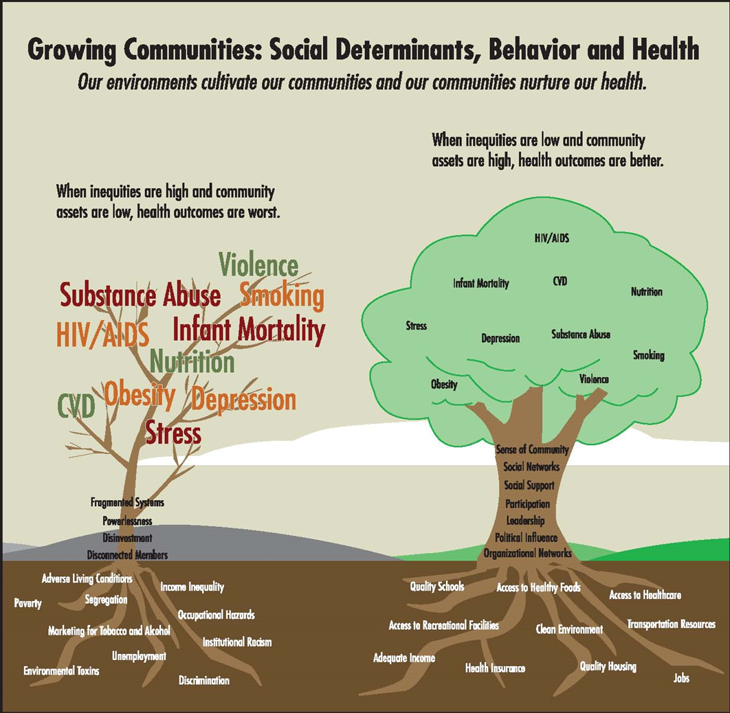
A Simple Graph of SDOH
Notes:
From: Social Determinants of Health:
The Basics
Gwendolyn A. Daniels, DNP, RN IPH Healthy Start Director, 2016
Additional Background materials
WHO Commission on SDOH
www.who.int/social_determinants/thecommission/en/index.html
Unnatural Causes documentary
www.unnaturalcauses.org/
NACCHO Health Equity and Social Justice Committee
www.naccho.org/topics/justice/mission.cfm
RWJ Commission on SDOH
www.rwjf.org/pr/product.jsp?id=41008
CDC Expert Panel on SDOH
www.healthyohioprogram.org/ASSETS/AF886060E94E4823A9338F7E68139947/hepanel.pdf
IOM Committee in SDOH
www.iom.edu/Activities/SelectPops/HealthDisparities.aspx
IOM Local Government Actions to Prevent Childhood Obesity Report
www.iom.edu/Reports/2009/ChildhoodObesityPreventionLocalGovernments.aspx
Healthy People 2020 Report
www.healthypeople.gov/hp2020/advisory/PhaseI/PhaseI.pdf
PolicyLink
http://www.policylink.org/site/c.lkIXLbMNJrE/b.6728307/k.58F8/Why_Place___Race_Matter.htm#

Slide 5
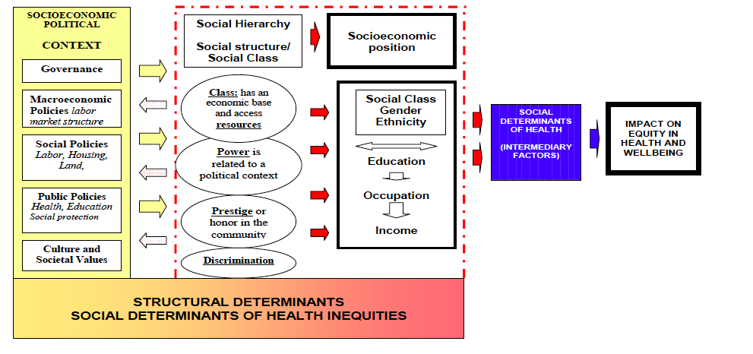
A More Complex Model of the Socioeconomic Political Context Influencing Equity, Health and Well-being
Source: World Health Organization Commission on Social Determinants of Health , 2007
Notes:
The above figure is taken from the A Conceptual Framework for Action on the Social Determinants of Health. Discussion paper for the Commission on the Social Determinants of Health, April 2007 written by the World Health Organization Commission on Social Determinants of Health.
Key Points to Highlight from the Figure:
structural determinants define social class divisions
social class divisions determine the distribution of power, prestige, and access to resources
the arrows between social divisions and the socioeconomic political context are bidirectional
the most important social stratifiers per the CSDH are income, education, occupation, social class, gender, race/ethnicity
this model explains the formation of social determinants of health inequities and the role of social determinants of health in that process
Ask the Audience
There is abundant evidence to demonstrate that lower incomes are associated with worse health outcomes.
Additionally, research from the Pew Research Center indicates that in 2017, women earned 82% of what men earned (See http://www.pewresearch.org/fact-tank/2018/04/09/gender-pay-gap-facts/). The Pew Research Center identifies several factors that contribute to this difference including educational attainment, work experience, occupational segregation, career interruptions, and discrimination (e.g. 25% of employed women reported earning less than a man doing the same job while 5% of men reported earning less than a woman doing the same job).
Thinking about this information, ask the audience:
What might be socioeconomic and political factors that are at work in this scenario?
How might the socioeconomic and political factors shape class, power, prestige, and discrimination?
How do class, power, prestige, and discrimination influence income, gender, occupation, and education?
Finally, how could this process shape social determinants of health and create inequities in health outcomes between men and women?

Slide 6
Major Contributions to Current Focus on Social Determinants of Health
Recognizing the salience of the social environment and conditions on health is not new. However, the term social determinants of health became popularized around the time the WHO established the Commission on the Social Determinants of Health in 2005. Below are some publications which made early contributions to moving the concept social determinants of health into professional and public awareness.
Black (1982): a report commissioned by British government revealing that poor health & mortality are unequally distributed across the population; report showed inequalities widened since creation of the National Health Service; inequalities largely due to factors such as income, education, housing, employment, diet
Mackenbach, Stronks, Kunst (1989): identified differences across socioeconomic groups in mortality due to conditions treatable by medical intervention; attributed differences at least partially lesser access, quality, and utilization of medical care
McGinnis and Foege (1993): objective to identify & quantify non-genetic causes of death; leading causes included tobacco, diet and physical activity, alcohol, microbial agents, toxic agents, firearms, sexual behavior, motor vehicles, and illicit drugs
Link and Phelan (1995): critiqued epidemiologic studies for attributing disease to individual (proximal) causes like diet and exercise while ignoring the context and social factors like socioeconomic status that are “fundamental causes”
Notes:
Ask the Audience
Are you surprised by any of the findings in the reports/articles listed? Why or why not?
Prior to these articles, the tendency was to discuss the causes of mortality and morbidity from a biomedical approach. How does attributing a death to lung cancer versus tobacco change the narrative regarding what caused the death?, who is responsible?, and what can be done to prevent further deaths from this causes?

Slide 7
Major Contributions to Current Focus on Social Determinants of Health
WHO Commission on Social Determinants of Health (2008): report reflecting global effort to identify health inequities due to social determinants and to make recommendations for ameliorating them
Jemal et al. (2008): assesses impact of education & race/ethnicity on mortality; finds that nearly half of all deaths among working-age adults are possibly preventable by addressing factors associated with low educational attainment
Stringhini et al. (2010): assess the extent to which health behaviors can explain differences in mortality across socioeconomic status; findings indicate that health behaviors account for significant portion of differences across socioeconomic status and that lower socioeconomic status individuals have a higher prevalence of unhealthy behaviors
Galea, Tracy, Hoggatt, Dimaggio, Karpati (2011): assessed the impact of social and societal determinants of health on mortality; quantify deaths attributable to low education, racial segregation, low social support, individual-level poverty, income inequality, and area-level poverty
Notes:
Ask the Audience
Jemal et al. (2008) found that nearly half of all deaths among working-age adults are possibly preventable by addressing factors associated with low educational attainment. Does this number seem higher or lower than what you expected? Why?
Stringhini et al. (2010) demonstrated that socioeconomic differences in mortality are largely attributable to differences in health behaviors. Why do you think individuals with lower socioeconomic status engage in less healthy behaviors than their higher socioeconomic status counterparts? How much choice do individuals have when selecting their diets and coping behaviors? What factors and/or actors influence these choices? Who do you think has greater capacity to “choose” their health behaviors, individuals with low socioeconomic status or individuals with high socioeconomic status? Why?

Slide 8
Theories of the Disease Distribution: Where do social determinants fit in?
Theories of disease distribution explain population distributions of disease and health across space and time (Krieger, 2011)
    Why are certain health outcomes more or less prevalent among populations? What causes the patterns of disease distribution?
Theory is not created in a vacuum; theories explaining the same process may differ drastically. To evaluate & compare theories of disease, consider the following:
  What is the level of the exposure and outcome? (e.g. individual, interpersonal, community, societal?)
  Who or what is being studied? (i.e. Who is the population?)
  What questions for study are generated by the theory?
  What data is collected and analyzed? What methods are used? Who is doing the studying?
See Krieger 2011 for further discussion of theories of disease distribution.

Slide 9

Theories of the Disease Distribution: Where do social determinants fit in?
Individual determinants
Social determinants
Societal determinants
Notes:
Theories of disease distribution range widely in their focus. Some theories focus on determinants, factors, or processes that are most proximal to the individual while others focus on determinants, factors, or processes that occur at the societal level.
Examples of theories focusing on individual determinants are the Biomedical Approach and the Lifestyle Approach. To explain disease and health, the Biomedical Approach focuses solely on biological or physiological elements influencing disease. For example, individuals that have tuberculosis in a population have the disease because they were exposed to the bacterium Mycobacterium tuberculosis and became infected. The Lifestyle Approach focuses on the health behaviors of the individual. For example, an individual is obese because s/he consumes more calories than s/he uses.
At the other end of the continuum, there are theories such as the Social Production of Disease and the Political Economy of Health that focus on societal determinants of disease and health. These theories suggest that patterns of disease and health are shaped or produced by the socioeconomic and political environments within which populations live. In this case, the distribution of tuberculosis in the population is determined by policies related to screening and treatment of tuberculosis, funding allocated to educate and treat the population, resources allocated to prevent the spread of the disease including food provisions since malnutrition is a risk factor for tuberculosis, and attention to the built environment which contributes to the spread of the disease.
In the middle of this continuum, there are social determinants of health. In the case of tuberculosis, this might include risk factors such as housing crowding, food insecurity, low socioeconomic status, and lack of access to health care. These factors are the “causes of the causes” (Krieger, 2011, pg. 185); that is, they explain the individual determinants which explain the distribution of tuberculosis. For example, individuals with low income and food insecurity consume less calories and less nutritious food which increases their risk of tuberculosis infection when exposed to the bacterium. This is different from the societal determinants which explain the “causes of the causes of the causes” (Krieger, 2011, pg. 185). Societal determinants explain the social determinants which explain the individual determinants.
Social determinants are well situated in the middle of this figure; however, biological factors across the life course are sometimes included in social determinants of health. Additionally, social determinants sometimes enters the realm of societal determinants. Yet, a critique of the social determinants of health concept is that it minimally considers the underlying socioeconomic and political context which shape the distribution of social determinants and subsequently health (Krieger, 2011).
Of course, as we saw from the WHO Commission on Social Determinants of Health framework presented earlier, the terminology is sometimes used interchangeably. Consequently, a common theme of this presentation will be to emphasis the need to be explicit and clear when using jargon.

Slide 10
Health Inequalities versus
Health Inequities
Health inequalities: differences in the distribution of a health outcome
Health inequities are differences in the distribution of a health outcome that are “unfair,” “socially-produced,” and “systematic” (Dahlgren & Whitehead, 2006)
Thus, not all health inequalities are inequities. Daniels (2015) argues that even if health inequalities are unavoidable, society still has an obligation to treat that condition.
The term health disparity is used frequently to describe health inequities. However, the word disparity simply means a “large difference.” Therefore, it is best to be explicit about the intended meaning of health disparity when using this term.
Notes:
Ask the Audience
In the examples below, ask the audience to state whether the following differences are health inequalities or health inequities and to explain their choice.
Cigarette smokers are more likely to die from lung cancer than non-smokers. Is this an inequity or merely an inequality? (Answer: This example is intentionally tricky. Cigarette smokers have an increased risk of lung cancer death due to their exposure to cigarette smoke and their smoking behavior. However, the question is why do cigarette smokers smoke? Are some individuals more likely to smoke cigarettes? If so, why? Consider the following epidemiologic findings from the CDC (https://www.cdc.gov/tobacco/disparities/index.htm):
Native Americans are more likely to smoke cigarettes than another other racial/ethnic group.
LGBT individuals are more likely to smoke than heterosexual individuals.
Individuals with a mental illness are more likely to smoke than those without a mental illness.
Individuals living in the West are less likely to smoke than any other part of the U.S..
Individuals with low socioeconomic status are more likely to smoke than their higher socioeconomic status counterparts.
Why do you think the above differences exist? What additional information would you need to know in order to determine if the differences are inequalities or inequities?
Men are more likely to have prostate cancer than women. Is this an inequity or merely an inequality? (Answer: This example is intentionally absurd. This is of course an inequality since only men have prostates, and therefore, women are not at risk of prostate cancer.)
White Americans of Northern European descent are more likely to have cystic fibrosis than non-white Americans. Is this an inequity or merely an inequality? (Hint: Cystic fibrosis is caused by a mutation in a gene). (Answer: Because cystic fibrosis is a genetically inherited condition differences in the presentation of the disease between genetic carriers and non-genetic carriers are not avoidable. While cystic fibrosis occurs in all races, it is most common among white individuals of Northern European descent. Consequently, this is a health inequality).
Individuals from lower income households are less likely to have access to safe outdoor spaces for recreation. Is this an inequity or merely an inequality? (Answer: This is an inequity. Income influences where an individual lives, works, and plays. Lower income neighborhoods may be less likely to have safe, outdoor green/recreational space and individuals with low incomes have less capacity to access recreational spaces not in their neighborhood.)
See Braveman (2014) for a discussion on the importance of being explicit regarding health inequalities and health inequities.

Slide 11
Comparison of Definitions
Health Disparities | Health Inequities | Health Equity | SDOH
Differences in the incidence and prevalence of health conditions and health status between groups based on: Race/ethnicity Socioeconomic status Sexual orientation Gender Disability status Geographic location Combination of these | Systematic and unjust distribution of social, economic, and environmental conditions needed for health. Unequal access to quality education, healthcare, housing, transportation, other resources (e.g., grocery stores, car seats) Unequal employment opportunities and pay/income Discrimination based upon social status/other factors | The opportunity for everyone to attain his or her full health potential. No one is disadvantaged from achieving this potential because of his or her social position or other socially determined circumstance. Equal access to quality education, healthcare, housing, transportation, other resources Equitable pay/income Equal opportunity for employment Absence of discrimination based upon social status/other factors | Life-enhancing resources whose distribution across populations effectively determines length and quality of life. Food supply Housing Economic relationships Social relationships Transportation Education Health Care
Notes:
From: Social Determinants of Health:
The Basics
Gwendolyn A. Daniels, DNP, RN IPH Healthy Start Director, 2016

Slide 12
Understanding Disparities:
Relative versus Absolute Differences
How are the groups or observations different?
Consider the quotation from the Boston Globe:
"Massachusetts experienced a 35 percent increase in suicides from 1999 to 2016, but its suicide rate remains comparatively low: 10 per 100,000 people in 2014-2016, compared with 15.4 per 100,000 for the nation as a whole.” (Freyer, 2018)
Relative Difference: “Massachusetts experienced a 35 percent increase in suicides from 1999 to 2016” This difference reports the 2016 suicide rate relative to the 1999 suicide rate.
Absolute Difference: “[The Massachusetts] suicide rate remains comparatively low: 10 per 100,000 people in 2014-2016, compared with 15.4 per 100,000 for the nation as a whole.” There was an absolute difference of 5.4 people per 100,000 between the United States and Massachusetts. 5.4 fewer people per 100,000 committed suicide in Massachusetts from 2014-2016 as compared to the nation at large.
Notes:
When presented with a difference between two groups or between the same group at two different time points, the first thing to do is to ask, “How are these groups/observations different?”
Ask the Audience
Would you rather know the relative difference or the absolute difference when evaluating a health disparity? Why?
(Answer: Usually, it’s helpful to know both the relative and the absolute difference. These differences convey different information and may yield different conclusions. Thus, it is better to take the information together.)

Slide 13
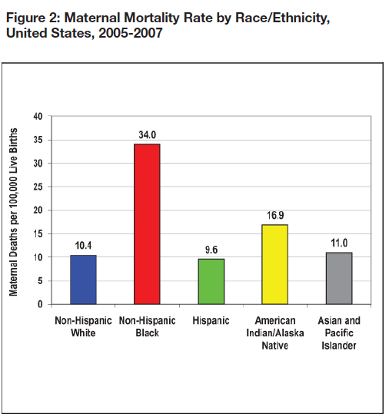
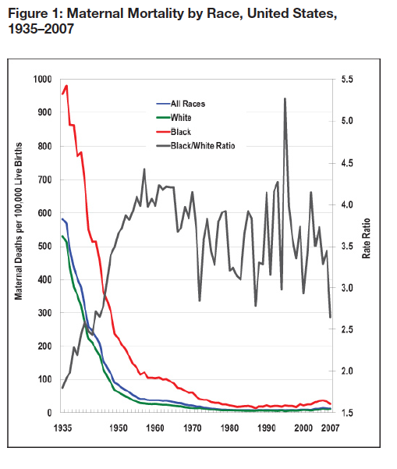
Relative versus Absolute Differences
Source: Singh, G. K. (2010). Maternal mortality in the United States, 1935-2007: Substantial racial/ethnic, socioeconomic, and geographic disparities persist. US Department of Health and Human Services, Health Resources and Services Administration.
Notes:
In Figure 2, we compare the U.S. maternal mortality rate by race/ethnicity from 2005-2007. On the y-axis we have the number of maternal deaths per 100,000 live births. On the x-axis we have racial/ethnic groups.
Ask the Audience
Does Figure 2 display an absolute or a relative difference? (Answer: Absolute. It’s possible to calculate relative differences using the numbers provided on the graph, but the display depicts absolute differences.)
Were there racial/ethnic differences in maternal mortality rates during this period? Please describe. (Answer: Yes. Non-Hispanic blacks experienced more maternal deaths than any other racial group. There were 23.6 more maternal deaths during this period among non-Hispanic black mothers than non-Hispanic white mothers. Hispanics had the lowest maternal mortality rate.)
*****************
In Figure 1, we compare the U.S. maternal mortality rate by race from 1935 to 2007. This graph displays two y-axes. On the y-axis on the left we have the number of maternal deaths per 100,000 live births. On the y-axis on the right we have the rate ratio (a ratio of one maternal death rate to another maternal death rate). On the x-axis we have time in years, and the lines are color coded to depict the corresponding racial group(s).
Ask the Audience
Does Figure 1 display an absolute or a relative difference? Please explain. (Answer: Both. Using the left-hand y-axis, we see absolute differences between whites, blacks, and all races. For example, blacks had ~420 more maternal deaths per 100,000 lives births in 1935 than whites [risk difference = ~950/100,000 – ~430/100,000 = 420/100,000]. Using the right-hand y-axis, we see relative differences between blacks and whites. In 1960, blacks had ~4.3 times the rate of maternal death as compared to blacks [rate ratio = (~105/100,000)/(~25/100,000) = 4.2].
Using just the information from the left-hand y-axis, please describe the trends across the racial groups from 1935-2007. Based on this information alone, would you say that maternal mortality rate have improved over time for whites and blacks in the U.S. Why or why not?
Using just the information from the right-hand y-axis, please describe the trends across the racial groups from 1935-2007. Based on this information alone, would you say that maternal mortality rate have improved over time for whites and blacks in the U.S. Why or why not?
Using all of the information in the graph, please describe the trends across the racial groups from 1935-2007. Based on this information alone, would you say that maternal mortality rate have improved over time for whites and blacks in the U.S. Why or why not?

Slide 14
Mechanisms: How Do Social Determinants Lead to Health Inequities?
Various Models
Notes:
The proposed mechanisms of the social determinants of health inequities come from the 2007 WHO Commission on Social Determinants of Health paper “A Conceptual Framework for Action on the Social Determinants of Health: Discussion paper for the Commission on Social Determinants of Health.”

Slide 15
Social Selection: Does Health Determines Socioeconomic Status?
Premise of the Social Selection perspective:
health influences attainment of socioeconomic status
poor health leads to lower socioeconomic status
excellent health enables social mobility
Evidence for the perspective:
evidence for Social Selection is mixed
one argument suggested that as individuals move upward in social position, their health is worse than the class they are joining while downwardly moving individuals have better health than the class they join. Thus, health disparities would narrow.
Source: World Health Organization Commission on Social Determinants of Health, 2007
Notes:
Additional considerations:
Does poor health directly determine socioeconomic status or does poor health indirectly influence socioeconomic status through determinants of health?
Does the impact of health on socioeconomic status vary across the life span? Is it more important when individuals are entering the labor force or finishing their education?
When considering the impact of health on social mobility, does this refer to inter-generational mobility, intra-generation mobility, or both?
Conclusion: There is evidence to suggest that health can impact socioeconomic attainment as well as social mobility. For example, consider an individual who is unable to work due to a health condition and/or accrues massive debt due to out-of-pocket medical expenses. However, the debate is whether there is sufficient evidence to suggest that social selection is the predominant explanation for health inequities.

Slide 16
Social Causation: Social Status Determines Health
Socioeconomic status
Intermediary variables
Health
Premise: Health inequities are due to unequal distribution of intermediary variables across socioeconomic classes.
Examples of intermediary variables include health behaviors, housing, working conditions, environmental exposures, the health care system, and stress.
Evidence from longitudinal studies in which socioeconomic status is measured before health problems shows that individuals of lower socioeconomic status are at great risk of developing health problems.
Source: World Health Organization Commission on Social Determinants of Health, 2007
Notes:
What is meant by the phrase “unequal distribution of intermediary variables across socioeconomic classes?”
For instance, exposure to air pollution is a risk factor for asthma. Individuals with lower socioeconomic status may have greater exposure to air pollution than their higher socioeconomic status counterparts due to where they live and work (e.g. poor neighborhoods may be closer to highways and contain more factories). Thus, low socioeconomic status increases the risk of asthma through increased exposure to air pollution.

Slide 17
Lifecourse Perspective: SDOH have an impact across the Life Span
Premise: the timing of exposure to risk factors and protective factors for health outcomes across the life course is key to understanding health
Health inequities are explained by socially patterned exposures across the life course for different socioeconomic classes
Different possible pathways of exposure
  Sensitive period model
  Accumulation model
  Social trajectory model
Source: World Health Organization Commission on Social Determinants of Health, 2007
Notes:
Health inequities are explained by socially patterned exposures across the life course for different socioeconomic classes.
For example, individuals with low socioeconomic status may be more likely to be exposed to risk factors for negative health outcomes in early life and/or later life compared to higher socioeconomic status individuals.

Slide 18
Strategies for Addressing SDOH and Reducing Health Inequities
Notes:
The following strategies are based on recommendations from the following sources:
Adler, N. E., Glymour, M. M., & Fielding, J. (2016). Addressing social determinants of health and health inequalities. Jama, 316(16), 1641-1642.
Marmot, M., Friel, S., Bell, R., Houweling, T. A., Taylor, S., & Commission on Social Determinants of Health. (2008). Closing the gap in a generation: health equity through action on the social determinants of health. The lancet, 372(9650), 1661-1669.

Slide 19
Actions Recommended by World Health Organization Commission on SDOH
Improve daily living conditions
Tackle inequitable distribution of power, money, and resources
Measure and understand the health/social problems and assess the results of actions to improve them
In the next slides, multiple strategies for improving US SDOH are suggested.
Notes:
Improve daily living conditions
Invest in early childhood to increase survival; improve nutrition; promote social-emotional, language, and cognitive development
Offer high-quality, universal, preschool, primary, and secondary education for all children regardless of ability to pay
Engage in urban planning and build environment solutions to ensure access to clean water and air, sufficient housing, electricity, and sanitation particularly as populations migrate to urban centers
Safe working conditions and employment that provides a livable wage
Universal social protection systems
Universal health care
Tackle the inequitable distribution of power, money, and resources
Coherence across policies not just in the realm of health (e.g. in the area of transportation, aim for safe transportation; e.g. use of seatbelts in cars) that minimizes exposure to pollution (e.g. emissions) and is accessible for the entire population (e.g. ensuring public transportation does not stop before reaching lower-income neighborhoods)
Fair taxation and financing as well as increasing aid to develop public infrastructure for economic growth
Market responsibility – public leadership to ensure that resources are protected and the environmental conditions (e.g. air quality, product availability, etc.) are regulated to ensure that markets do not lead to negative impacts on health
Gender equity – (e.g. making gender discrimination illegal, programs to support women’s economic participation, increasing sexual and reproductive services, creating commissions for gender equity)
Political empowerment – ensuring inclusion and participation in decision-making at all levels
Good global governance – making health equity a global development goal
Measure and understand the problem and assess the results of action
Gather data on health inequities and conduct research to identify causes as well as effective solutions
Train workforce to understand and address social determinants of health
Routine monitoring of social determinants of health to inform policy agendas
Engagement of politicians to understand and address social determinants of health

Slide 20
Addressing SDOH: More Than an Uber Ride?
“Hospitals and health care systems have started to address these social determinants of health through initiatives that buy food, offer temporary housing, or cover transportation costs for high-risk patients. The prevalence and initial success of these efforts are clear…But when you take a closer look, these…aren’t about improving underlying social & economic conditions in communities to foster improved health for all – they’re about mediating patients’ individual social needs.
If this is what addressing the social determinants of health has come to mean, not only has the definition changed, but it has changed in ways that may impede efforts to address those conditions that impact the overall health of our country.” (Castrucci & Auerbach, 2019)
Notes:
Theories of disease distribution range widely in their focus. Some theories focus on determinants, factors, or processes that are most proximal to the individual while others focus on determinants, factors, or processes that occur at the societal level.
Examples of theories focusing on individual determinants are the Biomedical Approach and the Lifestyle Approach. To explain disease and health, the Biomedical Approach focuses solely on biological or physiological elements influencing disease. For example, individuals that have tuberculosis in a population have the disease because they were exposed to the bacterium Mycobacterium tuberculosis and became infected. The Lifestyle Approach focuses on the health behaviors of the individual. For example, an individual is obese because s/he consumes more calories than s/he uses.
At the other end of the continuum, there are theories such as the Social Production of Disease and the Political Economy of Health that focus on societal determinants of disease and health. These theories suggest that patterns of disease and health are shaped or produced by the socioeconomic and political environments within which populations live. In this case, the distribution of tuberculosis in the population is determined by policies related to screening and treatment of tuberculosis, funding allocated to educate and treat the population, resources allocated to prevent the spread of the disease including food provisions since malnutrition is a risk factor for tuberculosis, and attention to the built environment which contributes to the spread of the disease.
In the middle of this continuum, there are social determinants of health. In the case of tuberculosis, this might include risk factors such as housing crowding, food insecurity, low socioeconomic status, and lack of access to health care. These factors are the “causes of the causes” (Krieger, 2011, pg. 185); that is, they explain the individual determinants which explain the distribution of tuberculosis. For example, individuals with low income and food insecurity consume less calories and less nutritious food which increases their risk of tuberculosis infection when exposed to the bacterium. This is different from the societal determinants which explain the “causes of the causes of the causes” (Krieger, 2011, pg. 185). Societal determinants explain the social determinants which explain the individual determinants.
Social determinants are well situated in the middle of this figure; however, biological factors across the life course are sometimes included in social determinants of health. Additionally, social determinants sometimes enters the realm of societal determinants. Yet, a critique of the social determinants of health concept is that it minimally considers the underlying socioeconomic and political context which shape the distribution of social determinants and subsequently health (Krieger, 2011).
Of course, as we saw from the WHO Commission on Social Determinants of Health framework presented earlier, the terminology is sometimes used interchangeably. Consequently, a common theme of this presentation will be to emphasis the need to be explicit and clear when using jargon.

Slide 21
Strategies: Expand health/social welfare programs that are known to improve health
Earned Income Tax Credit (Improves overall health)
  Improve/expand enrollment: ~20% of eligible workers are NOT enrolled
  Increase benefits: increase benefits for participants currently receiving low benefits (e.g. non-custodial parents, childless workers)
Supplemental Nutrition Assistance Program (Improves diet)
  Improve/expand enrollment: ~17% of eligible households are NOT enrolled
  Expand benefits: adjust eligibility parameters to increase coverage
Women, Infants, and Children (Improves birth outcomes)
  Improve enrollment: ~47% of eligible women and children are NOT enrolled
Source: Alder, Glymour, Fielding; 2016
Notes:
Earned Income Tax Credit
Provides income benefits via tax returns to ~30 million low-moderate income working families
Health benefits: improved birth outcomes, adult physical health, adult mental health
Improve enrollment: ~20% of workers are eligible but not enrolled, increasing enrollment could improve health
Increase benefits: Increasing benefits for childless workers and non-custodial parents increases employment and child support payments
Supplemental Nutrition Assistance Program (SNAP)
Provides ~45 million households with assistance to purchase healthy foods such as breads, fruits and vegetables, cereals, meats, fish and poultry, and dairy products as well as seeds and plants to grow food for the family
Health benefits: improved dietary intake for enrolled children
Improve enrollment: ~17% of eligible households but not enrolled, increasing enrollment could improve health
Expand benefits: eligibility varies by state and may factor in household size, citizenship/legal status, household income, and household expenses; when Massachusetts temporarily expanded SNAP benefits, there was a reduction in inpatient Medicaid expenditures which suggests that expanding benefits can improve health
Women, Infants, and Children
Targets pregnant and postpartum mothers of children aged 0-5 years; provides food vouchers, breastfeeding counseling, nutritional education, and resource referral; in 2017 served 7.3 million women and children (Source: USDA. Women, Infants, and Children. Available at: https://www.fns.usda.gov/wic/frequently-asked-questions-about-wic#3)
Health benefits: better birth outcomes, higher child immunization rates
Improve enrollment: in 2015, ~52.7% of eligible women and children nationwide were not enrolled in WIC; the participation rate varies by state – CA had the highest enrollment at 65% while Utah had the lowest enrollment at 37.1% (Source: USDA. Food and Nutrition Services. WIC 2015 Eligibility and Coverage Rates. Available at: https://www.fns.usda.gov/wic/wic-2015-eligibility-and-coverage-rates#Chart2)

Slide 22
Strategies: Expand policies known to promote and facilitate healthy behaviors
Lower permissible nicotine levels in cigarettes via FDA regulation to enable smoking cessation
Promote firearm safety and reduce intentional and unintentional firearm injury (Hemenway; 2017)
Expand poverty reduction through policies to increase minimum wage, which are associated with improved health
Build green areas in communities
Source: Alder, Glymour, Fielding; 2016
Notes:
Bullet #1: Individuals with lower income and less education are more likely to smoke cigarettes. However,
reduced-nicotine cigarettes are linked to fewer cigarettes smoked as well as reduced dependency so may help people quit.
Bullet 2: Vulnerable populations of firearm injury and death: children, adolescents, women, and African Americans
Policy aimed at preventing and treating mental illness could reduce suicide by all methods
Policy to reduce alcohol and drug use could reduce un/intentional injury
Policy to improve firearm safety (e.g. gun will not fire when dropped)
Licensing and registration policies to reduce criminal access

Slide 23
Strategies: Adopt Health Care Financing Schemes that Promote Health
Payment Models for Healthcare (Adler et al., 2016)
Fee-for-service
  Status quo
Pay-for-performance
  Associated with increased care quality
Bundled or global payments
  Associated with quality improvement and cost savings
Source: Alder, Glymour, Fielding; 2016
Notes:
Payment Models for Healthcare
How do health insurance companies determine how much they will pay medical providers or health care organizations for the services and care they provide?
The answer is complex and multifaceted. Here we will discuss a few different payment models and describe how these models influence provider behavior and ultimately patient care.
Fee-for-service: this is the typical payment scheme for health services; providers or health care organizations are paid for the services they provide; reimbursement is influenced by the volume of service provided as well as the type of service provided
Ask the audience: How do you think this scheme would influence provider behavior? On average, would providers provide more services or less services? More expensive treatment options or less expensive treatment options? (Answer: On average we would expect providers to provide more services and more expensive treatment options, since they are incentivized by money to do so.) Thinking about reducing health disparities, why might the fee-for-service scheme be problematic? (Answer: This model is designed to incentivize more services and more expensive services, but not patient outcomes. Patients may receive services that they do not need. Additionally, services associated with higher reimbursement might be prioritized over services associated with lower reimbursement despite the impact on patient outcomes. Finally, unless preventive interventions are covered and reimbursed at competitive rates, providers are incentivized to wait and treat rather than intervene early to prevent.)
Pay-for-performance: in this alternative payment scheme, payments are influenced by patient outcomes, particularly rates of avoidable adverse outcomes such as readmission to the hospital after discharge or excessive use of the emergency room department by individual patients
Bundled or global payments: in this alternative payment scheme, providers or health care organizations receive fixed amounts of money for each patient treated or for treatment of a particular condition and adjustments are made based on severity and diagnosis
Ask the audience: How might the alternative payment models, pay-for-performance and bundled or global payments, address health disparities? (Answer: When patient outcomes and population health are the metric, providers are incentivized to prevent illness (or worsening severity) and promote health. Thus, while the outcomes of all individuals might be expected to improve, individuals more likely to experience negative outcomes due to social or other factors are most likely to benefit. Consequently, disparities are reduced.)

Slide 24
Strategies: Increase Health Access and Improve Coverage
Some progress has been made through the Patient Protection and Affordable Care Act of 2010 (ACA). Going forward:
  Get more states to opt in
  Expand minimum coverage to include oral health, vision services, and preventive care can improve health
  Stabilize the marketplace, lower premiums and deductibles
  Ensure all are covered through more expansive mechanisms: e.g. Medicare for All
Source: Alder, Glymour, Fielding; 2016
Notes:
Health insurance exchanges and Medicaid expansion increased coverage (although some states opted out of Medicaid expansion)
Expanded evidence-based home visiting programs for vulnerable families
Health care plans have greater ability to cover nontraditional services (e.g. in-home prenatal visits) and clinical coordinating with social service and community agencies (Machledt, 2017)

Slide 25
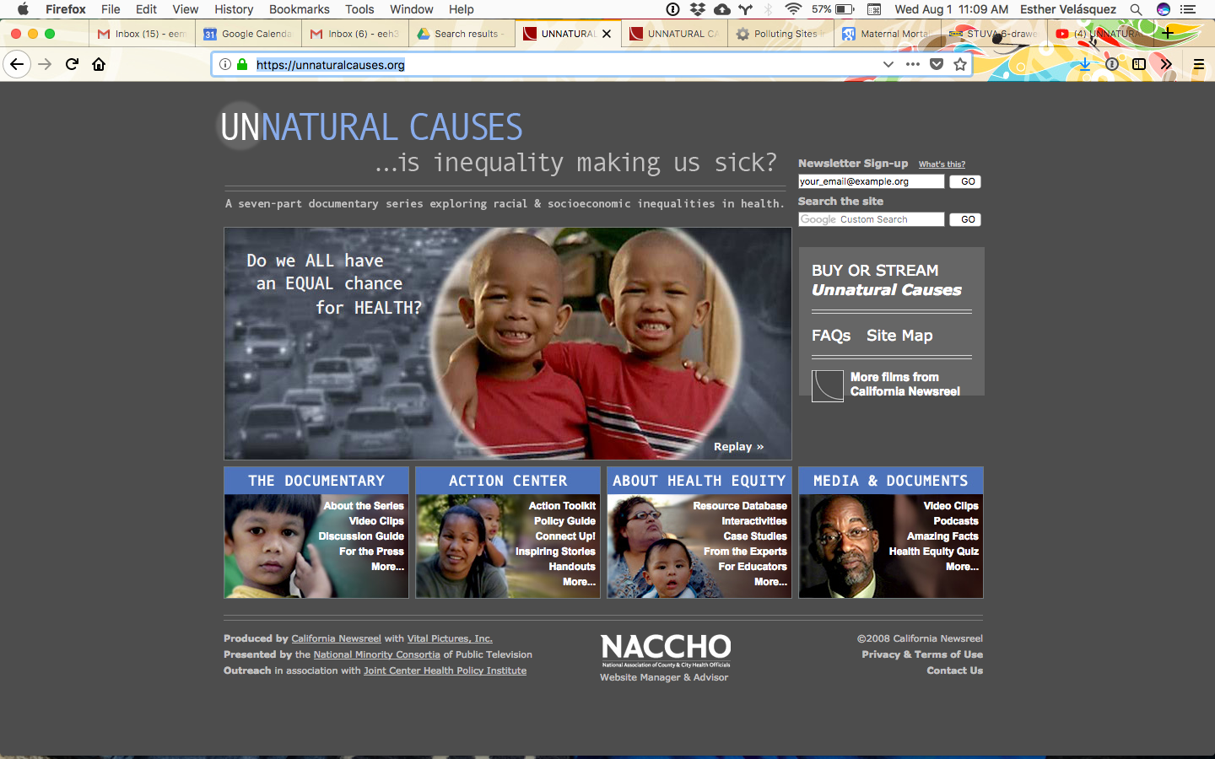
Exploring the Social Determinants of Health and Health Inequities
Notes:
There are many ways to explore the social determinants of health. The 2008 documentary “Unnatural Causes…is inequality making us sick?” is an educational resource that discusses health inequalities and the causes of these inequalities. If the video is not available to you through an institutional or public library, you can watch many clips on the website: https://unnaturalcauses.org/
Ask the Audience
Play the trailer of the video for the audience. Then ask them the following discussion questions.
In the video, social epidemiologist Nancy Krieger stated, “We carry our history in our bodies.” What do you think she meant by this?
The trailer states that nearly half of all health dollars spent in the world are spent in the United States and yet, we are not the healthiest country in the world. In fact, in 2008, the life expectancy in the U.S. was ranked 30th, and our ranking has fallen further in the last decade.
What evidence is there that genetics cannot entirely explain health outcomes?
Is the poorer American health entirely attributable to the large numbers of Americans without health insurance? Why or why not?
Is the poorer American health entirely attributable to health behaviors like eating patterns?
How do social determinants of health shape the lives of Americans?
Is the video suggesting that genetics, health behavior, health insurance, or health care don’t matter for health?
Extend the Activity
The website also provides extensive educational and teaching resources including discussion guides to accompany the video and video clips, toolkits for taking action to address social determinants of health, articles discussing particular health outcomes and social determinants, podcasts, case studies, interactive activities, and lesson plans for educators using case studies to name a few of the key resources.
Suggestion: Before showing the “Unnatural Causes” trailer administer the Health Equity Quiz as a way to assess the audience’s existing knowledge and perceptions as well as a way to engage them in a discussion of health inequities and their causes. The quiz is available as a pdf, online interactive activity, or as a downloadable PowerPoint presentation from the website: https://unnaturalcauses.org/interactivities.php

Slide 26
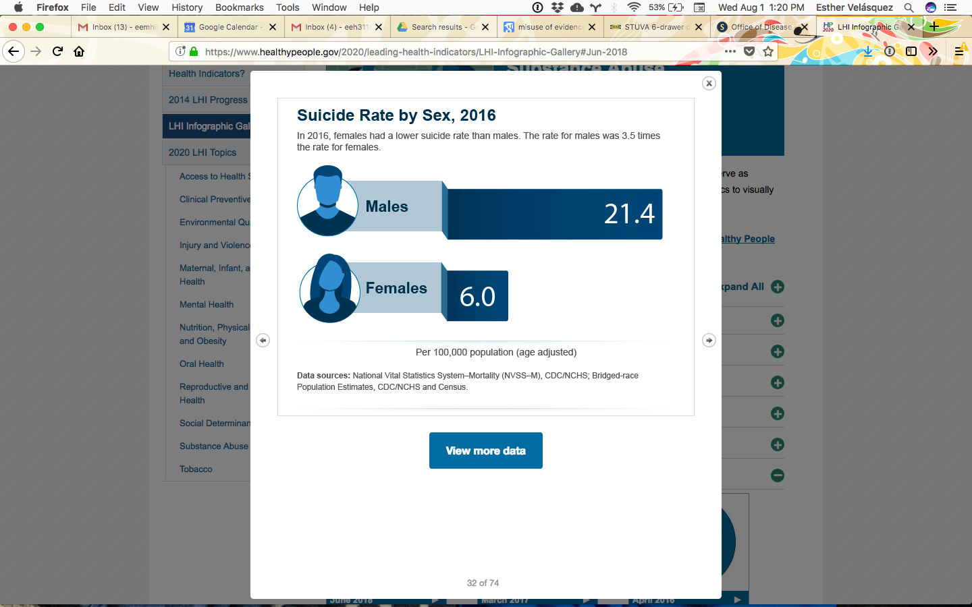
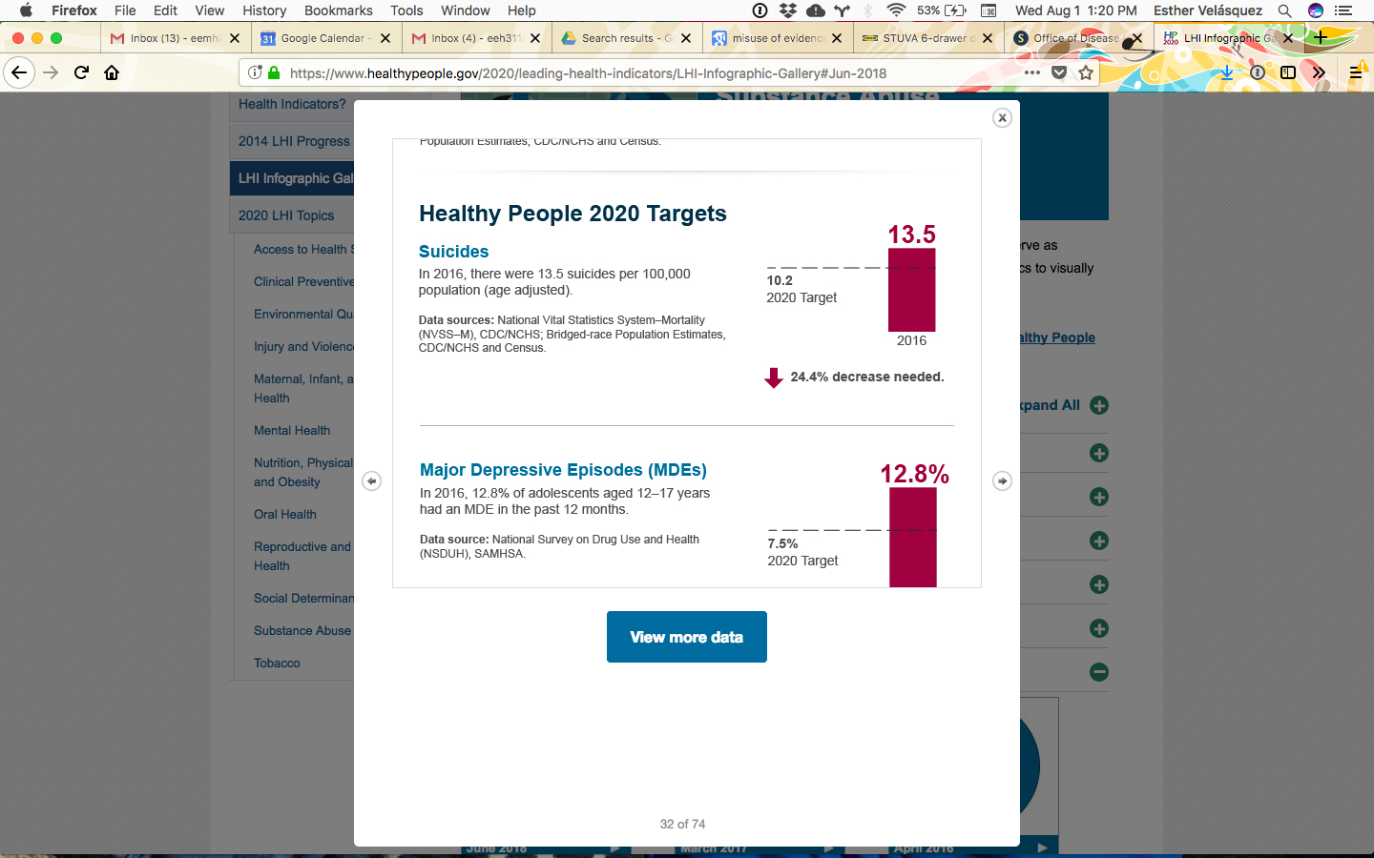

Healthy People 2020: Assessing Progress on Suicide
Health disparities exist for suicide use by the following indicators:
Geographic region
Race/ethnicity
Sex
Marital status
Country of birth
Age group
Notes:
Another resource is the Healthy People initiative. Healthy People is a federal government initiative that creates 10-year objectives to improve the health of Americans. Healthy People 2020 outlines benchmarks that the nation hopes to reach by the year 2020. Let’s take a look at our progress thus far.
In the figure above, we see one of the Healthy People 2020 objectives: MHMD-1 Reduce the suicide rate
At the 2007 baseline, there were 11.3 suicides per 100,000 population (age adjusted to the year 2000 standard population). The target is 10.2 suicides per 100,000 population by 2020 which represents a 10% improvement. (Data Sources: National Vital Statistics System-Mortality (NVSS-M), CDC/NCHS; Bridged-race Population Estimates, CDC/NCHS and Census). In 2016, there were 13.5 suicides per 100,000 population. This is an increase from the baseline, and a 24.4% decrease is needed by 2020 in order to reach the goal.
We observe health inequities or disparities in suicides by the following social determinants: sex, race/ethnicity, age group, geographic region, marital status, and country of birth.
Sex: In 2016, the suicide rate for males was 3.5 times the rate for females.
Race/ethnicity: Whites have the highest suicide rate (17 per 100,000) followed by American Indians/Alaskan Natives at 13.5 per 100,000. Asian/Pacific Islanders and Hispanic/Latinos both had rates of 6.7 per 100,000 while Blacks/African Americans had the lowest rate at 6.3 per 100,000.
Age group: Middle age adults (45-64yr) have the highest suicide rates (19.2 per 100,000) followed by older adults (65yr+; 16.7 per 100,000), and young adults (18-44yr; 16.4 per 100,000). Individuals less than 18 years of age have the lowest rates (2.1 per 100,000).
Geographic region: Suicide rates in non-metropolitan areas are higher (18 per 100,000) as compared to metropolitan areas (12.7 per 100,000).
Marital status: Suicide rates are highest among divorced individuals (33.1 per 100,000) and lowest among married individuals (11.7 per 100,000). Suicide rates for widowed and never married individuals are 32.5 and 23.5 per 100,000 respectively.
Country of birth: Suicide rates are higher among individuals born in the U.S. (14.6 per 100,000) as compared to individuals born outside the U.S. (6.9 per 100,000).
Ask the Audience
We cannot modify the social characteristics discussed in this slide, so what can we do to address these disparities? How would you use the information on the suicide rate disparities to create interventions designed to prevent suicides?
** For additional information, graphs, and interactive activities, visit the Healthy People website: https://www.healthypeople.gov/

Slide 27
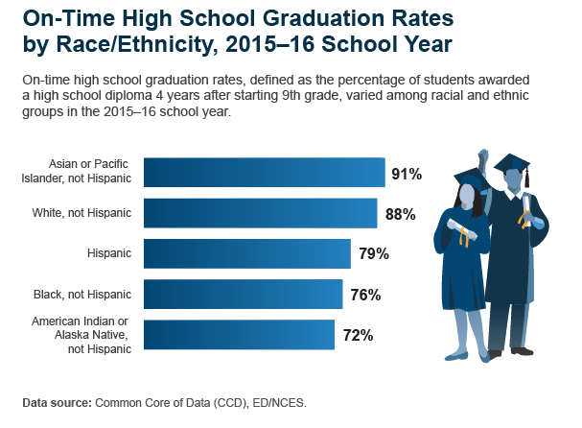

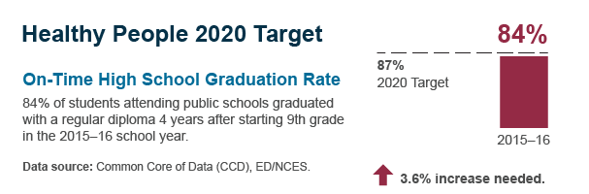
HP2020: Assessing Progress on Education
Notes:
In the figure above, we see another one of the Healthy People 2020 objectives: AH-5.1 Increase the proportion of students who graduate with a regular diploma 4 years after starting 9th grade LHI
In the 2010-2011 academic year 79% of students attending public schools graduated with a regular diploma in 4 years after starting 9th grade. The target is that 87% of students will graduate within 4 years by 2020. This represents a 10% improvement in 4-year graduation rates. (Data Sources: Common Core of Data (CCD), ED/NCES)
In the 2015-2016 academic school year, the on-time high school graduation rate was 84%. While this is an improvement from the baseline, an additional 3.6% increase is needed to reach the 2020 objective.
Ask the Audience
Reviewing the on-time high school graduation rates by race/ethnicity, describe the disparities you observe in the figure.
What additional information would you want to know in order to select or design strategies that could be used to reduce racial/ethnic disparities and reach the 2020 target?
What do you suppose are the most proximal factors preventing on-time graduation? (e.g. absenteeism, low test scores, etc.)
Why might these factors vary by race/ethnicity?

Slide 28
Enhancing Social Work on SDOH

Slide 29
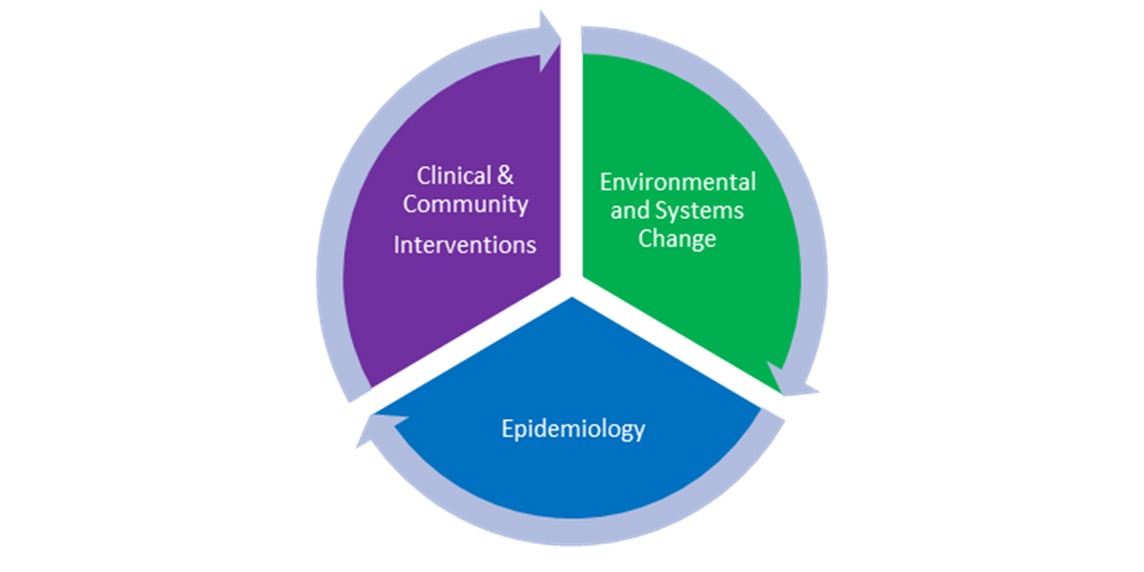
Social Work’s Deep History in Addressing SDOH
Social workers have labored to address social conditions that lead to poor health outcomes since beginning, but over time, field has trended toward clinical/medical model, and individual interventions
The Public Health Social Work model, with its emphasis on community and clinical interventions, epidemiology, and systems/structural change, redirects profession and reflects WHO’s recommendations for educating practitioners who can address SDOH (slide 31)

Slide 30
Increasing Social Work’s Impact on SDOH
Ways for social work to increase its impact on SDOH:
Investigate root causes of issues SW addresses
Become familiar with terminology, literature, and ongoing controversies on how best to address SDOH
Collaborate across professions & sectors to address unmet social needs and to build capacity for structural change
Intentionally focus on “widening the lens” of practice to include more advocacy, prevention, & focus on changing social conditions
Use Social Work Health Impact Model to strengthen education and professional development

Slide 31
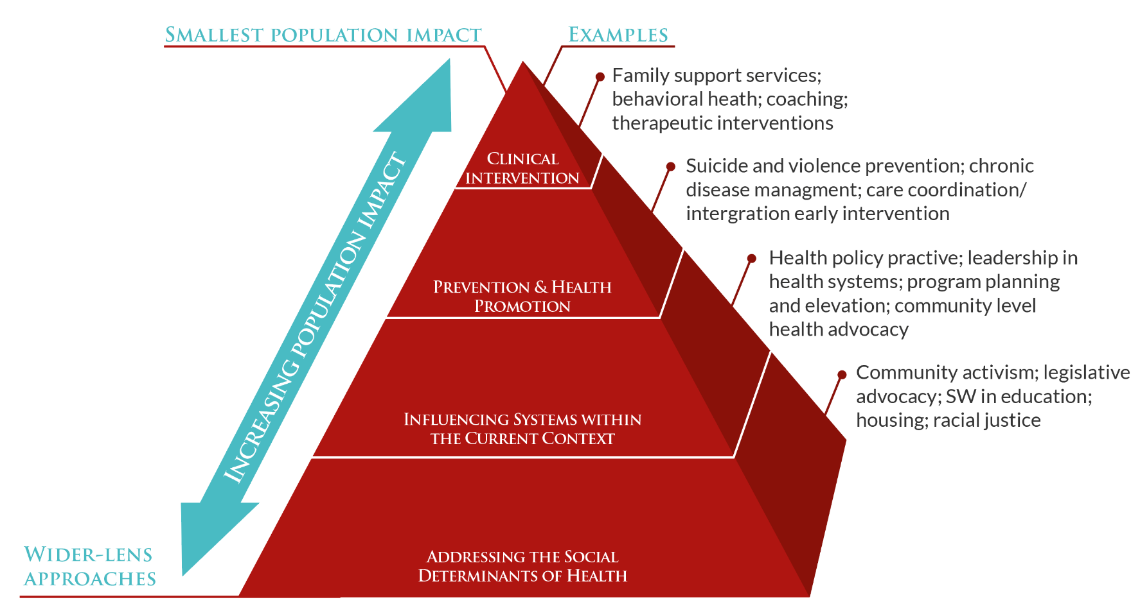
Social Work Health Impact Model
(Ruth, Wachman & Schultz, 2014)
Notes:
The Social Work Health Impact Model illustrates the different ways in which public health social workers are involved in efforts to impact health and social well-being and how they can increase their impact by focusing on the bottom of the pyramid. As the pyramid rises to a point, the lens of the approach narrows from populations to individuals and consequently the impact of the work narrows from populations to individuals.
Each level of this pyramid is an essential and valuable function of public health social work. Consequently, it is essential that the field is intervening at each of these levels. Unfortunately, most social workers are primarily educated at “tip” of the pyramid and acquire limiting abilities from their education and practice to work/collaborate/lead at other levels. Public health social work aims to engage social workers at all levels and work within and across levels with other health and non-health professionals to improve health and well-being.
Ask the Audience
Self-reflection exercise: Ask the audience to think about which of the level(s) encompasses the work that they do. Do they interact with individuals, organizations, or institutions that are working at different levels? What would need to happen in order for them to increase their interaction with individuals, organizations, or institutions working at different levels? What additional knowledge or experience would they need to gain to achieve competence in the other levels ? How would they go about obtaining this competence?

Slide 32
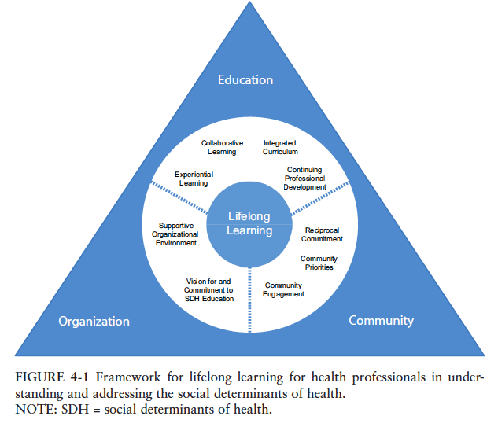
A General Framework for Educating Health Professionals
Source: National Academies of Sciences, Engineering, and Medicine; 2016
Notes:
This figure comes from “A Framework for Educating Health Professionals to Address the Social Determinants of Health,” a 2016 publication that was authored by various professional organizations and national academies. The figure describes how health professionals can engage in learning throughout their education and careers that promotes the understanding of social determinants of health as well as creates opportunities for health professionals to address social determinants of health.
Below are the components of each domain as listed by the publication. See the full publication for additional detail.
Education
Experiential learning: applied learning (includes providing services in a real world context and simultaneously engaging in learning through supervision, self-study, and classroom reflection), mutually beneficial community engagement, performance assessment
Collaborative learning: problem/project-based learning, student engagement (student engage in self-study and practice and are guided by instructors), critical thinking
Integrated curriculum: interprofessional and cross-sectoral, longitudinally organized (builds in complexity as student advance)
Continuing profession development: faculty development, interprofessional workplace learning
Organization
Vision for and commitment to education in the social determinants of health
Policies, strategies, and program reviews
Resources (e.g. grant-funded projects that enable academic institutions and community organizations to partner)
Infrastructure and promotion/career pathways (e.g. leadership of academic institutions reward community-engaged scholarship and allow time for faculty to engage in work in the community)
Supportive organizational environment
Transformative learning and dissemination of pedagogical research (learning that informs how health and communities can be transformed for the benefit of the community population and disseminating this information and putting it into practice)
Faculty development/continuing professional development
Community
Reciprocal commitment: community assets (strengths-based approach), willingness to engage (understanding community mistrust and reluctance to engage and addressing this through community-based research and other methods of engagement), networks and resources (using formal and informal networks to channel resources)
Community priorities: evaluation of health impacts toward equity and well-being
Community engagement: workforce diversity, recruitment and retention

Slide 33
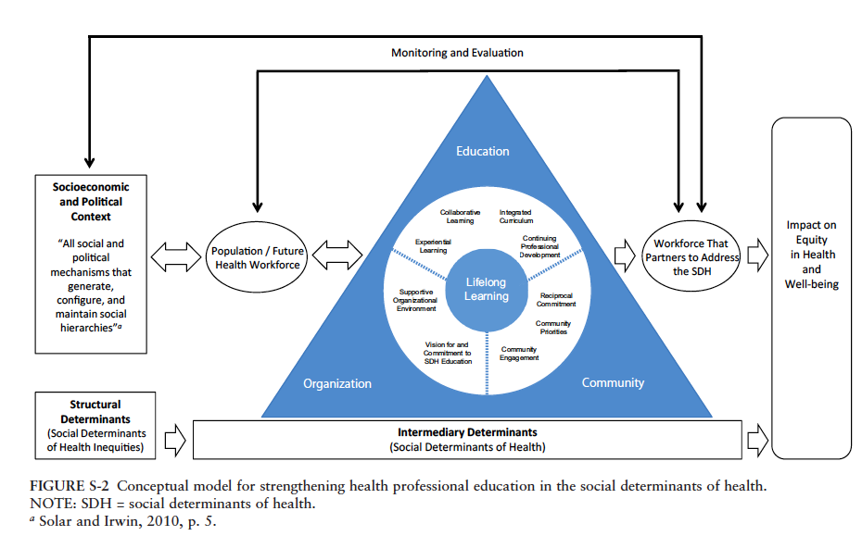
Factoring SDOH into Health Workforce Analysis
Notes:
This figure asks us to think about who “gets” to be a health professional in our society and the degree to which social determinants shape access to professional education. This also comes from “A Framework for Educating Health Professionals to Address the Social Determinants of Health,” a 2016 publication that was authored by various professional organizations and national academies. You might notice that this figure looks similar to a figure we discussed earlier by the WHO’s Commission on the Social Determinants of Health Inequities.
The difference in this figure is that there is an emphasis on the health workforce and in particular the education of the workforce, the organizations within which the workforce is employed, and the relationship between the workforce and the communities within which they work. Here we see that the social, economic, and political context influences the health workforce and the health workforce in turn influences the health of the population. An additional layer of complexity here is that the health workforce is derived from individuals within the population.
Notice at the top of the figure, there are lines showing bidirectional pathways for monitoring and evaluation. This asks, “How does the socioeconomic and political context impact the workforce?” and “How does the workforce influence the socioeconomic and political context?” Additionally, these lines ask us, “How does the population and future health workforce impact the existing workforce?” as well as “How does the existing workforce impact the population and future health workforce?”
Ask the Audience
What are some socioeconomic and political mechanisms that shape the education of public health social workers? (Prompt: Who determines what public health social workers learn and how they learn it? Who influences these actors? What is the process for determining what public health social workers learn through school and continuing education?)
What are some socioeconomic and political mechanisms that shape the organizations within which public health social workers work? (Prompt: What factors within an organization influence the culture and characteristics of an organization? What factors outside of an organization influence the culture and characteristics of an organization?
What are some socioeconomic and political mechanisms that shape the relationships and exchange between public health social workers and the communities within which they work? (Prompt: How are relationships between public health social workers and the community established? What characteristics of the workers and of the community help to facilitate this relationship? What factors apart from the workers and the community themselves shape their relationship?

Slide 34

Conclusion: A Social Work Call to Action
“It is imperative that social work grasp the implications of the social determinants of health model. Given the profession’s expansive social justice goals, (the profession) must embrace the goals of health equity and link the actions of the majority of practitioners who work in health to it” (Ruth, Wachman, Marshall, Backman, Harrington, Schultz, Ouimet, 2017).

Slide 35
References
Adler, N. E., Glymour, M. M., & Fielding, J. (2016). Addressing social determinants of health and health inequalities. Jama, 316(16), 1641-1642.
Berkman, L. F. (2009). Social epidemiology: social determinants of health in the United States: are we losing ground?. Annual review of public health, 30, 27-41.
Braveman, P. (2014). What are health disparities and health equity? We need to be clear. Public Health Reports, 129(1_suppl2), 5-8.
Black D. Inequalities in Health: The Black Report. London: Penguine; 1982.
Cederbaum, JA, Ross, AM, Ruth, BJ, Keefe, RH (2018). Public health social work as a unifying framework for social work's Grand Challenges. Social Work, swy045, https://doi-org.ezproxy.bu.edu/10.1093/sw/swy045
Dahlgren G, Whitehead M. 2006. Levelling up (part 1): a discussion paper on European strategies for tackling social inequities in health. WHO EURO.
Daniels, N. (2015). Why we should care about the social determinants of health. The American Journal of Bioethics, 15(3), 37-38.
Freyer, F. J. (2018, June 8). Suicide rates rise sharply across the US, new report shows. Boston Globe. Retrieved from https://www.bostonglobe.com/metro/2018/06/07/suicide-rates-rise-sharply-across-new-report-shows/7S7P45TheoPkEjlsMoEBcP/story.html
Galea S, Tracy M, Hoggatt KJ, Dimaggio C, Karpati A. Estimated deaths attributable to social factors in the United States. Am J Public Health 2011;101:1456-65.
Hemenway, D. (2017). Private guns, public health. University of Michigan Press.
Jemal A, Thun MJ, Ward EE, Henley SJ, Cokkinides VE, Murray TE. Mortality from leading causes by education and race in the United States, 2001. Am J Prev Med 2008;34:1.
Krieger, N. (2008). Ladders, pyramids and champagne: the iconography of health inequities. Journal of Epidemiology & Community Health, 62(12), 1098-1104.

Slide 36
References Continued
Krieger, N. (2011). Epidemiology and the people's health: theory and context. Oxford University Press.
Link, B. G., & Phelan, J. (1995). Social conditions as fundamental causes of disease. Journal of health and social behavior, 80-94.
McGinnis, J. M., & Foege, W. H. (1993). Actual causes of death in the United States. Jama, 270(18), 2207-2212.
Stringhini S, Sabia S, Shipley M, Brunner E, Nabi H, Kivimaki M, et al. Association of socioeconomic position with health behaviors and mortality. JAMA 2010;303:1159
Machledt, D. (2017). Addressing the Social Determinants of Health Through Medicaid Managed Care. Issue brief (Commonwealth Fund), 2017, 1-9.
Mackenbach JP, Stronks K, Kunst AE. The contribution of medical care to inequalities in health: differences between socio-economic groups in decline of mortality from conditions amenable to medical intervention. Soc Sci Med 1989;29:369-76
Marmot, M., Friel, S., Bell, R., Houweling, T. A., Taylor, S., & Commission on Social Determinants of Health. (2008). Closing the gap in a generation: health equity through action on the social determinants of health. The lancet, 372(9650), 1661-1669.
National Academies of Sciences, Engineering, and Medicine. 2016. A framework for educating health professionals to address the social determinants of health. Washington, DC: The National Academies Press. Doi: 10.17226/21923.
Ruth, BJ & Marshall, JM. (2017). A history of social work in public health. American Journal of Public Health, 107(S3), S236-S242.
Ruth, BJ, Wachman, M & Schultz, N (2014). Health in all programs? Findings from a website analysis of MSW programs. Council on Social Work Education Annual Program Meeting, Tampa, FL.
Singh, G. K. (2010). Maternal mortality in the United States, 1935-2007: Substantial racial/ethnic, socioeconomic, and geographic disparities persist. US Department of Health and Human Services, Health Resources and Services Administration.
World Health Organization Commission on Social Determinants of Health (CSDH). A Conceptual Framework for Action on the Social Determinants of Health. Discussion paper for the Commission on the Social Determinants of Health, April 2007. http://www.who.int/social_determinants/resources/csdh_framework_action_05_07.pdf (Accessed July 30, 2018).

Slide 37
Resources
Healthy People Curriculum Task Force and the Clinical Prevention and Population Health Curriculum Framework
  Blog entry August 8, 2018 "Clinical Prevention and Population Health in Health Professions Education: Tackling the Social Determinants of Health"
    Includes 3 case studies along with instructor guides
Association for Prevention Teaching and Research
  Case studies
  Curriculum guides
  Case studies

Slide 38
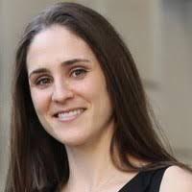
About the Author
Esther E. Velásquez, MSW, MPH, ScD is a research specialist in the Science and Technology Platform at Ariadne Labs, a joint health system innovation center of the Harvard T.H. Chan School of Public Health and Brigham and Women’s Hospital.
Dr. Velásquez received MSW and MPH degrees from the Boston University Schools of Social Work and Public Health, and a ScD in Social Epidemiology from the Harvard T.H. Chan School of Public Health.
She is a mixed methods researcher with experience as a clinical social worker. Dr. Velásquez's primary research interest is to apply social epidemiologic research methods to address the social determinants of health inequities.

Slide 39
Acknowledgements
The Advancing Leadership in Public Health Social Work Education project at Boston University School of Social Work (BUSSW-ALPS), was made possible by a cooperative agreement from the Health Resources and Services Administration (HRSA) of the U.S. Department of Health and Human Services (HHS) under grant number G05HP31425. We wish to acknowledge our project officer, Miryam Gerdine, MPH. Thanks also to Sara S. Bachman, BUSSW Center for Innovation in Social Work and Health, and the Group for Public Health Social Work Initiatives
The ALPS Team:
Betty J. Ruth, Principal Investigator bjruth@bu.edu
Madi Wachman, Co-Principal Investigator madi@bu.edu
Alexis Marbach Co-Principal Investigator alexis_marbach@abtassoc.com
Nandini Choudhury, Research Assistant nschoud@bu.edu
Jamie Wyatt Marshall, Principal Consultant jamiewyatt1@gmail.com

