Slide 1
HIV and Aging
Working with and Supporting People over 50 with HIV/AIDS
Notes:
1

Slide 2
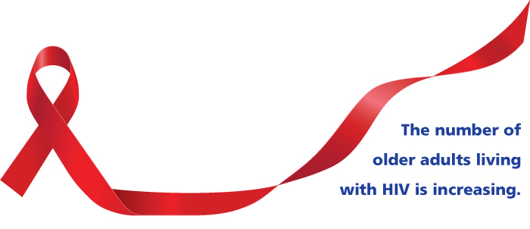
Objectives
HIV and Aging
At the end of this unit participants will be able to:
Identify and discuss special challenges among those aged 50 and older with HIV regarding:
Clinical and physical health
Mental and emotional health
Substance use
Sexual health
Addressing challenges with clients
PrEP
Living well with HIV
Notes:
Review the objectives.
Introduce HIV and aging topic by acknowledging:
Work remains to control the spread of HIV by identifying people with HIV who are undiagnosed.
Development of HAART (i.e. cocktails using multiple drugs) has increased life expectancy of people with HIV.
Annual numbers of HIV diagnosis declined by 5% between 2011 and 2015.

Slide 3
The Numbers
HIV and Aging
Notes:
The next slides will focus on the numbers—the scope and impact of people over 50 with HIV.
Aging is a part of the natural course of life. However, HIV seems to accelerate the aging process. We’re not sure if it is the virus
itself or HIV treatment that influences the aging process, but we will discuss some of these special challenges.
People aged 50 and older accounted for approximately:
17% (6,812) of the 39,782 new HIV diagnoses in 2016 in the United States. Though new HIV diagnoses are declining among people aged 50 and older, around 1 in 6 HIV diagnoses in 2016 were in this group.
35% of people aged 50 and older already had late stage infection (AIDS) when they received an HIV diagnosis 2016
The good news is that as a result of the development of highly active antiretroviral therapy starting in the 1990s and today, life
expectancy for many people with HIV nears that of a person without HIV. The bad news is research increasingly shows that diseases
that typically strike HIV negative people in their 60s and 70s are occurring in people with HIV in their 40s and 50s.
We have seen a decline of 5% in HIV diagnosis nationwide, but we still have special populations where we see increases in the
number of infections.
Growing older with HIV is uncharted territory. This is the first generation of people with HIV who are over 50.
The American Academy of HIV Medicine (AAHIVM), the American Geriatrics Society (AGS) and the AIDS Community Research
Initiative of America (ACRIA) released the first clinical treatment strategies for managing older HIV patients: The HIV and Aging
Consensus Project: Recommended Treatment Strategies for Clinicians Managing Older Patients with HIV in the fall of 2011.

Slide 4
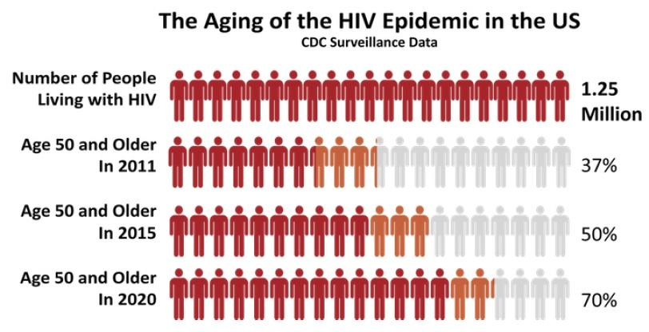
HIV and Aging
Notes:
Review the chart.
People with HIV who are over 50 are a growing population. According to CDC surveillance data:
Number of people with HIV is 1.25 million
In 2011 – 37% were age 50 and older
In 2015 – 50% were age 50 and older
In 2020 –70% are projected to be 50 and older

Slide 5
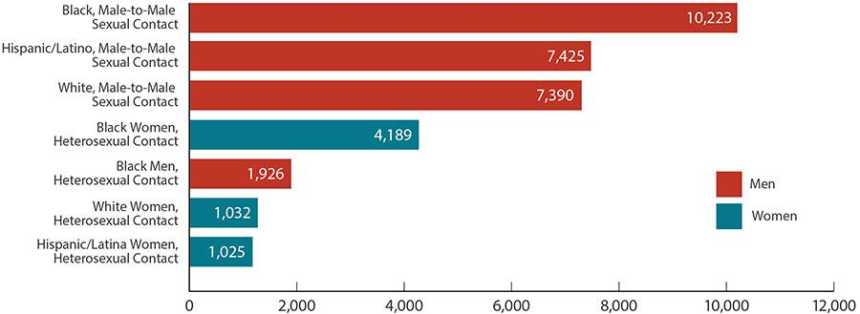
Estimated New HIV Diagnoses in the US for the Most-Affected Subpopulations, 2016
HIV and Aging
In 2016, 39,782 people received an HIV diagnosis. The annual number of HIV diagnoses declined 5% between 2011 and 2015
Notes:
Point out the following on the chart:
Disparities: The most impacted sub-populations are:
Black men who have sex with men (MSM);
White MSM; and
Latino MSM; followed by
Black, Latina, and white heterosexual cisgender women.
Among people aged 50 and over, Blacks/African Americans accounted for 43% of all new HIV diagnosis in 2015. Whites accounted for 36%, and Hispanics/Latinos accounted for 17%.
Among people aged 50 and older, 49% of new HIV diagnosis in 2015 were among gay and bisexual men, 15% were among heterosexual men, 23% were among heterosexual women, and 12% were among people who inject drugs.
It’s important to note that this slide only shows subpopulations that represent more than 2% of all HIV diagnoses, so smaller, but
still heavily impacted communities are not reflected.
Let’s take a closer look at some of these disparities. In 2016:
African Americans represented 12% of the population, but accounted for 44% (17,528) of HIV diagnoses. African Americans have the highest rate of HIV diagnoses compared to other races and ethnicities.
Hispanics/Latinos represented 18% of the population, but accounted for 25% (9,766) of HIV diagnoses.
5

Slide 6
Intersection of Issues for People Aged 50 and Older
HIV and Aging
Sexism
Aging
HIV
Stigma
Ageism
ART
Homophobia
Transphobia
Racism
Notes:
Older people with HIV have to grapple with aging, HIV, and the effects of anti-retroviral therapy (ART), all within the context of
stigma and societal oppression which may include racism, homophobia, transphobia, sexism, and ageism.
6

Slide 7
Activity: Special Challenges
HIV and Aging
HIV among those aged 50 and older:
Clinical and physical health
Mental and emotional health
Sexual health
Notes:
Group activity: special challenges
Break participants into 3 groups and assign each group one of the 3 topics listed below. If there are fewer than 10 participants then
conduct activity as a large group. Have the group(s) discuss what challenges people with HIV who are 50 or older may encounter
with respect to the topic. Assign a recorder to write on the flip chart and a recorder to share with the larger group. Allow the
groups 5 minutes to discuss before reporting back to the larger group.
Clinical and physical health
Mental and emotional health
Sexuality and sexual health
After the group discussion, the facilitator will close out the activity by reviewing any issues not covered by participants by reviewing
the next slide.
7

Slide 8
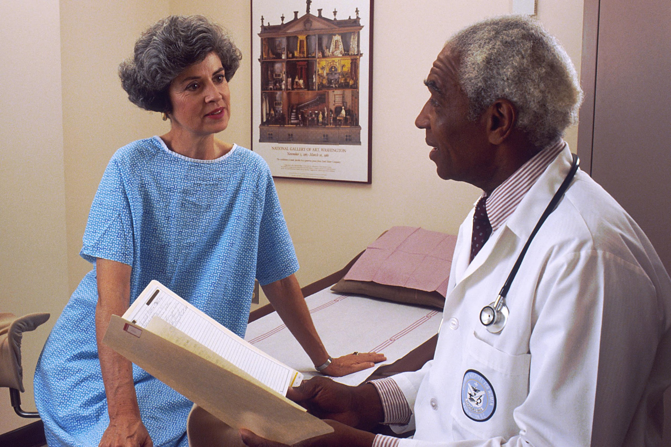
Clinical and Physical Health
HIV and Aging
HIV inflammation
Long-term effects of antiretroviral medication
Polypharmacy
Co-morbidities
Notes:
Make sure to cover the following points, or emphasize them during the group discussion:
HIV treatments have decreased the likelihood of AIDS-defining illnesses among people aging with HIV.
HIV-associated non-AIDS conditions are more common in individuals with long-standing HIV infection. These conditions include cardiovascular disease, lung disease, certain cancers, HIV-Associated Neurocognitive Disorders (HAND), and liver disease (including hepatitis B and hepatitis C), among others.
In addition, HIV appears to increase the risk for several age-associated diseases, as well as to cause chronic inflammation throughout the body. Chronic inflammation is associated with a number of health conditions, including cardiovascular disease, lymphoma, and type 2 diabetes.
8

Slide 9
Polypharmacy
HIV and Aging
Polypharmacy, the use of multiple medications, is common.
People with HIV are living longer with improved antiretroviral therapies.
As patients age, other health conditions become more common such as:
Drug-drug interactions effects may decrease the effectiveness of HIV medications or increase medication toxicity.
Heart Disease | Osteoporosis
High Cholesterol | Kidney Disease
High Blood Pressure | Non-AIDS Related Cancer
Diabetes
Notes:
Polypharmacy – the use of multiple medications – is common. We talked about polypharmacy when we discussed drug to drug
interactions and drug to condition interactions
The number of medications prescribed for conditions such as heart disease, high cholesterol, and diabetes predicts the number of
drug interactions.
Drug-drug interaction – a reaction between two (or more) drugs.
Drug-condition interaction – a reaction that occurs when taking a drug while having an existing medical condition.
People with HIV are living longer than ever before with improved antiretroviral therapies, so as patients age, other health conditions
become more common.
9

Slide 10
Mental and Emotional Health
HIV and Aging
Studies have found high rates of depression among older people with HIV
Social isolation is an important issue:
Older people may face isolation due to illness or loss of family and friends.
Stigma from HIV infection and aging.
Negative stereotypes of aging, including viewing older people as:
Needy
Senile and less useful than younger people
Stigma can lead to increased symptoms and decreased quality of life
Social isolation has been linked to a decrease in health and quality of life
Notes:
Review the slide making sure to emphasize the following points:
People need human connection in order to survive. As people grow older, a chipping away of connections and social life can lead to isolation from family and community.
An increased burden of symptoms, such as fatigue, pain, and depression, are perhaps worse in women with HIV. This can negatively influence everything from daily functioning, to employment, to quality of life.
HIV and dementia can be particularly challenging.

Slide 11
Substance Use
HIV and Aging
Rates for substance use are higher in older individuals with HIV than among same-age peers who are HIV negative.
Increases in depression have been linked with increased use of substances, including alcohol, marijuana, cocaine, opioids, and benzodiazepines.
Interactions can occur between prescription medications and illicit substances. These interactions may make it difficult for individuals to adhere to their prescribed medications and could greatly reduce quality of life.
Notes:
Review the slide.
Note that veterans are particularly at risk. Homelessness and substance use are huge challenges for the veteran population. This group
of people may not be seen as at risk because of stereotypes associated with being older.
11

Slide 12
Sexuality and Sexual Health
HIV and Aging
Older individuals are sexually active, but there are lower rates of HIV testing among adults 50 and older.
Post-menopausal women are at risk of HIV and STI infection due to increased risk of vaginal tearing during intercourse.
Older adults generally have lower rates of condom use. Women who are not concerned about pregnancy may not use condoms.
Older adults who are divorced or who have lost a partner due to death may be unaware of HIV risks.
Notes:
Review the slide.
Older Americans are more likely than younger Americans to be diagnosed with HIV infection late in the course of their disease,
meaning they start treatment late, and have more damage to their immune systems.
Older people are sexually active, including those with HIV, and may have the same HIV risk factors as younger people, including a
lack of knowledge about HIV prevention, as well as having multiple sex partners.
Older people also face some unique issues:
Many widowed and divorced people are dating again. They may be less aware of their risks for HIV than younger people, believing HIV is not an issue for older people. Thus, they may be less likely to protect themselves.
Women who no longer worry about becoming pregnant may be less likely to use a condom and to practice safer sex. Age-related thinning and dryness of vaginal tissue may raise older women’s risk for HIV infection.
Although they visit their doctors more frequently, older people are less likely than younger people to discuss their sexual habits or drug use with their doctors. And doctors are less likely to ask their older patients about these issues.
12

Slide 13
PrEP for Older Adults
HIV and Aging
Condom use declines with age; used by less than 10% of those over age 50.
15 to 20% of older adults with HIV engage in high-risk (unprotected) sex.
In multiple studies, older adults with HIV report that their partners are often not capable of using a condom, due to the inability to sustain an erection.
Many older women with HIV report that they and their male partners do not perceive the need to use a condom because they are post-menopausal.
Notes:
Review the slide.
Although older adults often have sexual relations more with age-matched peers, several studies have shown that there is a
significant amount of high-risk behavior occurring between younger and older individuals. For the older adult with HIV who is
having sex with a younger person, the opportunity to encourage the use of PrEP is evident.
Older adults with HIV, with the support of providers, can be effective advocates for the use of PrEP among their seronegative, at
risk sexual partners, be they casual, short-term, or long-term. Many of these at-risk partners are also among those least likely to be
routinely tested for HIV. The use of PrEP together with “treatment as prevention” and other prevention interventions (condoms and
behavioral interventions) is considered to be an important path toward ending the AIDS epidemic.
13

Slide 14
Case Scenario: Ms. Mavis Jones
HIV and Aging
Mavis is a 63-year-old African American female. She is pre-diabetic, postmenopausal, and has high blood pressure. She’s a member of the Lively Steppers Dance group that meet at the Elks Club three days a week, and participates in dances on weekends. She’s very social, smokes a pack of cigarettes a day, and has 3 to 5 cocktails a week. Mavis was diagnosed with AIDS when her long-term partner Stan died of lymphoma three years ago. Mavis began treatment and has been adherent to her ART. She has not disclosed to family or friends because of the stigmatizing language they have expressed about people with AIDS .
Notes:
Activity: Case scenario
Ask a participant to read the scenario. Ask participants to reflect and then answer the following questions:
Ask, “What are the challenges that Mavis must face to improve her health?”
Preventing diabetes
High blood pressure
Smoking
Feels stigmatized
Ask, “What are some options, education, and screenings you could possibly discuss with her to address these challenges and
improve her quality of life?”
Diabetes class – diet and high blood pressure
Exercise – weigh bearing
Smoking cessation
Ask, “What are things Mavis is doing that are affirming that you could point out?”
Dance group – aerobic exercise
Social support outreach
Ask, “Do you have other concerns or questions you would want to discuss with Mavis?”
Ask: “How can you as a CHW help Mavis stay healthy?”
Check in with her by phone or visits to see if she is seeing her doctors about managing not only HIV but diabetes and high blood pressure. She may be seeing more than one doctor so it is important for her to keep all her medical appointments. If you agency allows you to accompany her to appointments ask her if there is any thing you can do to help her with appointments and if she would like go to appointments with her.
Discuss options about cutting back the number of cigarettes she smokes.
Talk with her about who she might feel comfortable disclosing her status and if you can help her manage the process. Since she describes herself as social, ask her if she would like to connect with other people who are HIV positive.
14

Slide 15
Living Well: Older Adults with HIV
HIV and Aging
While these health challenges mentioned may seem discouraging, people with HIV are now living long-enough, healthy-enough lives to experience the same types of conditions as the general population.
There is no magic bullet for aging well, no matter your health status.
Evidence suggests some promising, nonpharmacological strategies that can help adults.
Physical activity – increasing the amount, intensity, and frequency
Improves cardiovascular health
Reduces symptoms of fatigue
Improves cognitive functioning
Improves chronic health conditions including hypertension, diabetes, and depression
Notes:
Close by summarizing: Growing older with HIV is unchartered territory. This generation is the first to live longer and healthier lives.
People with HIV are now living long-enough, healthy-enough lives to experience the same conditions related to aging as the
general population. Living well with HIV is very similar to living with other chronic illnesses, or just “living well.”
There is no magic bullet for aging well, no matter your health status, however exercise can improve lean body mass, decrease fat,
stress, fatigue, and depression, and improve strength, endurance, and cardiovascular fitness. It may also help the immune system
work better. Accessible exercises can include walking, water aerobics, etc.
15

Slide 16
Live Well: Older Adults with HIV
HIV and Aging
Eating a nutritious, balanced diet can improve chronic health conditions.
Limiting alcohol consumption is important for aging well.
Positive social interactions can improve HIV treatment adherence.
Paid employment can be beneficial; research also finds that volunteerism, activism, and being involved in a spiritual community can be a source of helpful interactions.
“You Are Only as Old as You Feel” – a positive attitude toward one's age can have a positive effect on one’s health.
Notes:
Review the slide.
Other health strategies that can help are eating nutritious meals, having positive social interaction, a positive attitude, and employment
or volunteer work. Being involved in one’s community can be a source of good health. Artistic expression can be beneficial as well.
16

Slide 17
Resources and References
HIV and Aging
Notes:
Share resources and references for helping people with HIV who are over 50.
17

