Slide 1
Sexual Health

Slide 2
Objectives
Sexual Health
At the end of this unit participants will be able to:
Understand that sexual health is more than sexual transmitted infections (STIs) and contraception, and requires a deeper understanding of sexuality
Understand how social determinants of health (SDOH) influence sexuality and sexual health
Effectively conduct conversations with clients about sexual health and sexuality
Support clients by presenting options and support them in making changes
Support clients in understanding and communicating with others about their sexuality and health goals
Notes:
Review the objectives.
Ask participants if someone knows the definition of sexual health? Take definitions from participants and then advance to next slide.

Slide 3
Sexual Health
Sexual Health
“…a state of physical, emotional, mental, and social well-being in relation to sexuality; it is not merely the absence of disease, dysfunction or infirmity. Sexual health requires a positive and respectful approach to sexuality and sexual relationships, as well as the possibility of having pleasurable and safe sexual experiences, free of coercion, discrimination, and violence.”
(World Health Organization (WHO), 2006a)
Notes:
3
Review the slide and compare how the WHO definition is the same and different from participants’ definitions.
Source: WHO (2006a). Defining sexual health: Report of a technical consultation on sexual health, 28–31 January 2002. Geneva, World Health Organization.

Slide 4

Sexuality Education
Sexual Health
“The primary goal of sexuality education is to promote adult sexual health. It should assist people in developing a positive view of sexuality, provide you with information that you can use to help clients take care of their sexual health, and help them acquire skills to make decisions now and in the future.”
(Hedgepeth, E., & Helmich, J. (1996). Teaching about sexuality and HIV: Principles and methods for effective education. New York: New York University Press.)
Notes:
4
Review the slide.

Slide 5

Influences on Sexual Health
Sexual Health
Attitudes
Access to resources
Discrimination
Sexual orientation
Neighborhood
Why bother it’s too much
Beliefs
With luck it won’t happen to me
I have little control over my life
Social Norms
Education
Income
Existing Prevalence
Values
Notes:
5
Review the slide.
These are some of the attitudes, beliefs, and values that can prevent people from engaging in their sexual health.

Slide 6
ACTIVITY: SEXUAL HEALTH PICTIONARY

Slide 7

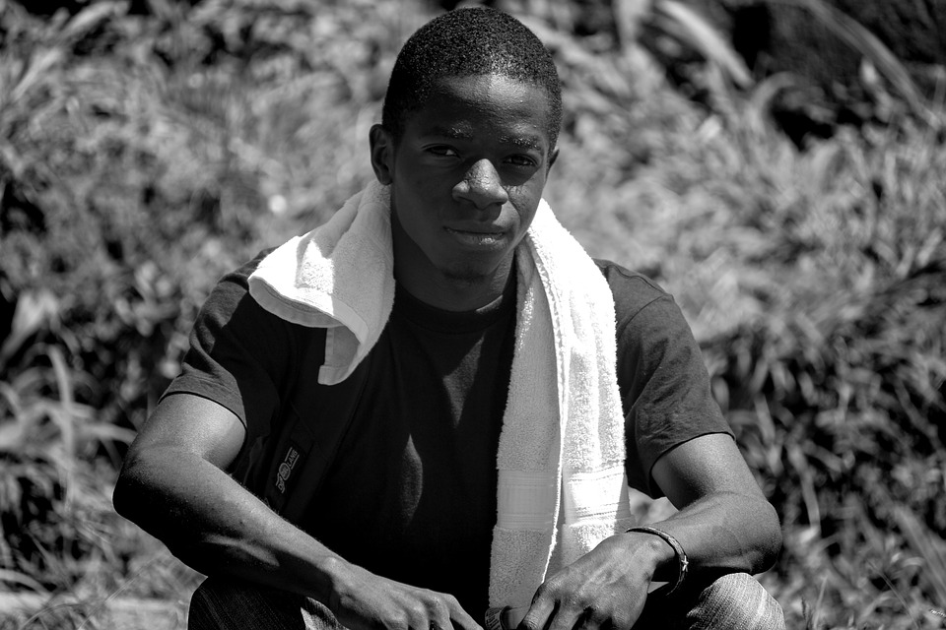
Sexual Health
Andrew
Darius Jenkins / DJ
Notes:
7
DJ is a 24-year-old Black MSM (man who has sex with men) who is living with HIV from Compton, CA and has not come out to his family. DJ is in a relationship with Sheba who also lives with HIV who performs at a club where DJ sells marijuana. He tells you that they both missed several doses of medication. DJ also shares with you that he’s the receptive party in his relationship and he’s concerned about superinfection because they are not using condoms. Sheba has tried, but he often loses his erection while putting on the condom.
Andrew is a 24-year-old white MSM from Pasadena, CA who works as a legal assistant and has the support of his family. He is in a serodiscordant relationship (one partner has HIV and the other does not) and he is going with his partner to the LGBTQ testing drop-in space to get tested today; they are considering PrEP.
What are some ways that social determinants of health (SDOH) impacted DJ’s life and not Andrew’s life?
Considering SDOH, how might you counsel DJ and what are some options you can share with him? Andrew?
Now you will have the opportunity to practice using the information we’ve learned about sexual health and influences on human sexuality.
Give instructions for role play.
You will have a chance to role play discussing sexual health with a client in pairs. Hand out role play. Each person has five minutes to practice the roleplay and then switch roles. After the pairs have completed the role plays, come back to the larger group for discussion.
Allow 10 minutes to debrief the role plays.
Ask:
How did this exercise feel for folks ?
What small action steps did you think of?

Slide 8
Summary
Sexual Health
The role of the CHW is to acknowledge that sexuality is a good and pleasurable part of human life and to emphasize sexual health and wellness.
Sexual intimacy and pleasure are important aspects of sexual health.
Common reasons people don't use condoms and other prophylaxis should be discussed to learn more about the client’s sexual experience, and to discover how the client can continue to enjoy their sexual experience while improving the sexual health of themselves and the people they have intimate relationships with.
This becomes possible when one listens, summarizes, and supports small and achievable goals.
Notes:
8
Review the slide to summarize and close.

