Slide 1
Community Assessment & Community Based Participatory Research (CBPR)
Notes:
1

Slide 2
Objectives
Community Assessment & CBPR
At the end of the unit, participants will be able to:
Explain the organic relationship between principles, methods and outcomes in CBPR, using the “Tree of CBPR” metaphor
Identify project design and implementation methods that foster an environment of equity and participation
Identify how CPBR principles could be used in their work as CHWs
Know how to involve the community in assessing a program/intervention’s impact on clients, organizations, and community
Notes:
2
Review the objectives.

Slide 3
Introduction to CBPR
Community Assessment & CBPR
What do you know or imagine about Community-Based Participatory Research (CBPR)?
Notes:
Ask for a volunteer to read the question on the slide and facilitate a group discussion around participants responses.

Slide 4
CBPR Definition
Community Assessment & CBPR
“Community Based Participatory Research (CBPR) is a collaborative approach to research that equitably involves all participants in the research process and recognizes the unique strengths that each brings. CBPR begins with a research topic of interest to the community with the aim of combining knowledge and action for social change to improve community health and eliminate health disparities.”
Definition developed and adopted by the Community Health Scholars Program based upon Israel BA, Schulz AJ, Parker E, Becker AB in "Review of Community-Based Research: Assessing Partnership Approaches to Improve Public Health", Ann. Rev. Public Health. 1998. 19:173-202. Available at: http://www.kellogghealthscholars.org/about/community.php
Notes:
Ask for a volunteer to read the definition.
After the definition is read, ask, “What words/phrases stand out to you from this definition?”

Slide 5
How is CBPR similar/different from other types of research?
Community Assessment & CBPR
Community participates and leads all aspects:
Community is the leader
Identifying the area of study & questions to be answered
Designs and gathers information to address the issue
Analysis and interpretation of results
Expert driven:
Community is a “participant/subject”
Community may help advise or approve area of study & research questions
Experts design & gather information; community members may be involved, usually in collection
Analysis and interpretation of results; experts may bring to community for input
Use results to inform and direct change
Notes:
Ask for a volunteer to read the slide.
Ask, “From your understanding and experience, how is CBPR similar/different from other types of research? When you think of conventional research or evaluation, what comes to mind? Have you personally participated in a research study? What did you do? Were you a participant? Did you ever participate in a survey or focus group? What was the experience like? Is research conducted in your work setting? Who conducts the research? What differences do you notice?
CBPR and other types of research (clinical research, intervention research, implementation research, and program evaluation all have the ultimate goal of producing results to inform change. However, most research tends to be expert driven. CBPR is driven by the community it. Ask, “Is there one you identify more in your experience and in your work setting?”

Slide 6
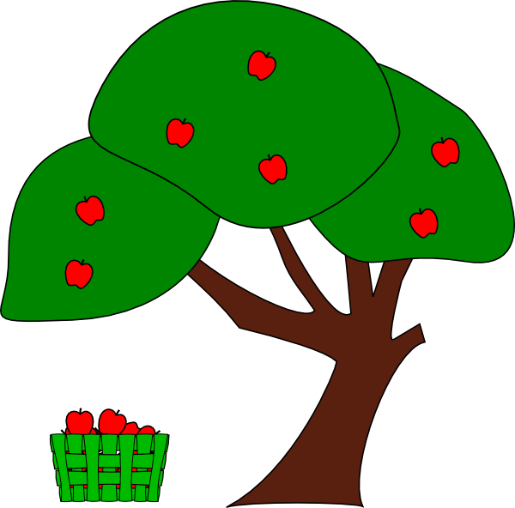
CBPR Tree
Community Assessment & CBPR
Fruit: Impacts
Branches: Methods
Trunk: Environment
Roots: Principles
Notes:
We will use a metaphor of a tree to help us understand the different components of Community Based Participatory Research (CPBR).
The roots of our tree are the principles of CBPR.
The trunk of our tree consists of the ways in which we embody these principles, or put the principles into action, throughout a project (i.e., the “how”).
The branches of the tree are methods of collecting data and conducting an intervention in CBPR projects (i.e., the “what”).
The fruits are the outcomes or the applications of CBPR projects.
We will go over each section of the tree in more depth, starting with the roots, or principles.

Slide 7
CBPR Principles- Roots
Community Assessment & CBPR
The roots are the principles that sustain good participatory research.
Recognizes community as a unit of identity
Builds on strengths and resources within the community
Facilitates collaborative, equitable involvement of all partners in all phases of the research
Integrates knowledge and intervention for mutual benefit of all partners
Promotes a co‐learning and empowering process that attends to social inequalities
Involves a cyclical and iterative process
Addresses health from both positive and ecologic perspectives
Disseminates findings and knowledge gained to all partners
Involves long‐term commitment by all partners
Israel, B. A., Schulz, A. J., Parker, E. A., & Becker, A. B. (1998). Review of community-based research: assessing partnership approaches to improve public health. Annual Review of Public Health, 19(1), 173-202.
Notes:
Ask for a volunteer to read through the list of CBPR principles.

Slide 8
CBPR Principles
Community Assessment & CBPR
Think about the people that you interviewed.
What do you think are their core values or priorities?
Do you see their core values or priorities reflected in the goals of CHW work?
Notes:
Ask the participants the questions on the slide.

Slide 9
Popular Education Principles
Community Assessment & CBPR
Popular Education: Just, Equitable & Democratic Society
Start with what people know or do
Everyone is a teacher and a learner
Create space to reflect on personal experience
Critically examine the world around us
Honor lived experience
Learn the skills to work together
We learn with our head, heart and bodies
Develop grassroots leadership
Take collective action
Build trust
Notes:
Inform participants that we are using two frameworks to think about Community Assessment and Community Based Participatory Research.
One framework is Popular Education, which is focused on principles such as starting with what people know, honoring lived experience, and creating spaces where everyone can learn from each other and critically reflect on their personal experiences.

Slide 10
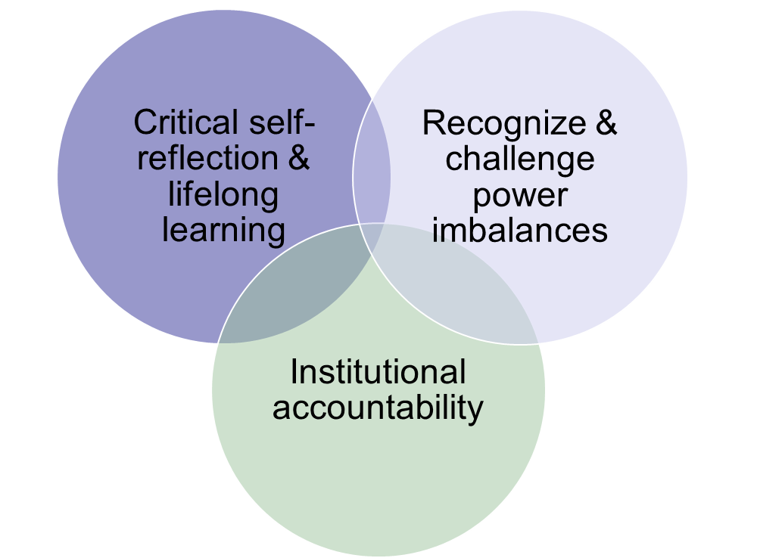
Cultural Humility Principles
Community Assessment & CBPR
Notes:
The other framework is cultural humility.

Slide 11
CBPR Environment
Community Assessment & CBPR
Think about where you conduct your work to meet people.
What was the space like?
Who did you invite? Who attended? Who did you invite but didn’t attend? Who would you have liked to invite?
Were there any challenges in setting up the meeting (i.e. transportation or childcare needs)?
Notes:
In order to put the principles into practice and to facilitate participatory data collection, we need to create a climate of equity and participation when we are designing and implementing our CBPR projects. The things that characterize how we work to create that climate form the trunk of our tree.
Invite participants to answer the questions based on the assessment that they conducted.

Slide 12
Key Aspects of the Environment
Community Assessment & CBPR
Participants
Are all voices from the community are present?
If some couldn’t attend, what is the plan to follow up with them?
Open space for conversation
Participants can see each other to promote conversation (i.e. sit in circle)
Refreshments
Resources (child care, transportation support)
Notes:
Review the slide with participants.
Ask if participants have any additional ideas (e.g. incentives?)

Slide 13
CBPR Principles- Branches
Community Assessment & CBPR
Think about how you gathered information to do your work.
How did you gather the information? Why did you choose that/those methods?
What worked well and were there any challenges with how you collected the information?
What follow up questions did you ask and why?
Israel, B. A., Schulz, A. J., Parker, E. A., & Becker, A. B. (1998). Review of community-based research: assessing partnership approaches to improve public health. Annual Review of Public Health, 19(1), 173-202.
Notes:
We are going to move on to the branches of our tree. Just as branches grow from the trunk of a tree, participatory data collection and evaluation grow out of a solid foundation of participation and equity.
And just as we hope you were able to see how the principles, or roots, of CBPR can be put into practice in the design of the project (the trunk), we’d like to demonstrate how those principles extend throughout the branches, and what this looks like in practice.
The branches refer to the evaluation/data collection methods, which may be the first thing people think of when they hear the phrase “Methods of CBPR.”
Invite participants to answer the questions based on the assessment that they conducted.
Ask if participants have any additional ideas.

Slide 14
CBPR Principles- Fruits: Impacts / Outcomes
Community Assessment & CBPR
The fruits are the results, impacts, and outcomes of the research.
Based on your interviews:
What were the impacts?
How did the responses compare/contrast with your views of the impacts and HRSA’s goals?
Notes:
We have finally arrived at the fruits of our tree. A healthy tree should yield fruit, and a healthy CBPR project should yield positive impacts for our communities.
There are many impacts of CBPR that we would hope to see from our efforts.
Invite participants to answer the questions on the slide based on the assessment that they conducted.
Ask if participants have any additional ideas.

Slide 15
Next Steps and
Questions?
Community Assessment & CBPR
Notes:
Group discussion:
Did you share the results of what you did?
How might you share back with your team or co-workers what you learned from your assessment and from this unit about CBPR?
How might you incorporate CBPR principles and practices into the work of the clinic?

