Slide 1
Patient Navigation
Notes:
Welcome participants.

Slide 2
Objectives
Patient Navigation
By the end of this unit participants will be able to:
Describe the purpose and elements of patient navigation meetings
Share how patient navigators can help clients access necessary services
Know which forms are needed to track patient navigation activities
Notes:
Review the objectives.

Slide 3
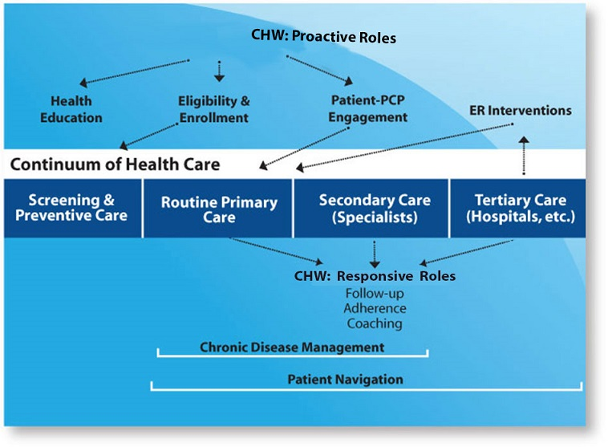
Section Header
Patient Navigation
Notes:
Let's take a look at the care continuum and what areas patient navigation influences.
This diagram reflects the key components of care: Screening and preventive care, routine primary care, secondary care (specialist), and tertiary care (hospitals).The CHW roles are separated into two categories:
Proactive roles
Health education
Eligibility and enrollment
Patient and PCP engagement
Emergency room interventions
Responsive roles
Follow-up, Adherence, and Coaching
Routine primary care
Specialty care
Tertiary care (e.g., hospitals)
The two areas that chronic disease management falls under are:
Routine primary care: working with clients on adherence, making appointments, and reaching their health care goals on their care plan.
Tertiary care: supporting clients in hospice situations, end stage liver disease and hospitalization transitions.
Patient navigation encompasses both of these, plus secondary care which might entail escorting a client to specialty appointments and understanding instructions from the PCP, or helping form questions they can ask the PCP. These roles are responding to the needs and goals of the client. Proactive roles are those supportive roles that help the client gain access to and navigate the health systems.
Ask, “Considering this diagram what roles are you playing at your organization?”

Slide 4
Patient Navigation
Patient Navigator Meetings
To check in with a client:
Answer any questions they may have
Deliver HIV self-management sessions
Provide individualized care and support
Notes:
Tell participants: These meetings are where you bond and gain trust with the client as you support them in identifying and developing health-related goals, as well as answer their questions and clear up myths that they may have using your communication skills such as motivational interviewing.
Ask Participants, “Do you perform these tasks at your organization, or does someone else?” “How do you perform these activities?” “How do you document and track your meetings with a client?”
4

Slide 5
Service Coordination and Tracking
Patient Navigation
Medical Care
Warm hand-off
Housing/benefits/public assistance programs
Financial assistance programs
Food assistance
Transportation
Notes:
Tell participants: These are some of the services that you as a CHW may perform and help a client navigate the service system in addition to linking and staying in medical care. You may work closely with the care team and other community partners to communicate client needs that may arise out of these meetings in order to support them in reaching their goals and increasing their investment in their health outcomes.
Ask Participants, “Do you perform these tasks at your organization, or does someone else?” “How do you perform these activities?” “Who do you contact?” “How do you document and track your work with clients on obtaining services?”
Write participant responses on a flip chart and note similarities and differences.
5

Slide 6
Medical Appointment and Care Support
Patient Navigation
Assistance
Physical accompaniment
Scheduling assistance
Reminders
Documentation
Care plan review
Patient education materials
Video: HRSA Dissemination of Evidence Informed Interventions/AIDS United Treatment Tips
Notes:
Tell participants: The need for assistance will vary from client to client. Some will require more support than others, especially in the beginning. You may have to physically escort or accompany them to appointments at first; that might be a good opportunity to educate a client about scheduling, identifying types of reminders that work best, and assisting them in setting up appointments. Remember, always make time for documentation as soon as possible after the visit and review the care plan and update what was and wasn’t accomplished.
Ask participants, “Do you perform these tasks at your organization, or does someone else?” “How do you perform these activities?” “Who do you contact?” “How do you document and track your work with clients on obtaining services?”
Ask participants, “Do you perform patient education?” If yes how for volunteers to share how they educate materials on what topics and what materials they use.
Share with participants: the video clips from AIDS United HRSA DEII initiative that can be used to educate clients.
Write participant responses on a flip chart and note similarities and differences.

Slide 7
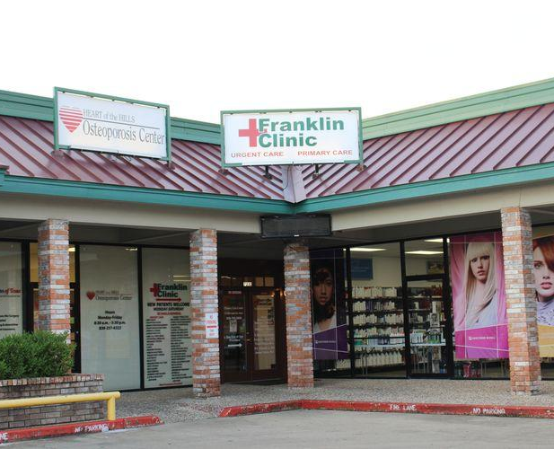
Back home….
Patient Navigation
Are the roles at your agency more proactive than responsive, or a mixture?
Which of these roles are not part your current role?
Is there a role you're not doing that you would like to incorporate into your role to improve service delivery?
This PhotoThis Photo by Unknown Author is licensed under CC BY-NC-ND
Notes:
Review the slide.
Break participants in to groups of 3-4 persons. Ask them to discuss the 3 questions on the slide for about 15 minutes.
Bring participants back and ask them to share what they learned from each other.

Slide 8
Useful Forms When Conducting Navigation
Patient Navigation
Acuity Tool for client risk assessment
Care Plan for working with the client on their goals
Notes:
In the HRSA Dissemination of Evidence Informed Interventions: Enhanced Patient Navigation for Women of Color with HIV tool kit you will find useful forms to help track client progress and health outcomes.
Ask participants if their agencies has forms they need to complete and how they document their services. Ask if they have access to the patients electronic medical record or paper chart. Note responses on a flip chart .
Tell participants: Whether your work is proactive or responsive, remember to schedule regular meetings with the client, take care to communicate changes and progress to your team, and document all the work you do concerning the client.
8

Slide 9
Resources
Patient Navigation
Video: HRSA Dissemination of Evidence Informed Interventions/AIDS United Treatment Tips.
https://www.youtube.com/playlist?list=PLmeLn9qRyk-hdU_ueS_QQCY8wHkKLqN0g
HRSA’s Dissemination of Evidence Informed Interventions: Enhanced Patient Navigation for Women of Color with HIV: Modules 1, 2, 4. Available at:
https://targethiv.org/library/dissemination-evidence-informed-interventions-2017
A Guide to Implementing a Community Health Worker (CHW) Program in the Context of HIV Care. Available at:
https://targethiv.org/library/hiv-chw-program-guide
Notes:
Share the resources with participants and wrap up the session.
9

