Slide 1
Conflict Resolution and Difficult Conversations

Slide 2
Learning Objectives
To identify common types of workplace conflict
To become familiar with the Conflict Resolution Model
To become aware of considerations for difficult conversations
To learn how to prepare for difficult conversations
Notes:
Review the objectives.

Slide 3
Discussion
What is conflict?
Is conflict a bad thing?
Notes:
Facilitate a group discussion with these two questions.

Slide 4
Discussion
What are examples of workplace conflict?
What are the underlying causes of the conflict?
Notes:
Think about conflicts that you experienced in the past week—work or personal. What caused the conflict? Ask participants to share with the group.

Slide 5
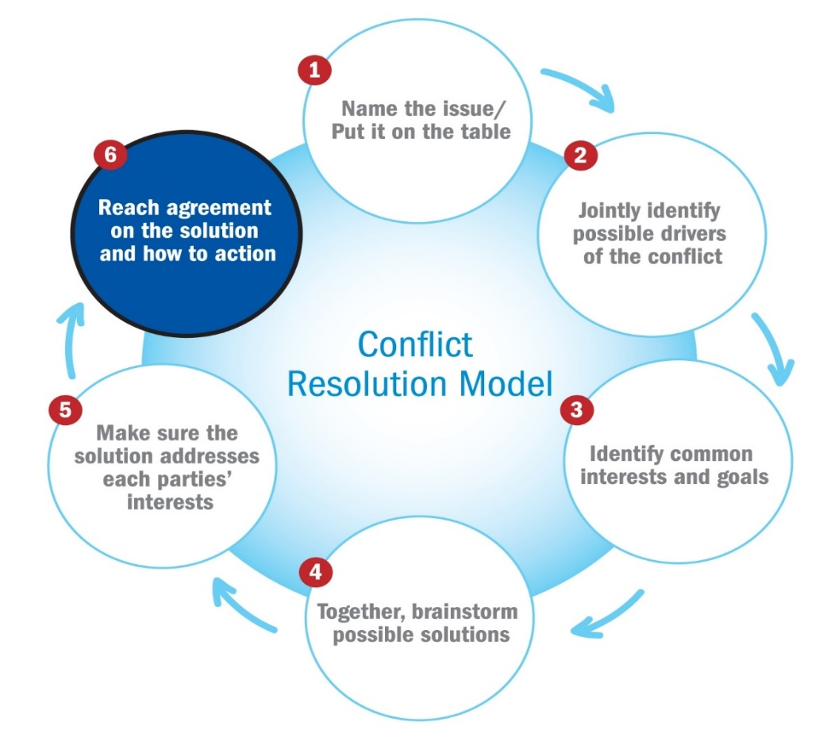
Conflict Resolution Model
Notes:
Review the conflict resolution model and emphasize the importance of identifying common interests, brainstorming possible solutions with your employee, and making sure that solution addresses each party’s interests.

Slide 6
Having Difficult Conversations: Before You Talk
Be clear about the issue and plan what you want to say ahead of time
Think about timing
Notes:
Review the slide. Ask participants to provide some examples.
To prepare for the conversation, you need to ask yourself two important questions: "What is the behavior that is causing the problem?" and "What is the impact that the behavior is having on you, the team or the organization?" You need to reach clarity for yourself so you can articulate the issue in two or three succinct statements. If not, you risk going off on a tangent during the conversation. The lack of focus on the central issue will derail the conversation and sabotage your intentions.

Slide 7
Having Difficult Conversations: During the Meeting
Set expectations
Talk about feelings
Pace the conversation
Manage emotions
Pace the conversation
Listen
Take breaks
Stay calm
Notes:
Review the slide.
Ask for examples.

Slide 8
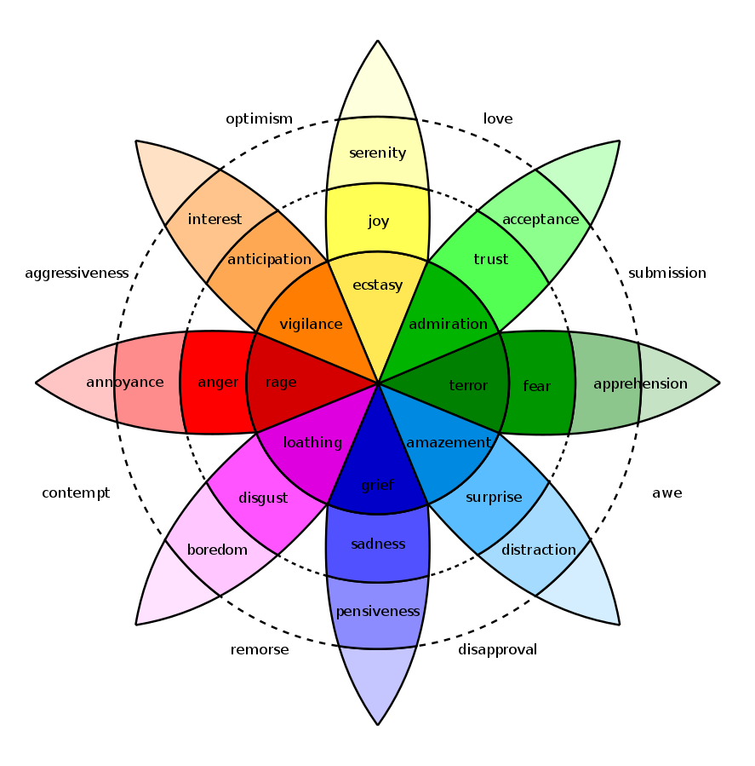
Manage Emotions
Wheel of Emotions
(Robert Plutchik, Albert Einstein College of Medicine)
Notes:
When we think about our emotions, we tend to think of them solely as states of feeling. For example, we may describe happiness as the state of feeling joy or pleasure. Psychologist Robert Plutchik states that there are eight basic emotions: joy, trust, fear, surprise, sadness, anticipation, anger, and disgust. Plutchik created the wheel of emotions, which illustrates the various relationships among the emotions.
Discuss the range of emotions and how they are on a continuum.
Ask participants how these emotions might impact having a fruitful conversation? Ask them to provide examples.

Slide 9
Having Difficult Conversations: Some Common Pitfalls
We fall into a combative mentality
We try to oversimplify the problem
We don’t bring enough respect to the conversation
We lash out – or shut down
We make false assumptions about our counterpart’s intentions
We lose sight of the goal
We arrive with our mind already made up
Notes:
Review the slide.

Slide 10
What are some phrases you might use to help resolve a conflict?
Notes:
Ask participants if they can provide some sample phrases?
Examples could include:
I didn't realize this was going on, so tell me more.
I want to listen to your point of view, but I can't do it when you are yelling at me.
I understand your point of view, but I see it differently.
I will incorporate your thoughts going forward.
Both of us need to put more effort into this if it's going to work out.
Why don't you agree with me?
Since we can't seem to agree, can we continue talking about it another day so we can think of more solutions?
Let's see what we can do to make sure it doesn't happen again.
What can I do to improve communications so this does not happen again?
What can I do next time to make this less difficult for you?
Distribute the handout 10 Phrases That Can Solve Any Work Problem and review.

Slide 11
Practice Using the Conflict Resolution Model
Think about a conflict/difficult conversation that you experienced in the past couple weeks—work or personal. What caused the conflict?
Pair up with a partner and share your example. Briefly discuss who, what, when, and where.
Share what worked and didn’t work in handling the conflict.
Talk about how this situation might have been resolved in a better way.
Share thoughts with the whole group.
Notes:
Interactive practice.
Review the instructions on the slide.
Distribute the Conflict Resolution Model handout. Give partners 20 minutes to practice. Then have people share their “ah ha” moments with the larger group.

Slide 12
Wrap Up
What are the take home messages?
Parting thoughts?
Notes:
Thank participants for their contributions.
Ask them to share key ideas and final thoughts.

