Slide 1
Ciclo de vida del VIH

Slide 2
Objetivos
Ciclo de vida del VIH
Al final de esta unidad las participantes podrán hacer lo siguiente:
Describir las etapas de la replicación del VIH utilizando la nemotecnia AFRITAB.
Comunicar cómo funciona el ciclo de vida del VIH (VLC), cómo el VIH ingresa a las células CD4, se replica y daña el sistema inmunitario
Identificar las diferentes clases de medicamentos antirretrovirales utilizados para el tratamiento contra el VIH.
Practicar la identificación de medicamentos antirretrovirales por marca, nombre genérico y abreviatura.
Demostrar dónde funciona cada medicamento antirretroviral para interrumpir la replicación del VIH.
Notes:
Review objectives.

Slide 3
Ciclo de vida del VIH
?
¿Qué saben acerca de cómo el VIH se replica dentro del cuerpo?
Notes:
Since the emergence of the HIV epidemic, there have been myths, misconceptions, and fears about HIV’s affect on the body. Disturbing images of patients clinging to life at the onset of the HIV/AIDS crisis have remained a prominent perspective for many, even though medical breakthroughs in treatment have made living with HIV manageable. In this next section we will learn how HIV uses our immune cells to make more of itself and how antiretroviral medications interrupt HIV replication. We will describe each stage of HIV replication using an easy format to aid memorization. Understanding HIV replication has the potential to radically shift the perception of HIV as a “boogeyman” to recognizing the virus as a chronic, treatable medical condition.
Ask participants to consider what they know about how HIV replicates inside the body.
Ask, “What did you learn about how the virus impacts a person’s health once they have been infected?”
Ask, “What do you know about how HIV replicates inside the body?”
Ask participants to keep these messages in mind to determine if they are confirmed or disproved.

Slide 4
Piensen en un huevo frito
Ciclo de vida del VIH
CÉLULA HUÉSPED = CD4 o célula T
La célula CD4 es la célula huésped del VIH.
NÚCLEO = el centro del núcleo de la célula CD4. Contiene ADN.
Notes:
Define some key terms that will be instrumental to describing the process of viral replication.
Host cell: A host is an animal or plant (or specific part of an animal or plant) in which another organism or microorganism lives. HIV targets the CD4/T-cell as its host cell.
The CD4 cell is one member of a collection of cells and substances that make up the immune system. It is responsible for stimulating other immune cells to respond to infection. In this way, it is often thought of as the general of the immune system’s army.
This fried egg is made up of two distinct parts, the egg white and the egg yolk. Without getting too technical, let’s think of the CD4 cell as a fried egg. This image illustrates two parts of a cell, the nucleus (egg yolk) and cytoplasm (egg white).
The center of the CD4 cell is called the nucleus. Imagine that the egg yolk is the nucleus of a CD4 cell. The nucleus is important because it contains human DNA that will be used in the process of making more HIV.
To summarize, HIV uses the CD4 cell as a host. Inside of the CD4 cell there is a core called the nucleus. The nucleus holds human DNA that will be used in the process of HIV replication.

Slide 5
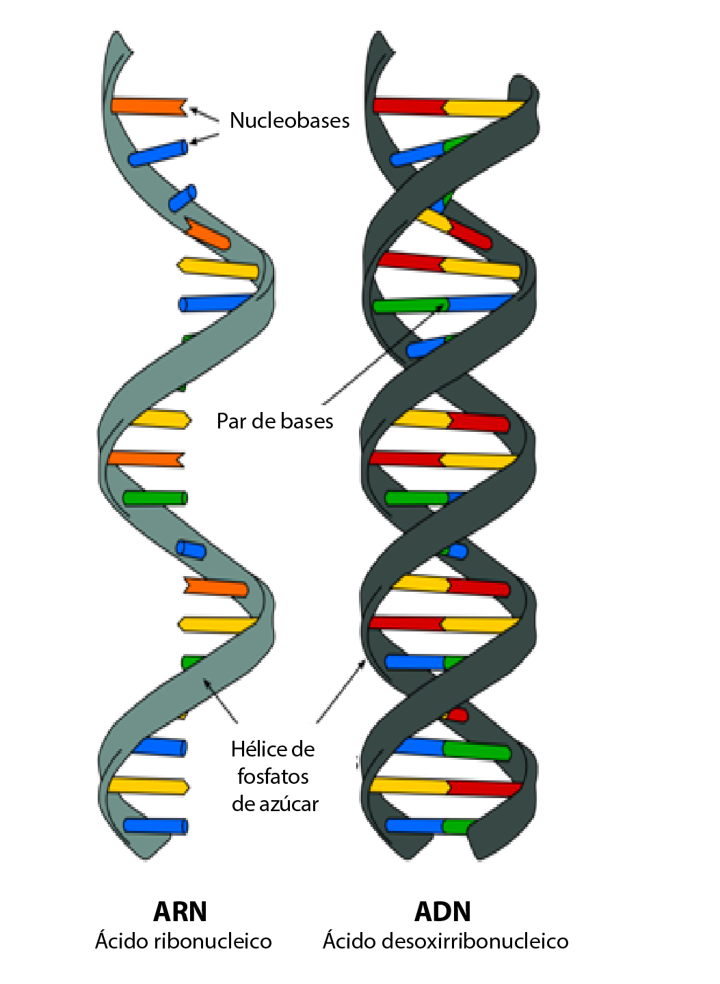
ARN frente al ADN
Ciclo de vida del VIH
ARN
El VIH tiene ARN.
Contiene una cadena de información genética.
ADN
Los humanos tienen ADN.
Contiene dos cadenas de información genética.
Notes:
There are two types of genetic material found in all living things, DNA (Deoxyribonucleic Acid) and RNA (Ribonucleic Acid). The main distinction that is important to understand how HIV replicates, is knowing that HIV contains RNA, which is a single strand of genetic material. DNA is the genetic material stored in the nucleus of the CD4 cell and it contains 2 strands of genetic material (see slide image).
Review definitions:
DNA (Deoxyribonucleic Acid): One of two types of genetic material found in all living cells and many viruses. (The other type of genetic material is RNA.) Deoxyribonucleic acid (DNA) carries the genetic instructions for the development and function of an organism. DNA allows for the transmission of genetic information from one generation to the next.
RNA (Ribonucleic Acid)- One of two types of genetic material found in all living cells and many viruses. (The other type of genetic material is DNA.) There are several types of ribonucleic acid (RNA). RNA plays important roles in protein synthesis and other cell activities.

Slide 6
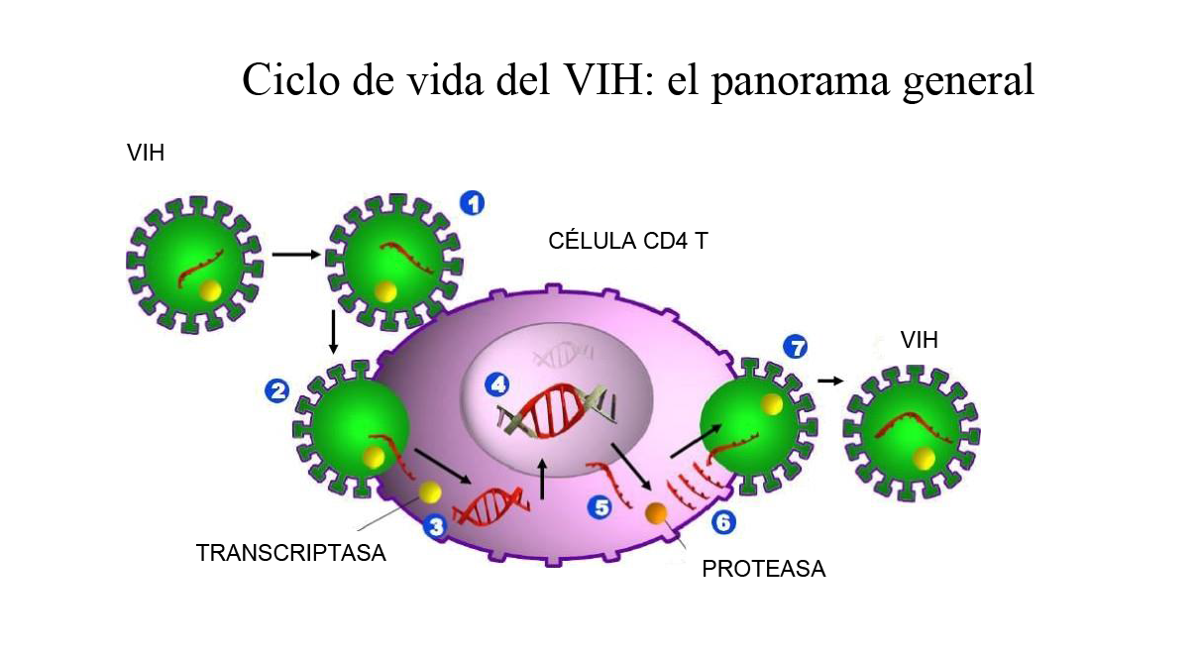
Ciclo de vida del VIH
Notes:
Distribute Handouts: “HIV Life Cycle - The Big Picture” and “HIV Life Cycle - Worksheet” for reference.
Using the slides, explain what happens at each phase of replication following the talking points. Remember to emphasize using the mnemonic AFRITAB to remember each stage.
The image above depicts the steps of HIV replication. HIV must follow several steps in order to make more HIV. The green images represent the journey of one HIV virion* using a CD4 cell (the purple image) to replicate.
*A virion is the complete, infective form of a virus outside a host cell, with a core of RNA or DNA and a capsid (a protein shell).
In the next few slides we will describe what occurs at each one of the 7 steps.
6

Slide 7
Ciclo de vida del VIH
A | Attachment (Enlace)
F | Fusión
R | Reverse transcription (Transcripción inversa)
I | Integración
T | Transcripción
A | Assembly (Ensamblaje)
B | Budding (Gemación)
Notes:
We will use the mnemonic AFRITAB to make it easier to remember each step of HIV replication. Each letter of AFRITAB represents a different step in the process of HIV making more of itself. Let's review the names for each step before we describe what happens during the individual phases.
Step 1
The letter A represents the first step of viral replication which is Attachment.
Step 2
The letter F stands for Fusion.
Step 3
The letter R represents the process known as Reverse transcription.
Step 4
The letter I stands for Integration.
Step 5
The letter T refers to the fifth stage called Transcription.
Step 6
The letter A stands for the process known as Assembly.
Step 7
The letter B represents the final step of viral replication known as Budding.
Take a minute to review the chart above so that you’ll become more familiar with the names of each stage. Be sure to use AFRITAB to support memorization. You might find it helpful to write AFRITAB vertically on a piece of paper and write the name of each corresponding step, essentially duplicating the chart above. This will help you to commit the information to memory.

Slide 8
Ciclo de vida del VIH
Notes:
Encourage participants to write each stage of viral replication on the HIV Life Cycle worksheet as they follow along.
Step 1
A = Attachment.
The first step in the HIV life cycle is Attachment.
Look at the image and you’ll see on the left an HIV virion (green and red image). The tan image on the right shows a portion of the CD4 cell. The image illustrates how HIV has located and attached itself to a CD4 call (host cell). Notice the “Y” like structures on the outside of the CD4 cell. These structures are called CD4 receptors. HIV attaches (binds) to the receptors on the CD4 cell and sends a message to the CD4 to let the virus enter.
HIV must connect to the CD4 cell receptors in a specific way in order for the message to the CD4 cell for entry to occur. If HIV does not attach correctly to the CD4 cell, the message for entry is not sent and that HIV virion will not be allowed entry into the cell.
In summary, the first step of the HIV life cycle replication is Attachment. HIV attaches to the CD4 cell and sends a message to the CD4 cell to gain entry.

Slide 9
Ciclo de vida del VIH
Notes:
Step 2
F = Fusion
Step 2 of the HIV life cycle is Fusion.
After HIV successfully attaches to the CD4 cell, it is ready to move to the second step called Fusion. Once bound, HIV enters and dumps its contents into the CD4 cell. The image illustrates the RNA and enzymes* carried inside of HIV.
*An enzyme is a molecule, usually a protein, that catalyzes (increases the rate of) chemical reactions in the body. Enzymes are essential to all body functions. HIV requires specific enzymes, such as reverse transcriptase or integrase, to replicate
Remember, the second step of viral replication is Fusion, when HIV enters the CD4 cell and dumps its contents. The contents include HIV RNA and reverse transcriptase (an HIV enzyme) along with other enzymes that will be described later.

Slide 10
Ciclo de vida del VIH
Notes:
Step 3
R = Reverse Transcription
Step 3 in the HIV life cycle is Reverse Transcription.
We learned at the last stage that HIV dumps HIV RNA and reverse transcriptase* into the CD4 cell. During the third step of viral replication the HIV RNA makes a copy of itself to become double-stranded HIV DNA within the CD4 cell. The enzyme reverse transcriptase (pictured as the little ball next to the RNA in the image above) aids in the process of HIV RNA becoming HIV DNA. HIV RNA must become HIV DNA in order to accomplish the next step in viral replication.
*Reverse Transcriptase: An enzyme found in HIV (and other retroviruses). HIV uses reverse transcriptase to convert its RNA into viral DNA, a process called reverse transcription.
The process of reverse transcription can be summarized as 1 strand of genetic material (RNA) becoming 2 strands of genetic material (DNA) using the enzyme reverse transcriptase.

Slide 11
Ciclo de vida del VIH
Notes:
Step 4
I = Integration
Step 4 in the HIV life cycle is Integration.
Once the HIV DNA has been formed it moves into the nucleus of the CD4 to combine with the human DNA. The integrase* enzyme is used to integrate the HIV DNA into the human DNA. Again, Integration occurs when HIV DNA inserts itself, or integrates, into the host CD4 cell’s DNA.
*Integrase: An enzyme found in HIV (and other retroviruses). HIV uses integrase to insert (integrate) its viral DNA into the DNA of the host CD4 cell.
So far we have covered the first four steps of viral replication. It is a good time to review what we have learned so far.
A = Attachment. In step 1, Attachment occurs when HIV attaches to the CD4 cell.
F = Fusion. In step 2, Fusion happens when HIV enters CD4 cell and dumps its contents.
R = Reverse transcription. During step 3, HIV RNA becomes HIV DNA (1 strand of genetic material becomes 2 strands of genetic material).
I = Integration. In step 4, Integration happens when HIV DNA combines with the human DNA in the nucleus of the CD4 cell.

Slide 12
Ciclo de vida del VIH
Notes:
Step 5
T = Transcription
Step 5 in the HIV life cycle is Transcription.
After integration, HIV uses the CD4 cell like a manufacturing factory to create “packages” for making new HIV. The nucleus releases long chains of HIV RNA and proteins that contain information to make new HIV.
The key idea to remember about transcription is information for making new HIV is released from the nucleus in long chains of proteins.

Slide 13
Ciclo de vida del VIH
Notes:
Step 6
A = Assembly
Step 6 in the HIV life cycle is Assembly.
Once the long chains are released from the nucleus, an enzyme called protease* is used to break down the long chains into smaller “packages” that line up along the edge of the CD4 cell in preparation for the final stage of the HIV life cycle. Everything needed to make new HIV is present at this point; however, it is not infectious.
*Protease: A type of enzyme that breaks down proteins into smaller proteins or smaller protein units, such as peptides or amino acids. HIV protease cuts up large precursor proteins into smaller proteins. These smaller proteins combine with HIV’s genetic material to form a new HIV virus.
In short, remember this is the stage where the “packages” of information for making new HIV line up along the edge of the CD4 cell.

Slide 14
Ciclo de vida del VIH
Notes:
Step 7
B = Budding
The seventh and final step in the HIV life cycle is Budding.
Once the newly formed HIV has assembled along the cell wall, it pushes itself out of the CD4 cell, stealing part of the cell’s protective coating. The new virus matures and becomes infectious and seeks to attach to another host to begin the process again.
We’ve outlined the process of a single HIV virion’s journey of replication; however, this process happens repetitively by multiple HIV virions, which can produce billions of copies daily.

Slide 15
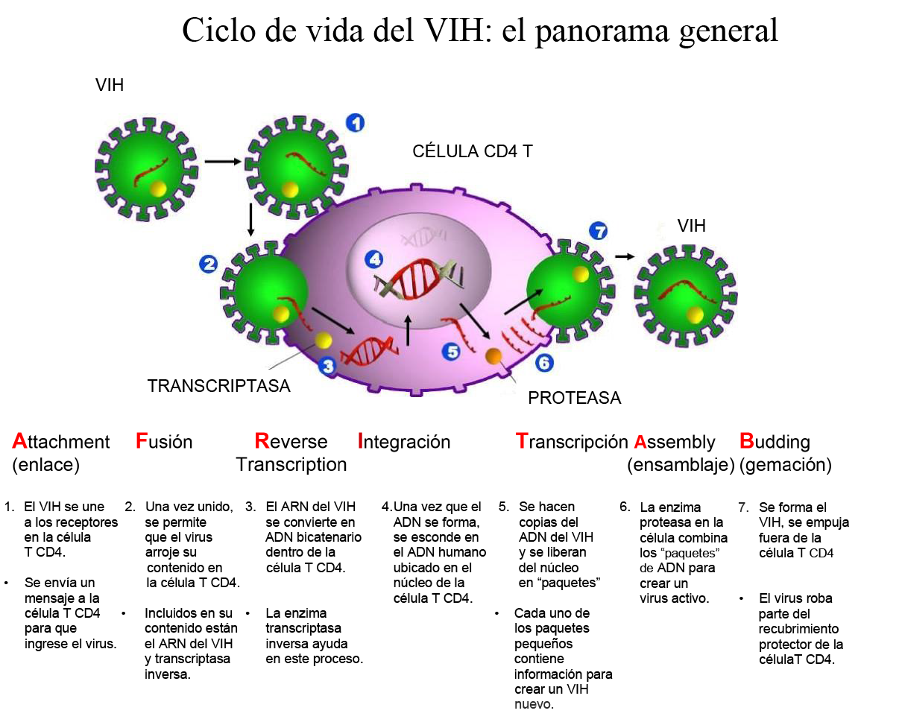
Ciclo de vida del VIH
Notes:
We have covered the seven steps of the HIV Life Cycle and used the mnemonic AFRITAB as a learning and memory aide. Lets review the steps one more time as repetition helps to anchor information into memory.
A = Attachment. Attachment occurs when HIV attaches to the CD4 cell.
F = Fusion. Fusion happens when HIV enters CD4 cell and dumps its contents.
R = Reverse transcription. HIV RNA becomes HIV DNA (1 strand of genetic material becomes 2 strands of genetic material).
I = Integration. Integration happens when HIV DNA combines with human DNA in the nucleus of the CD4 cell.
T = Transcription. Information for making new HIV is released from the nucleus in long chains of proteins.
A = Assembly. Packages of information for making new HIV line up along the edge of the CD4 cell.
B = Budding. During the final step of replication, newly formed HIV pushes itself out of the CD4 cell, stealing part of the cell’s protective coating.
Knowing how HIV replicates is important because it provides an explanation of what happens after someone contracts HIV. It is clear that HIV is a virus that uses the CD4 cell as a host to make more HIV. The process eventually destroys the CD4 host cell, which leads to poor immune function and makes it harder for the body to fight infection. Scientists use knowledge about the HIV life cycle to build an arsenal of HIV medications that are able to block replication at multiple stages of the process. When HIV medications are skillfully used, the amount of HIV in the body is drastically reduced, immune function is preserved and people live healthier lives.

Slide 16
ACTIVIDAD: CICLO DE VIDA DEL VIH
Notes:
Let’s practice together! Now it’s your turn to teach the HIV Life Cycle using the mnemonic AFRITAB.
Instructions:
On a flip chart sheet, write AFRITAB vertically down the left side.
Solicit a volunteer to write the name of the stage beginning with A, and describe what takes place during that phase of replication. Continue with F and so on encouraging a new volunteer to describe the subsequent steps.
Be sure the verbal description for each step is factually accurate.
Ask participants to follow along by filling in the blanks on the HIV Viral Life Cycle worksheet.
Optional variations for this practice segment:
Participants can form dyads or small groups to “act out” each stage of replication.
Participants can form small groups, each assigned one step of replication. Distribute flip chart sheets to each group along with markers. Ask each group to draw and present their step in the correct order of replication.

Slide 17
Ciclo de vida del VIH: Medicamentos en funcionamiento
Notes:
Next we’ll discuss how HIV medications work.

Slide 18
Medicamentos contra el VIH: el comienzo
Medicamentos en funcionamiento
FECHA | HITO
1987 | 1.º medicamento, AZT fue aprobado por la FDA
1995 | 1.º aprobación de la FDA de la terapia combinada
1996 | 1.º inhibidor de proteasa que recibe la aprobación de la FDA
Actualidad | Seis clases de medicamentos contra el VIH; varios regímenes de una sola tableta una vez al día
Notes:
Advances in HIV medications have been a hallmark achievement for extending the lives of people with HIV. When HIV was first identified in the early 1980’s there was little that could be done to help those who were diagnosed with HIV. It wasn’t until 1987, that the first drug, AZT, was approved by the FDA. AZT was useful in blocking replication until viral mutations caused resistance, decreasing AZT’s efficacy as a single-agent treatment.
Monotherapy (use of one drug) was the standard of care until 1995 when the FDA approved combination therapy (use of two or more drugs) with AZT and 3TC (Epivir). Both AZT and Epivir worked to block HIV replication during the process of Reverse Transcription, when HIV RNA converts to HIV DNA. It wasn’t until the following year, in 1996, that the first Protease Inhibitor was approved for use in combination therapy, which allowed for interruption of viral replication at two different steps of the HIV life cycle.
Since HIV can easily develop resistance to single drug treatments, combination treatment was a game changer for many living with HIV. Life expectancy increased, but it was at the expense of treatment regimens containing numerous pills and multiple doses per day.
The progress was slow during the onset of the epidemic; however, the new millennium brought a surge in newer, more tolerable therapies that have significantly lowered pill burdens. In fact, today there are multiple single-dose, once-a-day regimens that contain at least three different medications to fight HIV. Further, there are six different classes of medications, many with several medication options all designed to block HIV replication at different steps. Several more medications are in development or in clinical trials to verify their effectiveness and gain FDA approval for use.
Finally, antiretroviral medications are not a cure for HIV; however, their benefits are significant for public health, life expectancy, and quality of life. HIV treatment medications help lower the amount of HIV in the blood, slow disease progression, reduce HIV transmission when undetectable, and enable people with HIV to live healthy, productive lives.
Note: The use of more than one drug is referred to multiple ways including, combination therapy, drug/treatment cocktails, medication regimen, HAART, ART and cART (see below for explanation of abbreviations).
HAART- Highly Active Antiretroviral Treatment
ART- Antiretroviral Treatment
cART- Combination Antiretroviral Treatment

Slide 19
Medicamentos en funcionamiento
Medicamentos contra el VIH: los tres nombres
Los medicamentos contra el VIH se conocen con tres nombres
Medicamentos contra el VIH: conceptos básicos
 | Ejemplo 1 | Ejemplo 2
Marca comercial | Prezista® | Sustiva®
Nombre genérico | darunavir | efavirenz
Abreviatura | DRV | EFV
“2017 HIV Drug Chart” - Positively Aware
Notes:
Before we talk about the different classes of HIV medications, it’s important to know that each HIV medication has 3 names:
Brand name
Generic name
Abbreviation
In example 1, Prezista is the brand name, darunavir is the generic name, and DRV is its abbreviation. Example 2 shows Sustiva as the brand name, efavirenz as the generic, and EFV as its abbreviation.
This information is useful to know when reviewing lab results, client charts, providing adherence counseling, researching side effects, and more. In fact, you may hear different disciplines use certain names more frequently. For example, a physician may refer to an HIV medication by its abbreviation or generic name when discussing a case study, but a CHW might refer to the medication’s brand name when working with a client. While it may not be a priority to remember the brand, generic, and abbreviation for every HIV medication, it is useful to know that a current HIV medication chart can be used as a quick reference guide. Medication charts often organize HIV medication by their class, list all three names per drug, show an image, and common dosage.
See an example of an HIV medication chart by clicking the link on the slide or copy and paste the link below into your web browser.
2018 HIV Drug Chart – Positively Aware
https://www.positivelyaware.com/issues/positively-aware-hiv-drug-chart-2018

Slide 20
Clases de medicamentos contra el VIH
Medicamentos en funcionamiento
Existen seis clases de medicamentos contra el VIH:
ITIN = inhibidores de la transcriptasa inversa análogos de los nucleósidos
ITINN = inhibidores de la transcriptasa inversa no análogos de los nucleósidos
IP = inhibidores de la proteasa
II = inhibidores de la integrasa
Inhibidores de la entrada
Intensificadores = potenciadores farmacocinéticos
Notes:
There are 6 Classes of HIV medications. HIV medications are grouped into drug classes according to how they fight HIV.
NRTIs = Nucleoside Reverse Transcriptase Inhibitors
NNRTIs = Non-Nucleoside Reverse Transcriptase Inhibitors
PIs = Protease Inhibitors
IIs = Integrase Inhibitors
Entry Inhibitors
Boosters = Pharmacokinetic Enhancers
In the next few slides we will discuss each class of HIV medications and how they work to interrupt the HIV life cycle. You should recognize several of these terms from our previous discussion of the HIV Life Cycle.
Facilitator’s Note: Please check current HIV medication drug charts for the most recent list. New developments occur and new classes may exist.

Slide 21
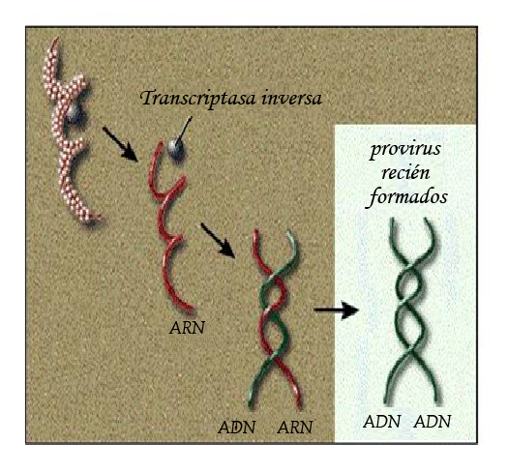
Inhibidores de la transcriptasa inversa análogos de los de nucleósidos (ITIN)
Medicamentos en funcionamiento
Los ITIN inhiben la transcripción inversa.
Descovy®
Emtriva®
Epivir®
Epzicom®
Truvada®
Viread®
Ziagen®
Notes:
NRTIs = Nucleoside Reverse Transcriptase Inhibitors
Nucleoside Reverse Transcriptase Inhibitors are often referred to as NRTI’s or “Nukes.” This class of medications prevent HIV RNA from making HIV DNA, part of the HIV life cycle known as Reverse Transcription. NRTIs block the enzyme reverse transcriptase. If the HIV RNA is not converted into HIV DNA, it cannot continue on to the next phase of the life cycle. Essentially replication is stopped when the medications intervene effectively.
Some commonly used medications in this class are listed on the slide.

Slide 22
Inhibidores de la transcriptasa inversa no análogos de los nucleósidos (ITINN)
Medicamentos en funcionamiento
Los ITINN inhiben la transcripción inversa.
Edurant®
Intelence®
Sustiva®
Notes:
NNRTIs = Non-Nucleoside Reverse Transcriptase Inhibitors
Non-Nucleoside Reverse Transcriptase Inhibitors are also known as NNRTIs or “Non-Nukes.” Non-Nukes also work at reverse transcription by blocking a specific protein HIV uses for replication at this stage. This group of inhibitors also prevent HIV RNA from making HIV DNA by targeting a different point during Reverse Transcription.
Non-nukes are known for their sensitivity to cross resistance. According to the U.S Department of Health and Human Services AIDSinfo, “Cross resistance is when resistance to one HIV medicine causes resistance to other medicines in the same HIV drug class. As a result of cross resistance, a person’s HIV may be resistant even to HIV medicines that the person has never taken. Cross resistance limits the number of HIV medicines available to include in an HIV regimen.”
Common NNRTIs are listed on the slide.

Slide 23
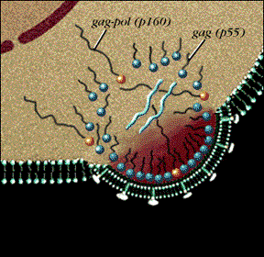
Inhibidores de la proteasa (IP)
Medicamentos en funcionamiento
Los inhibidores de la proteasa ayudan a prevenir que el ADN del VIH forme “paquetes” pequeños.
Evotaz®
Prezcobix®
Prezista®
Reyataz®
Notes:
Protease Inhibitors
Protease Inhibitors are also called PIs. Protease inhibitors prevent the protease enzyme from cutting long chains of proteins into smaller “packages” that are used form new HIV. These medications work at Assembly, the sixth stage of the viral life cycle.
Common PIs are listed on the slide.

Slide 24
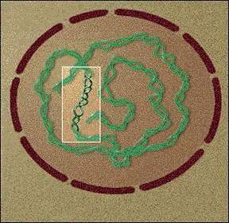
Inhibidores de la integrasa (II)
Medicamentos en funcionamiento
Los inhibidores de la integrasa ayudan a bloquear la unión del ADN del VIH al ADN de la célula huésped.
Isentress®
Tivicay®
Notes:
II = Integrase Inhibitors
Integration Inhibitors are also known as IIs and work to prevent HIV DNA from binding to the CD4 host cell’s DNA by disabling the integrase enzyme. Integrase Inhibitors are a newer class of medications that gained FDA approval in 2007. The are potent antiretroviral agents that are well tolerated and provide options for people who may have developed resistance to several medications in other classes.
Common IIs are listed on the slide.

Slide 25
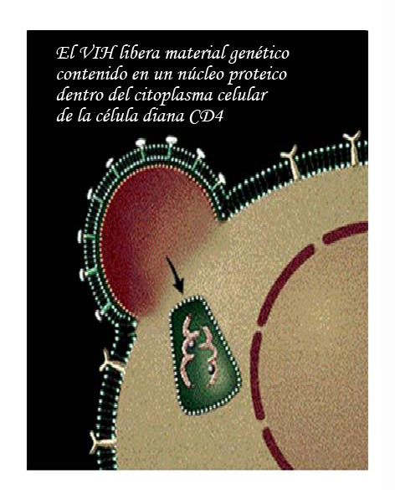
Inhibidores de la entrada (inhibidores de fusión)
Medicamentos en funcionamiento
Los inhibidores de fusión ayudan a bloquear la entrada del VIH en la célula CD4.
Selzentry®
Notes:
Entry Inhibitors
Entry Inhibitors block HIV’s entry into the CD4 host cell. Selzentry, the most commonly used Entry Inhibitor is called a CCR5 antagonist because it blocks HIV from attaching to the CCR5 receptors on the surface of the CD4 cell. Another less commonly used medication in this category is Fuzeon. Fuzeon is a Fusion Inhibitor and prevents HIV from entering the CD4 cell to dump its contents for replication. Both medications block HIV’s entry into the host cell in different ways and that’s why this class is best categorized as entry inhibitors. Entry inhibitors work at the Attachment and Fusion stages of the viral life cycle.
The most common medication is listed on the slide.

Slide 26
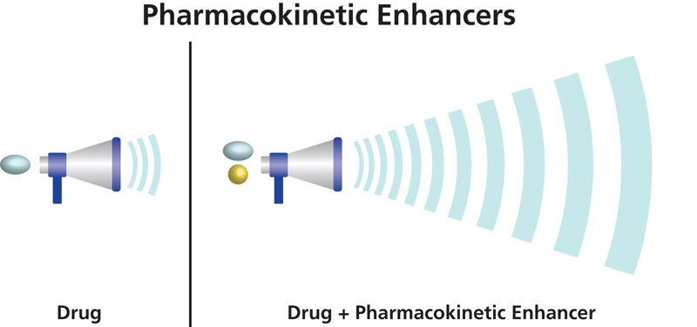
Potenciadores farmacocinéticos (Intensificadores)
Medicamentos en funcionamiento
Los potenciadores se usan para aumentar la efectividad de otro medicamento.
Norvir®
Tybost®
Potenciadores farmacocinéticos
Medicamento Medicamento + mejora farmacocinética
Notes:
Boosters = Pharmacokinetic Enhancers
The sixth class of HIV medications is Pharmacokinetic Enhancers.
Pharmacokinetic Enhancers are more commonly known as Boosters. Boosters are medications that are taken with another drug are used to increase the effectiveness of the other drug. They work by helping the other drug stay in the body longer at higher concentrations without increasing toxicity. Boosters are often included in single tablet regimens. These drugs do not interfere with the HIV life cycle, but they boost the effects of accompanying HIV medications.
Common Boosters are listed on the slide.

Slide 27
Medicamentos contra el VIH de una vez al día
Medicamentos en funcionamiento
Atripla® (efavirenz, emtricitabina, fumarato de disoproxilo de tenofovir)
Biktarvy® (bictegravir, tenofovir alafenamida, emtricitabina)
Complera® (rilpivirina, tenofovir, emtricitabina)
Delstrigo® (doravirina fumarato de disoproxilo de tenofovir, lamivudina)
Genvoya® (elvitegravir, cobicistat, emtricitabina, tenofovir alafenamida)
Juluca® (dolutegravir, rilpivirina)
Odefsey® (rilpivirina, tenofovir alafenamida, emtricitabina)
Stribild® (elvitegravir, cobicistat, tenofovir, emtricitabina)
Triumeq® (abacavir, dolutegravir, lamivudina)
Symfi® y Symfi Lo® (efavirenz, lamivudina, fumarato de disoproxilo de tenofovir)
Symtuza® (darunavir, cobicistat, emtricitabina, tenofovir alafenamida)
Notes:
This final group isn’t considered an official class of HIV medications, but it is useful to see them grouped together in this way. This is a grouping of once-daily medications.
Each medication is comprised of 2 or more medications that work together to block HIV replication. This group has revolutionized HIV treatment regimens and are a great support of medication adherence. Once-daily regimens empower people with HIV by helping to stop HIV progression, reducing the amount of HIV virus in the body, and increasing convenience for taking the daily dose. Continued advancements in HIV treatment move closer to a cure and provide hope for those living with this chronic, treatable medical condition.

Slide 28
Actividad: Medicamentos contra el VIH en funcionamiento
Medicamentos en funcionamiento
Compartan lo siguiente:
El nombre del medicamento
La clase de fármaco a la que pertenece
Ubiquen la etapa de replicación donde el medicamento interrumpe la replicación del VIH.
Ejemplo
Selzentry®
Inhibidor de la entrada
Selzentry® evita que el VIH ingrese a la célula CD4.
Notes:
Activity: HIV Medications at Work
Distribute handout: Medication At Work in the HIV Life Cycle
Distribute an up-to-date HIV medication chart, for example: https://www.poz.com/drug_charts/hiv-drug-chart
Examples of a Prescribed HIV Regimen (reference the slide with once-daily regimens)
Now that we have gained knowledge of how HIV medications work in supporting viral suppression, we will do an activity that can be life-changing for clients who are challenged with adherence.
The purpose of the activity is to understand at what stage of the HIV life cycle a medication works to impede replication.
Invite volunteers to choose a single tablet regimen from the medication chart or once-daily medication slide (variation: participants can work in teams).
Ask participants to which drug class the medication belongs.
Ask participants to identify what stage of the HIV life cycle is interrupted.
Ask participants to locate the stage of the HIV life cycle on the Medication At Work in the HIV Life Cycle handout.
Next, ask for volunteers to describe how the medications work to interrupt viral replication, while remaining participants follow along.
Example:
The name of the medication
Biktarvy® (bictegravir, tenofovir alafenamide, emtricitabine)
Biktarvy® is comprised of bictegravir, tenofovir alafenamide and emtricitabine.
The drug class to which it belongs
Locate each medication on the drug chart and note the class to which it belongs.
bictegravir is an Integrase Inhibitor.
tenofovir alafenamide + emtricitabine belong to the Nucleoside Reverse Transcriptase Inhibitor (NRTI) class of medications.
Locate the stage of replication where the medication interrupts HIV replication
Since bictegravir is an Integrase Inhibitor, it works at the HIV life cycle stage called Integration. Bictegravir blocks HIV DNA from integrating with human DNA in the nucleus of the CD4 cell. In short, it blocks integration.
The other medications, tenofovir alafenamide + emtricitabine are NRTIs and work at the HIV life cycle stage called Reverse Transcription. These medications block HIV RNA from making HIV DNA.
Biktarvy® is a single tablet regimen made of 3 medications that block HIV replication in 2 places of the life cycle.
If discussing as one large group, repeat a few times as time allows. If participants have been broken into groups, facilitate a large group share. Participants can reference the slide to guide their responses.

