Slide 1
Centering Health equity in a pandemic
COVID-19 in Black Communities
Cassandra Pierre MD, MSc
March 24, 2021
Notes:
Good evening, I am honored to be here with this wonderful panel and participants. As an infectious disease physician whose clinical focus is HIV and works in an essential/safety-net hospital, looking through health care with a health equity lens is a daily occurrence. But this year a whole other thing, where providing treatment and prevention recommendations for COVID-19 has been all about navigating differences in social determinants and disparities in structurally vulnerable populations including Black communities (which is resonant for me as a Black woman who has had several family members with severe COVID).

Slide 2
Agenda
COVID-19’s impact on the Black community: outcomes, access, treatment and vaccines
Case study: MA and COVID-19 health equity
Actions to center health equity during a pandemic
Notes:
What I’d like to discuss today is that despite the many warning signs along the way this year that COVID wasn’t experienced equally across race (particularly in the Black community) in terms of outcome, access, testing, treatment and prevention—despite all of those warning signs and the commitment that many of our national and state leaders have pledged to health equity during this process—how we still fail to get it right, why do we continue to see these disparities (in fact, worsening disparities) and why that might be. I’d like to use the MA COVID-19 vaccine roll-out in the Black community as an illustration of how even when you say you’re invested in an equitable health outcome, you can fail to achieve it. And then I’ll end by noting some actions that we can take to center and promote health equity across race and within other structurally vulnerable populations in this pandemic and future ones.

Slide 3
Agenda
COVID-19’s impact on the Black community: outcomes, testing, treatment and vaccines
Case study: MA and COVID-19 health equity
Actions to center health equity during a pandemic
Notes:
First, we’re going to speak about what COVID-19 has done to the Black community in numbers. Next, we’re going to look at previous American infectious disease epidemics and whether there was anything from those experiences we should have learned. Then we’ll discuss what has set us up to be where we are; now and how policies created decades ago has made us vulnerable to yet another pandemic. But I’ll end by speaking about how we can end COVID-19 in the Black community both by taking what we need from the system while holding the system: of healthcare, public health and the government—accountable to us.

Slide 4
COVID-19 cases, hospitalizations and death by race/ethnicity
Rate ratios c/w White, non-Hispanic persons | American Indian or Alaska Native | Asian | Black or African American | Latinx
Cases | 2.8 x higher | 1.1 x higher | 2.6 x higher | 2.8 x higher
Hospitalization | 5.3 x higher | 1.3 x higher | 4.7 x higher | 4.6 x higher
Death | 1.4 x higher | No increase | 2.1 x higher | 1.1 x higher
Source: CDC, https://www.cdc.gov/coronavirus/2019-ncov/covid-data/investigations-discovery/hospitalization-death-by-race-ethnicity.html
Notes:
UPDATE (look at link)

Slide 5
COVID-19 death by race/ethnicity
Black and Brown populations are not inherently more susceptible to poor COVID-19 outcomes
Neighborhood, household, employment characteristics and effects on chronic health conditions explain the disproportionate COVID-19 outcomes in Black communities
Notes:
We know that these disparities are not by chance, luck or genetics. Although COVID-19 is not the great equalizer it was originally billed as being, it doesn’t discriminate and it doesn’t target individuals based on race or ethnicity. The past several months have been spent in a national conversation regarding the neighborhood, work and housing related characteristics that have contributed to these disparities and correctly pinned them to the social determinants of health.

Slide 6
COVID-19 and Healthcare in Black community: testing
Evaluation of billing claims in February/March 2020 revealed that Black patients exhibiting COVID-19 symptoms were six times less likely to receive testing or treatment, in comparison to white patients who exhibited symptoms.
COVID-19 and Minority Health Access. Rubix Life Sciences. https://rubixls.com/wp-content/uploads/2020/04/COVID-19-Minority-Health-Access-6.pdf
Notes:
And the differences caused by these social determinants of health have been compounded by systemic racism and racial bias in healthcare.
Unfortunately, those systems of marginalization just don’t stop at the doors of our hospital and research institutions. They live inside us as well. ….That’s painful
With the benefit of hindset, one questions whether the algorithms defined to instruct who to admit and who to discharge were generally flawed
Black people may disproportionately benefit from hospitalization

Slide 7
COVID-19 and Healthcare in Black community: treatment
Monoclonal antibody
Only approved outpatient treatment for COVID-19; EUA in November 2020
Distribution in Massachusetts
20% of monoclonal antibody reserved for individuals in structurally vulnerable populations with high COVID-19 incidence
Despite intention to ensure equitable access, to date MA DPH reports that most infusion therapy recipients were White (83%)
6% were Black
6% were Hispanic/Latinx
Suggests there may be additional factors a/w disparities in allocation
Social determinants of health (transportation)
Bias in treatment guidance for ambulatory patients
Concern regarding trustworthiness/safety of medication and medical establishments
Notes:
Now many people may not be crying over the fact that we have a lot of unused monoclonal antibodies. Rollout has been ambivalent in many hospitals due to lukewarm response from infectious-disease specialists, who say they want more clinical trial data before using them on a regular basis.
To date, there are three published studies on the use of monoclonal antibodies to treat COVID-19 in the outpatient setting and studies are still ongoing

Slide 8
COVID-19 and Healthcare in Black community: vaccines
Racial disparities characterize COVID-19 vaccination roll-out in the US (White Americans have received a disproportionate percentage of vaccinations compared with Black and Hispanic Americans)
Misconception: Vaccine hesitancy is the primary reason for disparities in COVID-19 vaccination among Black communities
Vaccine acceptance polls (CBS News/You.Gov)
Those who have received vaccines: 26% of White adults, 17% of Black adults, 11% of Hispanic/Latinx adults
Those who say they want the vaccine: 31% of White adults, 34% of Black adults, 41% of Hispanic/Latinx adults
Source: CBS News/You.Gov poll, March 2021. https://drive.google.com/file/d/1fIZaAH0X45MazScguHAnitO4SsV_PdhR/view

Slide 9
COVID-19 and Healthcare in Black community: vaccines
Misconception: Vaccine hesitancy is the primary reason for disparities in COVID-19 vaccination among Black communities
Vaccine hubs (which rely on previously existing healthcare infrastructure) are largely missing from predominantly Black and Latinx communities in the south (including Louisiana, Texas and Alabama)
Black Americans in nearly two dozen urban counties in and around Atlanta, New Orleans and Dallas, among a host of other cities, faced significantly longer driving distances to vaccine centers than white Americans.
Sources: West Health, University of Pittsburgh School of Pharmacy; https://www.westhealth.org/resource/vaxmap-potential-covid-19-vaccine-locations/
Notes:
What we’re actually seeing is that vaccine access is the primary issue
The access is more about access than it is about hesitancy

Slide 10
Agenda
COVID-19’s impact on the Black community: outcomes, access, treatment, vaccines and chronic disease
Case study: MA and COVID-19 vaccine equity
Actions to center health equity during a pandemic

Slide 11
MA and COVID-19 vaccines
Massachusetts vaccination statistics (as of 03.18.21)
Ranks 3rd in the country in the percentage of Black people who have received at least one dose of a COVID-19 vaccine
25.7% of White people have received at least one dose of a COVID-19 vaccine
16.9% of Black people have received at least one dose of a COVID-19 vaccine
Marked inequity in vaccine distribution
Despite government’s emphasis on equitable vaccine distribution as a pillar of the vaccine distribution process in MA, none of the initial mass vaccination sites nor first responder sites initially set up were located in areas of high social vulnerability/communities of color
Notes:
There’s still this marked inequity of vaccine distribution relative to the population that is highest risk for exposure with COVID-19 (healthcare workers, front-line workers) and those who are at hightest risk for complications with COVID-19—
There was this dissonance between what we saw and what we heard.

Slide 12
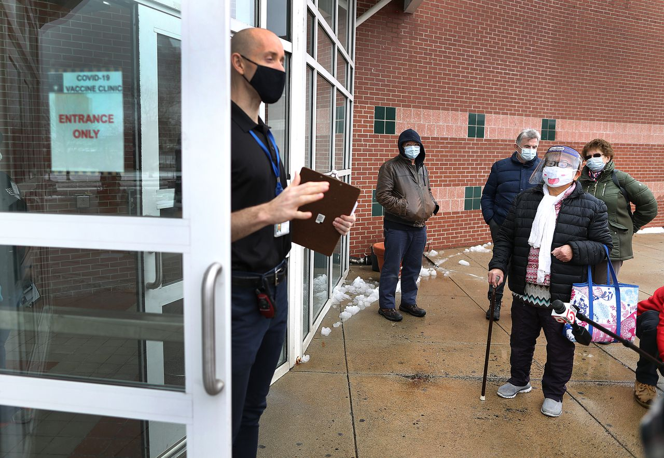
MA, COVID-19 vaccines and health equity
Designated Reggie Lewis Center in Roxbury as the 3rd mass vaccination site
Slots were filled by an overwhelmingly white population from Beacon Hill, Brookline and Cambridge (much fewer Black and Brown people)
Planned to designate 20% of the state’s vaccine supply for hard-hit, largely structurally vulnerable Black and Brown communities beginning in Phase 2 of the three-phase rollout
Despite concerns re: inequitable vaccine access in these communities, this has yet to be realized
Notes:
Again we have this situation where we’re saying again and again and again that we’re prioritizing health equity (including racial equity among the Black and Latinx communities that have disproportionately been affected by COVID-19) and yet failing to achieve equity. What’s missing here?
20%: has yet to come to fuition

Slide 13
MA, COVID-19 vaccines and health equity
Community/healthcare partnerships and community-led initiatives sought to bridge vaccine inequity in communities of color
Black Boston COVID-19 Coalition: partnered with Black physician group for once monthly weekend event where physicians, nurses, pharmacists and administrative staff are people of color
Boston Medical Center: worked with faith leaders, activists, community health centers and community organizations to designate 5 community vaccine administration sites in neighborhood COVID-19 hotspots (Mattapan, Dorchester, Roslindale, Hyde Park and South End)
Community Health Centers (various): mobile vans to deliver vaccines to homebound elders and other less mobile populations
Notes:
I would argue that the missing key ingredient in this process has been true engagement with the community. With the people who have the most experience in understanding community needs, community mobilization and community education and outreach—these people and organizations have been the main reason (I think) that we have the 3rd highest rate of COVID-19 vaccination in the country.

Slide 14
Agenda
COVID-19’s impact on the Black community: outcomes, access, treatment, vaccines and chronic disease
Case study: MA and COVID-19 health equity
Actions to center health equity during a pandemic

Slide 15
Actions to promote health equity during COVID-19
Educate in ways that resonate with Black communities
Use data as a tool for equity
Attend to the social determinants of health
Advocating efforts to address COVID-19 disparities
Leveraging community partnerships

Slide 16
Summary
Policies/norms that led to Black/Brown communities bearing disproportionate burden of COVID-19 infection, hospitalization and death are not new
Attempts to improve health equity across the spectrum of healthcare delivery will fail if the system doesn’t change (social determinants not addressed; community not engaged).
Initiatives that seek to meaningfully promote COVID-19-related health equity must seek to focus on social determinants of health and form lasting partnerships with community organizations and advisors.
Notes:
Education and implementation of infection prevention efforts (particularly COVID-19 vaccines) must be tailored to the unique perspective of Black communities

Slide 17
Thank you

