Slide 1
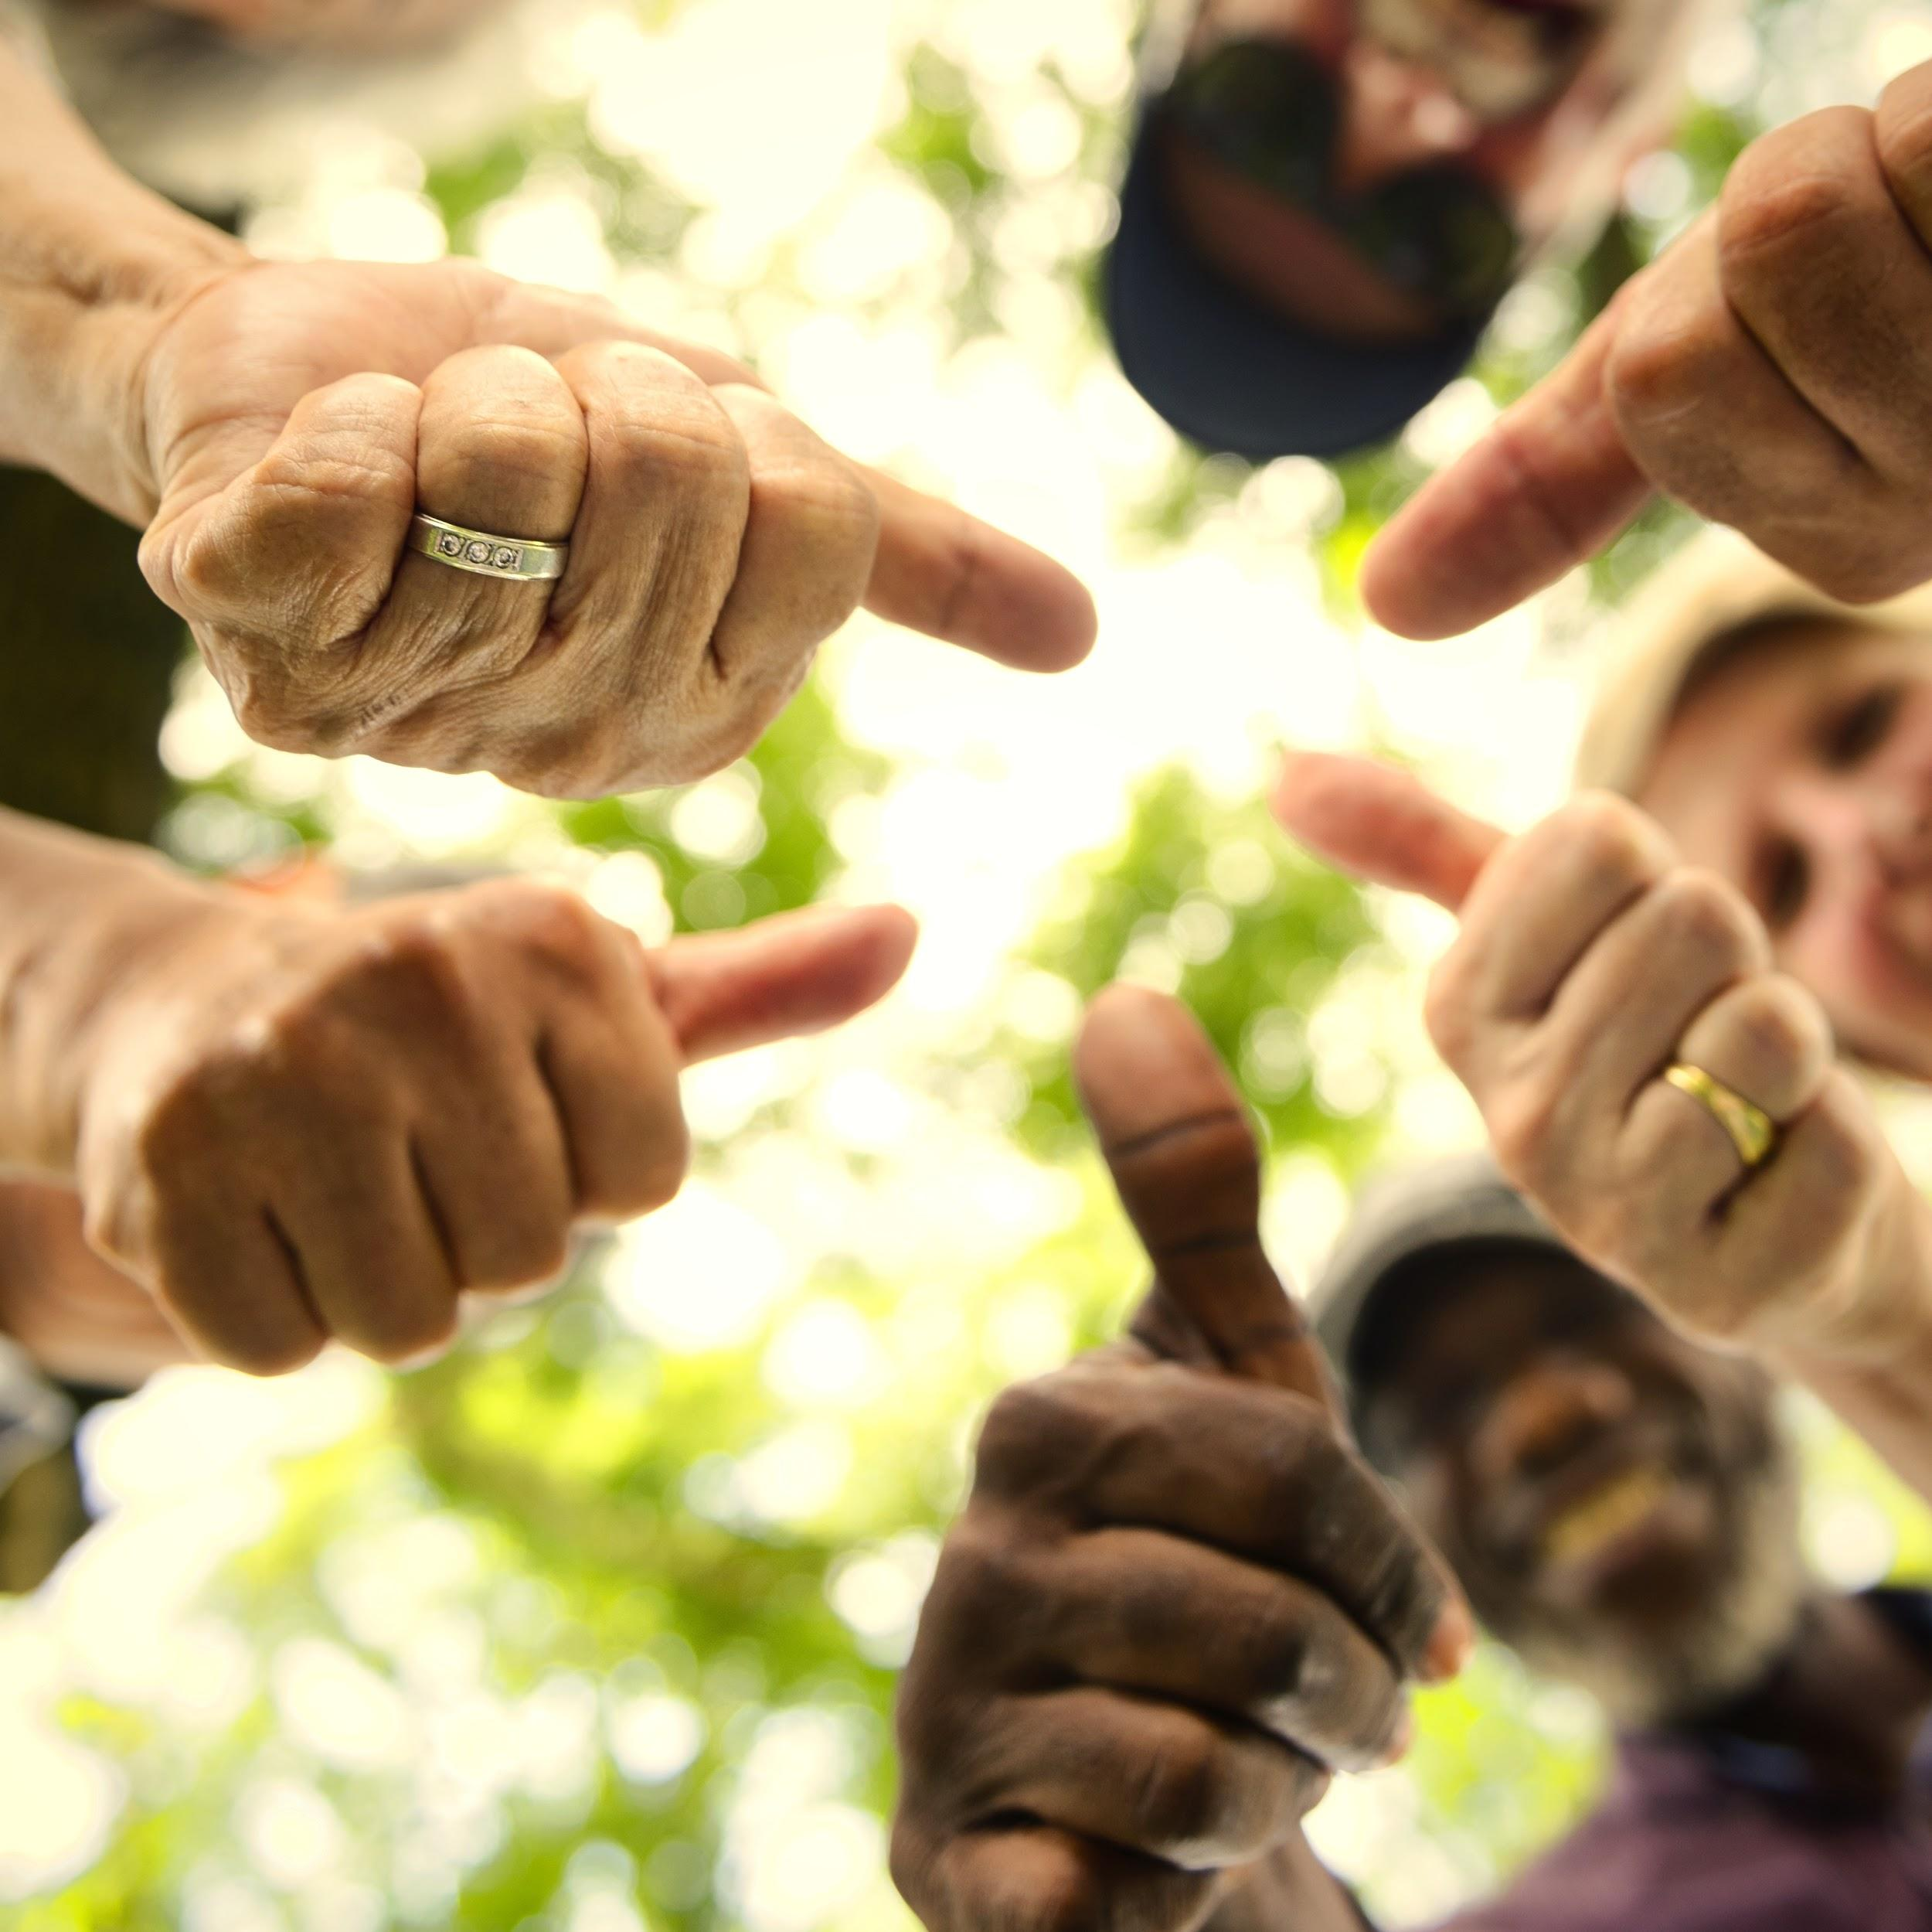
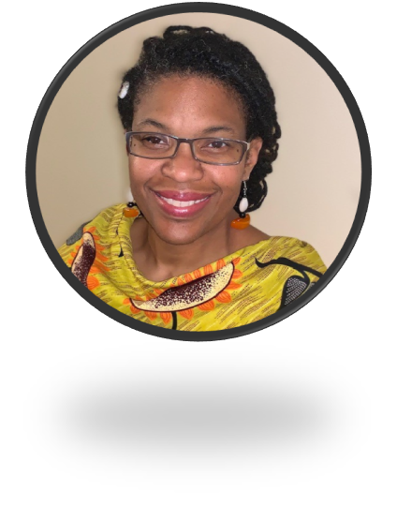
PARTNERING WITH
BLACK CHWS AND OUR COMMUNITIES DURING COVID-19
March 25, 2021
Boston University
Center for Innovation in Social Work and Health

Slide 2
VISION : Community Health Workers united nationally to support communities in achieving health, equity and social justice.
ABOUT
NACHW
ENGAGE
CHWs, Allies, Supporters, Partners, Sponsors, and Influencers
EXPAND
Membership, Recognition, Opportunities, and Collective Action
ENHANCE
CHW Leadership Skills and Opportunity
EDUCATE
Stakeholders on the Impact of CHWs
ESTABLISH
National Voice and Sustainable Strategies On Issues Related To CHW Workforce

Slide 3
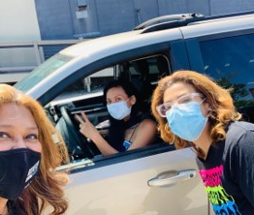
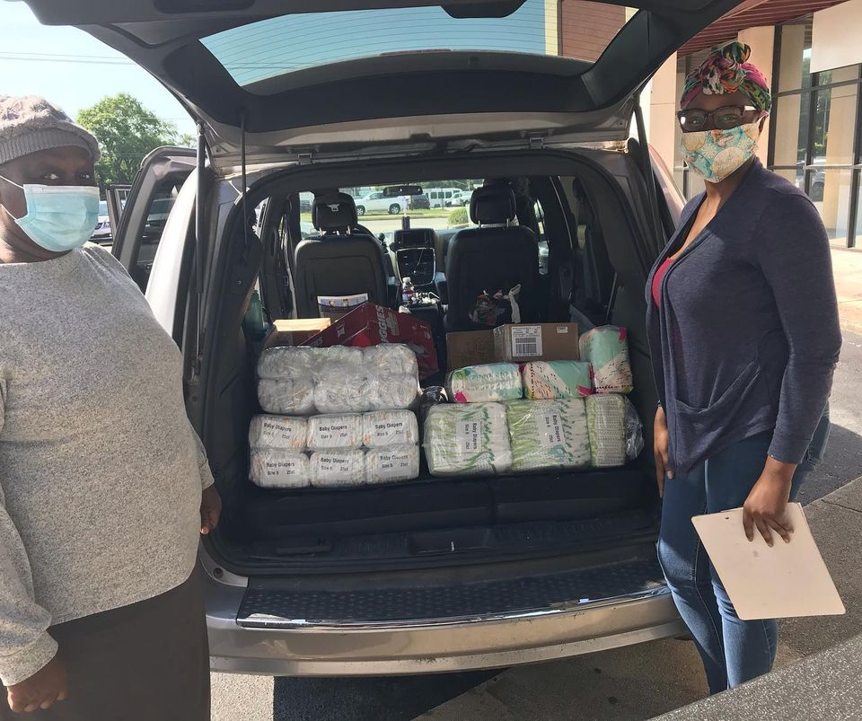
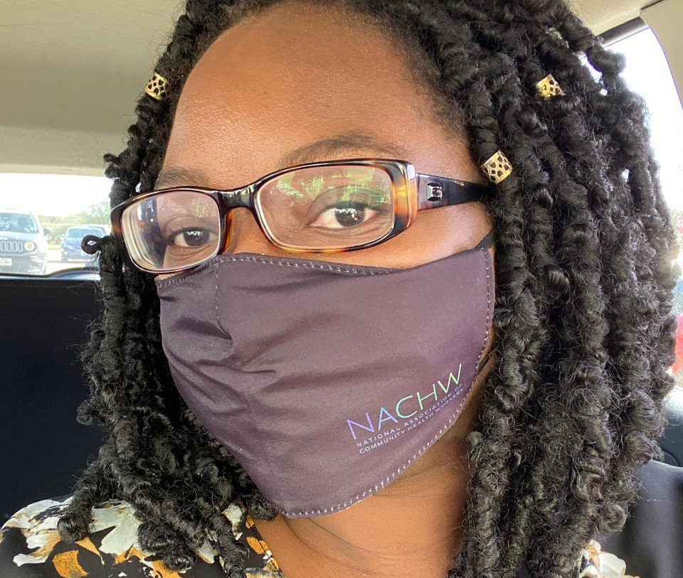
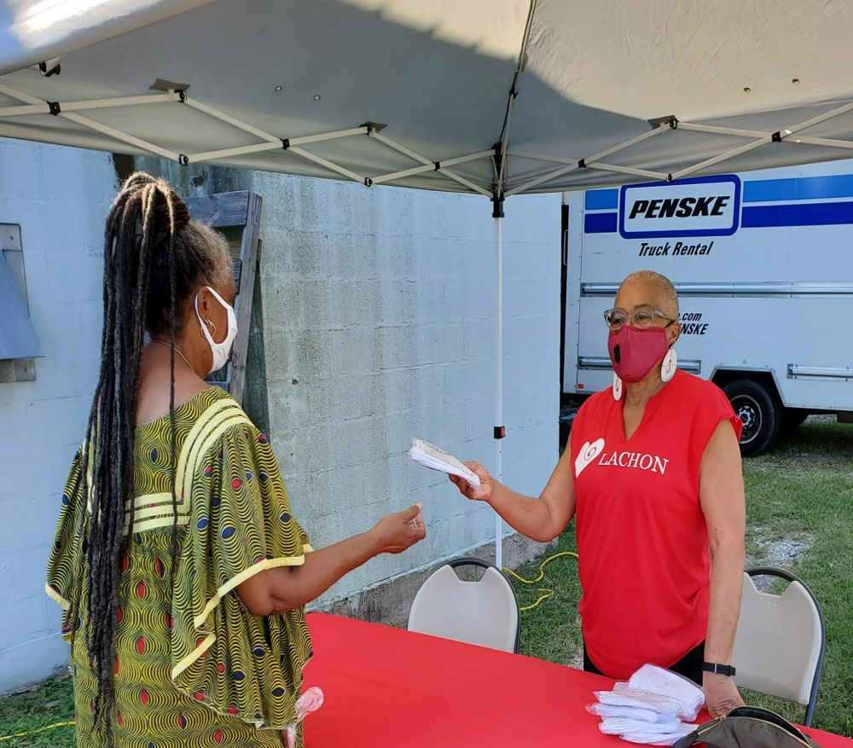
Notes:
Precarious workforce! We who are, where we serve, what we do, how we’re funded

Slide 4
The Forgotten Healers…
African Americans can trace their CHW origins through the history of US enslavement as plantation healers who integrated their mostly West African religious health beliefs with Indigenous Native Americans health practices and European medicine from slave masters and scientists as a form of resistance and to ensure their survival.
https://nachw.org/2020/02/18/the-forgotten-healers/

Slide 5
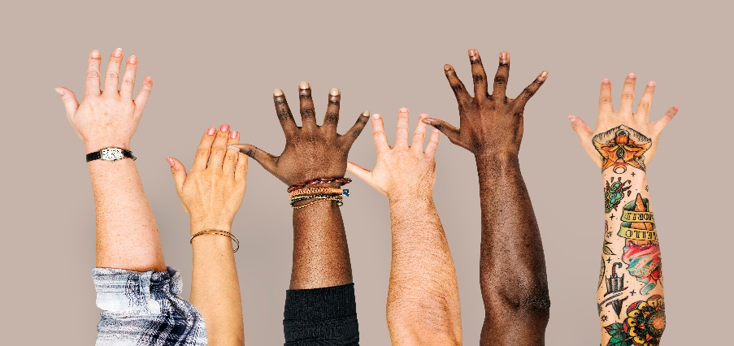
The Long Road to Black Health Equity…
SOCIAL DETERMINANTS AND RACISM
2011
Unmet social needs — like access to nutritious food, transportation assistance and housing assistance — are leading to worse health for all Americans
At least 60 “survival programs”: health clinics, free breakfast programs, sickle cell testing, etc.
Philadelphia study of structural racism’s impact on negro health status, income, employment, alcohol use and segregation.
HEALTHCARE’S BLIND SIDE: SOCIAL DETERMINANTS – TOO LITTLE TOO LATE?
BLACK PANTHER PARTY
1899
1966-1975
WILL COVID-19 BECOME A MOVEMENT FOR EQUITY AND SYSTEM TRANSFORMATION?
Enslaved Africans synthesized and maintained community health, while contributing to vaccination science without compensation and recognition
1609-1865
CHATTEL SLAVERY AND HEALTH PRACTICE SYNTHESIS
1985
Margaret Heckler’s report provides strategies to accelerate a national assault on the persistent health disparities in Black and Minority Health.
HEALTH DISPARITIES ACKNOWLEDGED BUT NOT ADDRESSED

Slide 6
Recognize that Community Health Workers are a Precarious Workforce
Who We Are
Who We Serve – How We’re Funded
01
02
Disproportionately females of color of Hispanic, Black American, Indigenous American and Asian American and Pacific Islanders. Peers, Neighbors and Survivors with shared lived experience working on the frontlines. (2007 National Workforce Study)
Most funding for CHW services is temporary grants and project-based funding to provide short term relief for marginalized communities, with income, access, navigation, quality and outcome inequities and disparities.
Where We Work
What We Do
03
Under-resourced community-based organizations; with growing presence in medical, behavioral health and social service systems. (nachw.org)
04
Cultural bridge building, health education, coaching, navigation and care coordination across sectors, community capacity building and advocacy, research and outreach support. (c3project.org)

Slide 7
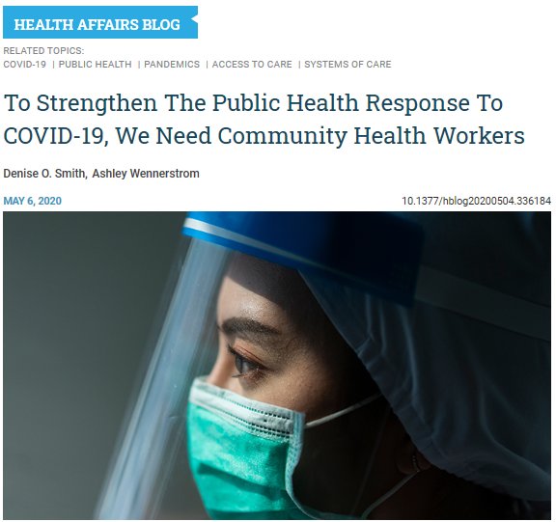
“I’ve had difficulty getting a response from the emergency response teams in my community. I’ve called, emailed the city, joined their Facebook groups, answered their questionnaires, etc. It is very frustrating.”
- CHW respondent to NACHW March 2020 Survey

Slide 8
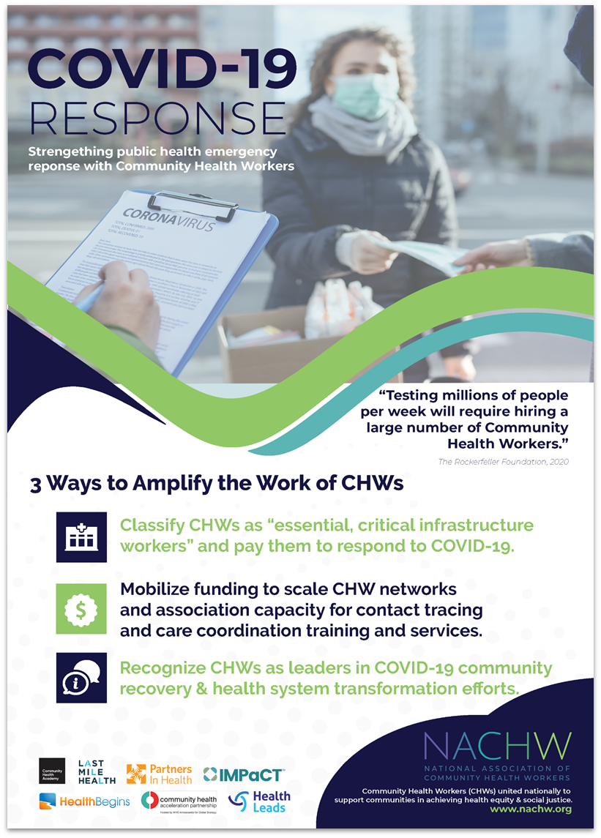
Amplify the Leadership and Capacity of CHWs and Our Networks and Associations
Response and recovery efforts focused on under-resourced communities must be embedded in and in partnership with communities to be equitable and effective.

Slide 9
Integrate CHW Roles in Equitable COVID-19 Response
CHWs can co-design, develop, distribute and evaluate materials and strategies that appropriately respond to community health beliefs, misinformation and cultural concerns.
CHWs can coordinate and administer screenings for food, housing, financial needs and mental health services and help people navigate to or directly access these services.
CHWs can navigate technology, literacy, language, enrollment and transportation barriers to ensure access to vaccines, emergency services and health care coverage.
CHWs can coordinate mobile testing and vaccination sites, organize tabling and registrations, collect data and monitor symptoms, and engage home-bound, house-less and transient community members.

Slide 10
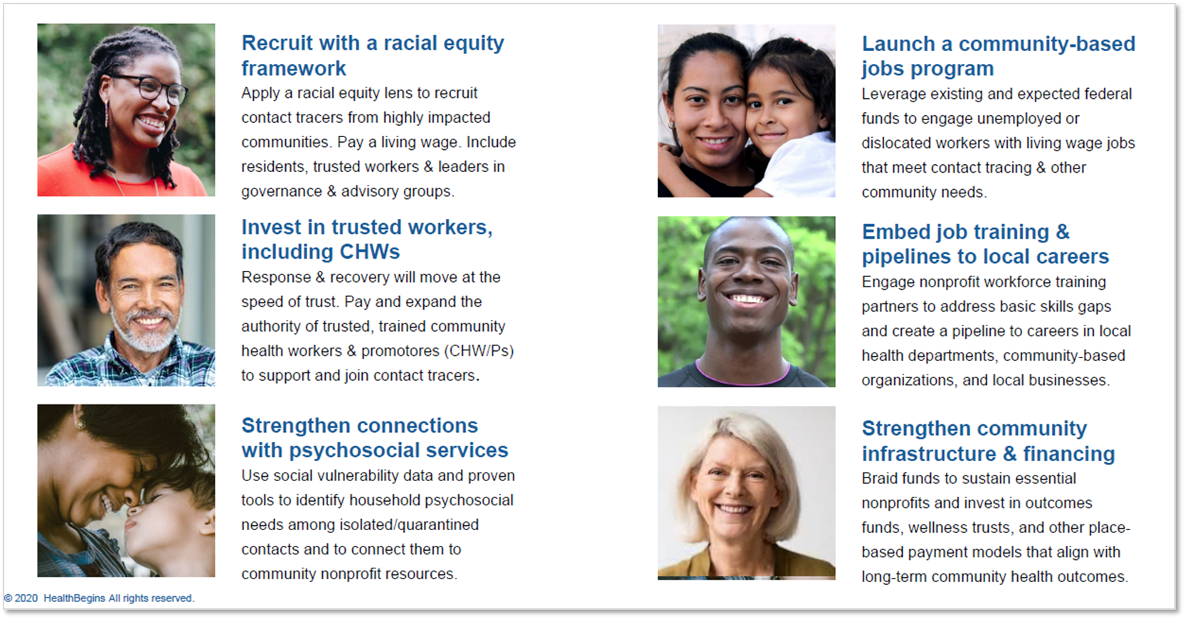
Promote Sustainability and System Transformation

Slide 11
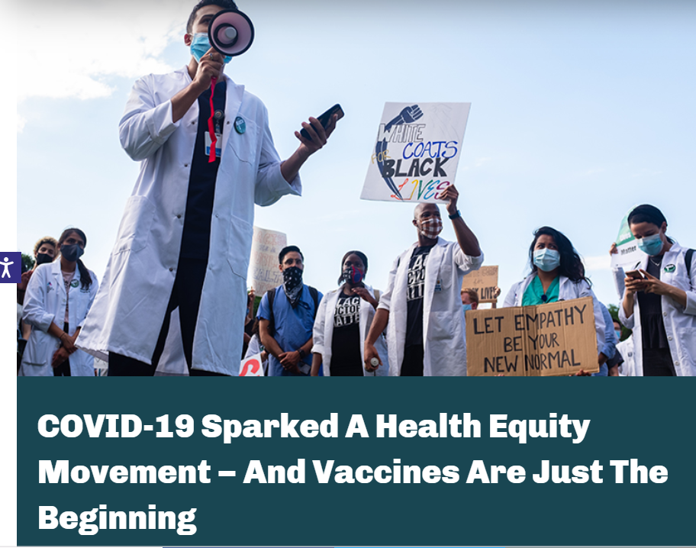
Notes:
A comprehensive, two-year U.S. vaccine equity initiative. This unified and collaborative approach to increasing vaccine confidence and uptake was built upon a co-created set of guiding principles and aims to support the rebuilding of community trust to address racial health disparities and spark a health equity movement.
Toolkits
Data
Working Groups
Convenings and Events

Slide 13
Thank You
www.NACHW.org
Info@NACHW.org

